Slide 1
Pilot’s perspective on AFIS and ENR FIS
Christos Malamas
International Flight Information Service Association
Corfu Holiday Palace, September 29th,2021

Slide 2
The chain that leads to Safety , starts with
Training
Ability, Knowledge, Experience
Situational Awareness
Human Factors
Safety

Slide 3
But it is very common that a wrong Situational Awareness status leads Human Factors to
Stress
Fatique
Safety ?

Slide 4
SITUATIONAL AWARENESS
It can be fulfilled by:
Having an official and certified way of visually monitoring the flights in their area, through the CAA radar monitoring hardware, with the appropriate training to see, get a clear idea of the traffic, transfer the equivalent information to pilots and finally interfere when needed (to prevent accidents).
Tip: If the VFR pilots know that they are being “monitored” they will not transmit false position information, something that they often do in order to “benefit” and get priorities…
Achieving a sequential (agreed or certified) chain of operation with the Traffic Controllers for the IFR flights
Getting the knowledge of the forthcoming VFR traffic via Flight Plans filed by the operators

Slide 5
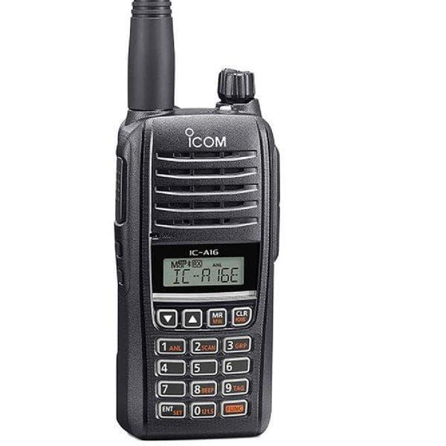
AFIS officers often use
a) Flightradar24 to get traffic information or/and
b) Handheld radio receivers to monitor frequencies in their neighborhood!!!
More info -> Reality -> Less stress ->Successful Management -> SAFETY

Slide 6
Greek AFIS airports rapidly become very popular for commercial, private, training and commercial flights throughout the whole year.
There is need for actions to be taken:
Operating hours (especially March to October) should be extended SR to SS , in order to facilitate traffic with safe separation intervals. Congestion of flights happens because of the a) limited hours of operation and b) the lack of apron space to accomodate many movements in a short time.
Hiring additional personnel (AFIS officers). Today’s reality is that 21 AFIS officers operate 15 aerodromes. It should be, at least double than that, and work under modernized training, stress management regulation and rostering schedule.
Create, edit and apply IFR arrival and departure procedures for all AFIS aerodromes.
The CAA can anticipate the increase of this costs by offering regulated Services for the Pilots and the Airplanes, and create additional activities to attract “customers”.

Slide 7


Slide 8


Slide 9
Thank you very much for your attention.
I am willing to discuss any questions.
Christos Malamas

