Slide 1
IFISA
(September 29, 2021)
IFATCA Stand-In:
1st A/FIS-Phraseology
(EASA NPA 2021-05)
2nd APDSG: incorporating Surveillance FIS in Doc 4444
Presented by
Thorsten Raue
Notes:
Who am I? ATCO, German, GdF board member responisble for operational topics, an IFATCA representative in Europe
Stand in for EASA slot – last minute presentation, please bear with me if anything doesn‘t work
Can not speak for EASA, but will touch on EASA related topics
2 topics in the presentation

Slide 2
IFISA
(September 29, 2021)
IFATCA Stand-In:
1st A/FIS-Phraseology
(EASA NPA 2021-05)
Presented by
Thorsten Raue

Slide 3
A/FIS Phraseology
What is EASA?
What is an NPA?
What is it about?
examples of changes and proposals

Slide 4
What is ?
EASA is the EU agency responsible for developing rules und guidelines for aviation (airlines, ANSPs, aerodromes, etc.)
e.g. transposing ICAO Docs to European legislation (IR, AMC, GM)
IR = Implementation Rule
AMC = Acceptable Means of Compliance
GM = Guidance Material
Notes:
Implementation rules, acceptable means of compliance, guidance material

Slide 5
What is an NPA?
Notice of Proposed Amendment
published by EASA
lists how and why the amendment is proposed including benefits and drawbacks
invites comments from any affected party: https://hub.easa.europa.eu/crt/
results in IR, AMC or GM

Slide 6
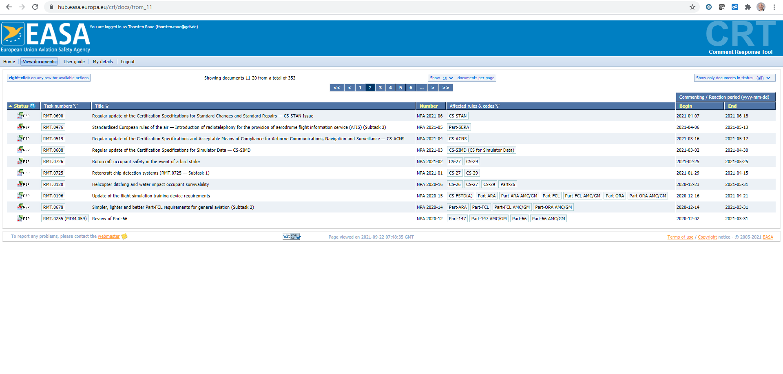
https://hub.easa.europa.eu/crt
Notice of Proposed Amendment
Published by EASA (European Union Aviation Safety Agency)
invites comments from any affected party: https://hub.easa.europa.eu/crt/
lists how and why the amendment is proposed including benefits and drawbacks

Slide 7
NPA 2021-05
Introduction of radiotelephony for the provision of aerodrome flight information service (AFIS)
End of Consultation
13.5.2021
Notes:
Short consultation period

Slide 8
What is it about?
The NPA 2021-05 addresses Appendix 1 to AMC1 SERA.14001:
aims to introduce amendments to enable the safe, efficient and harmonised provision of AFIS and complete the EU regulatory framework in the provision of FIS/AFIS.
Notes:
SERA: Single European Rules of the Air
Gültig seit Dez 2012
14001 basically copied Chaper 12 of 4444

Slide 9
What is it about?
The NPA 2021-05 addresses Appendix 1 to AMC1 SERA.14001:
aims to introduce amendments to enable the safe, efficient and harmonised provision of AFIS and complete the EU regulatory framework in the provision of FIS/AFIS.
Notes:
SERA: Single European Rules of the Air
14001 basically copied Chaper 12 of 4444

Slide 10
General
ATC -> ATS PHRASEOLOGIES
NEW
Notes:
Basically a transposition of ICAO Doc 4444 Chapter 12.

Slide 11
Proposal (non-A/FIS)

Slide 12
Example Comment
IFATCA:
Since there is no difference in handling we would prefer to use the word fuel synonymously for any kind of energy storage, be it fossil fuel, batteries or other. If needed, introduce GM.
Notes:
EASA verbally: will be FUEL

Slide 13
Additions A/FIS
applicability
Phraseology to relay clearances
Phraseology for AFIS about landings, take-offs and traffic circuit
this is new phraseology on this level
EASA is overtaking ICAO

Slide 14
Applicability

Slide 15
Relay Phraseology
EASA emphasises Information character of A/FIS – no clearances or instructions unless relayed from ATC
Notes:
ADVICES ;)

Slide 16
AFIS aerodrome RT
EASA strengthens info character again
Notes:
stitched together from different parts of the NPA
Again no instructions – only information

Slide 17
IFATCA Proposals
Suggest additional phrases: “MAINTAIN VMC”, “OBSERVE MINIMUM SAFE HEIGHT” and “NAVIGATIONAL ASSISTANCE TERMINATED” for FIS.
Suggest additional phrases: “CANCELLING/CLOSING MY FLIGHT PLAN“ and “FLIGHT PLAN CANCELLED/CLOSED AT (time)” for FIS/AFIS.
Notes:
To be seen

Slide 18
Way forward
the NPA received about 200 comments were collected
a lot of comments were substantial and of high quality
therefore decision delayed to Q4 (est. Oct.)
EASA verbally: changes, but no instructions or similar for A/FIS

Slide 19
1st part done
Questions?
Comments?
Do you already have AFIS phrases in use? Similar? Different?

Slide 21
IFISA
(September 29, 2021)
IFATCA Stand-In:
1st A/FIS-Phraseology
(EASA NPA 2021-05)
2nd APDSG: incorporating Surveillance FIS in Doc 4444
Presented by
Thorsten Raue
Notes:
Thank you for inviting me to this workshop and allowing me to share with you the hopes and worries that the international air traffic controller community has with SWIM.

Slide 22
IFISA
(September 29, 2021)
IFATCA Stand-In:
2nd APDSG: incorporating Surveillance FIS in Doc 4444
Presented by
Thorsten Raue
Notes:
Thank you for inviting me to this workshop and allowing me to share with you the hopes and worries that the international air traffic controller community has with SWIM.

Slide 23
Surveillance FIS
What is Eurocontrol / APDSG?
What is Doc 4444?
What‘s the problem?
Details
Notes:
Sorry if I slip up and say radar instead of surveillance

Slide 24
What is ?
Eurocontrol is a European organization working on safe and seamless air traffic across Europe.
41 Member States
publishes guidance
think tank for EASA
many other tasks

Slide 25
What is the APDSG?
ATM Procedures Development Sub-Group
All member ANSPs are represented incl. PSOs IFATCA and IFALPA
drafting future ATS procedures
drafting proposals to amend EASA/ICAO regulation
Notes:
IFISA was invited by the chair

Slide 26
What is APDSG working on?
e.g. definitions of where to provide wake turbulence separation
update of rules for low approaches
use of tracks in addition to headings in ATC
update of ATC “silent transfer”
and surveillance FIS
Notes:
IFISA was invited by the chair

Slide 27
What is the FIS-problem?
ICAO does not explicitly stipulate that FIS with surveillance is provided by ATCOs, but it is implied in some paragraphs
because some European states have FISOs with surveillance, the APDSG tries to develop a new text to amend ICAO Doc 4444

Slide 28
Identifying the problem
Doc 4444 has about 80 paragraphs relating to the use of surveillance services.
Eurocontrol created a table with all paragraphs and each was analysed
about 17 paragraphs need changes or amendments

Slide 29
Example 1
8.1.1 ATS surveillance systems used in the provision of air traffic services shall have a very high level of reliability, availability and integrity. The possibility of system failures or significant system degradations which may cause complete or partial interruptions of service shall be very remote. Backup facilities shall be provided.
NO CHANGE
NEEDED

Slide 30
Example 2
8.3.2 Direct pilot-controller communications shall be established prior to the provision of ATS surveillance services, unless special circumstances, such as emergencies, dictate otherwise.

Slide 31
Example 2
8.3.2 Direct pilot-controller communications shall be established prior to the provision of ATS surveillance services, unless special circumstances, such as emergencies, dictate otherwise.
CHANGE NEEDED

Slide 32
Proposal 2
air-ground
8.3.2 Direct pilot-controller communications shall be established prior to the provision of ATS surveillance services, unless special circumstances, such as emergencies, dictate otherwise.
Notes:
Might even solve potential problems with RPAS

Slide 33
Example 3
8.2.9 Labels shall be associated with their position indications in a manner precluding erroneous identification by or confusion on the part of the controller. or flight information officer. All label information shall be presented in a clear and concise manner.

Slide 34
Example 3
8.2.9 Labels shall be associated with their position indications in a manner precluding erroneous identification by or confusion on the part of the controller. or flight information officer. All label information shall be presented in a clear and concise manner.
CHANGE NEEDED

Slide 35
Proposal 3
8.2.9 Labels shall be associated with their position indications in a manner precluding erroneous identification by or confusion on the part of the controller or flight information officer. All label information shall be presented in a clear and concise manner.
or flight information officer.

Slide 36
Example 4
8.4.1 Information derived from ATS surveillance systems, including safety-related alerts and warnings such as conflict alert and minimum safe altitude warning, should be used to the extent possible in the provision of air traffic control service in order to improve capacity and efficiency as well as to enhance safety.

Slide 37
Example 4
8.4.1 Information derived from ATS surveillance systems, including safety-related alerts and warnings such as conflict alert and minimum safe altitude warning, should be used to the extent possible in the provision of air traffic control service in order to improve capacity and efficiency as well as to enhance safety.
CHANGE NEEDED

Slide 38
Example 4
8.4.1 Information derived from ATS surveillance systems, including safety-related alerts and warnings such as conflict alert and minimum safe altitude warning, should be used to the extent possible in the provision of air traffic control service in order to improve capacity and efficiency as well as to enhance safety.
control

Slide 39
Example 4
8.4.1 Information derived from ATS surveillance systems, including safety-related alerts and warnings such as conflict alert and minimum safe altitude warning, should be used to the extent possible in the provision of air traffic control service, as appropriate, in order to improve capacity and efficiency as well as to enhance safety.
IFATCA agrees in principle, but the new wording weakens provision for ATC
Notes:
IFATCA: did not agree, because it weakens the original provision

Slide 40
Controversial 1
8.8.2.3 When an identified uncontrolled flight is observed to be on a conflicting path with another aircraft, the pilot should be informed and suggestions or advice regarding avoiding action should be provided.
this would be a new provision similar to an existing ATC paragraph
was discussed and deleted as controversial
Notes:
Removed by ANSPs
IFISA POV?

Slide 41
Controversial 2
8.4.3 A flight information service unit using an ATS surveillance system should establish criteria to ensure a proportionate workload of the flight information service officer stemming from need to monitor the progress of identified aircraft.
How? ATFM for FIS? ANSPs will have to address that topic.
Notes:
ANSPs have to address that problem!

Slide 42
Way forward
the proposals were discussed and I expect them to be deemed mature enough to be passed on at the next meeting (Jan ‘22)
will then be discussed at higher level withing EC
eventually be forwarded to ICAO
ICAO working group may take a while
Notes:
ICAO huge backlog

Slide 43
2nd part done
Questions? Comments?

Slide 44
2nd part done
See you in person in 2022!

