Slide 1
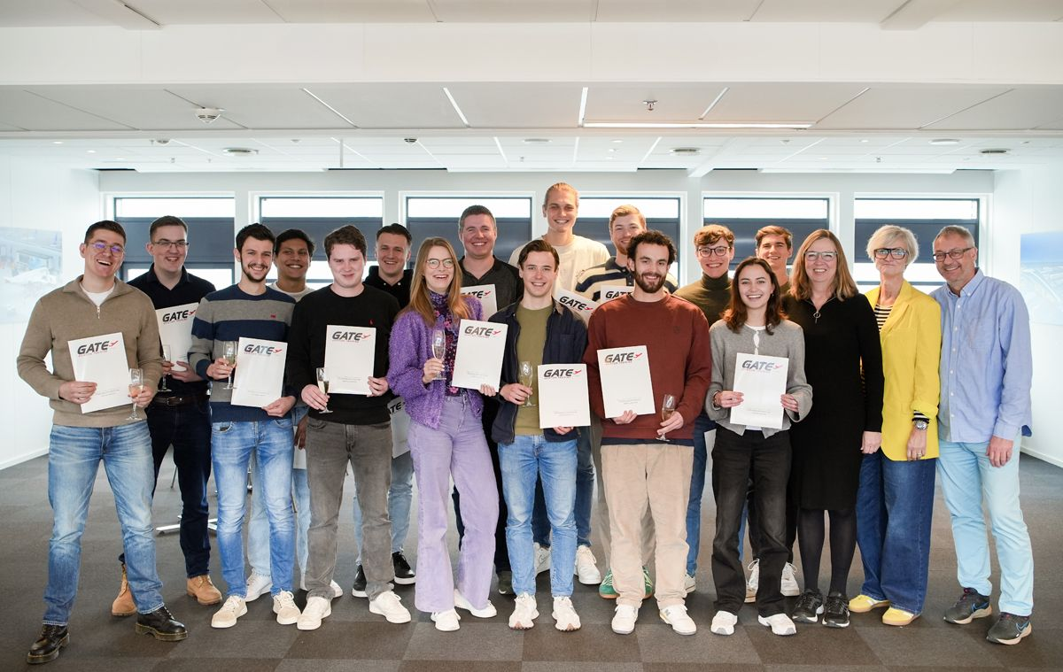


Recruitment and training for
FISOs
-
Where are we heading?
Dr Henning Schmidt

Slide 2
Why?
Shortage of staff (CANSO task force etc.)
Staff fluctuation, retirement rounds etc.
High failure rates in some units
We see new behaviours - example: generation Z doesn’t tell you when they consider leaving, they just leave

Slide 3
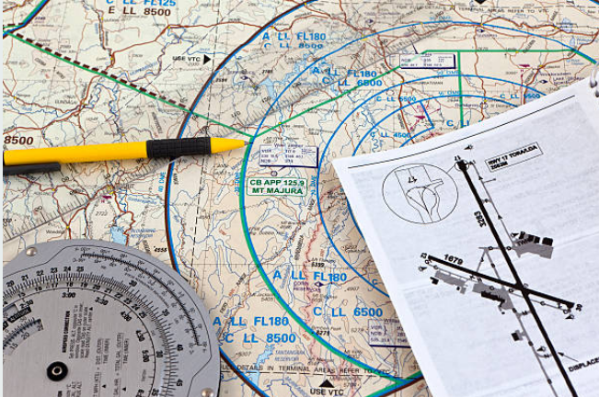
Flight plan of todays presentation
Aligning what are we looking speaking about generation Z
Where are we going with recruiting from generation Z?
Where are we going with training for
generation Z?

Slide 4
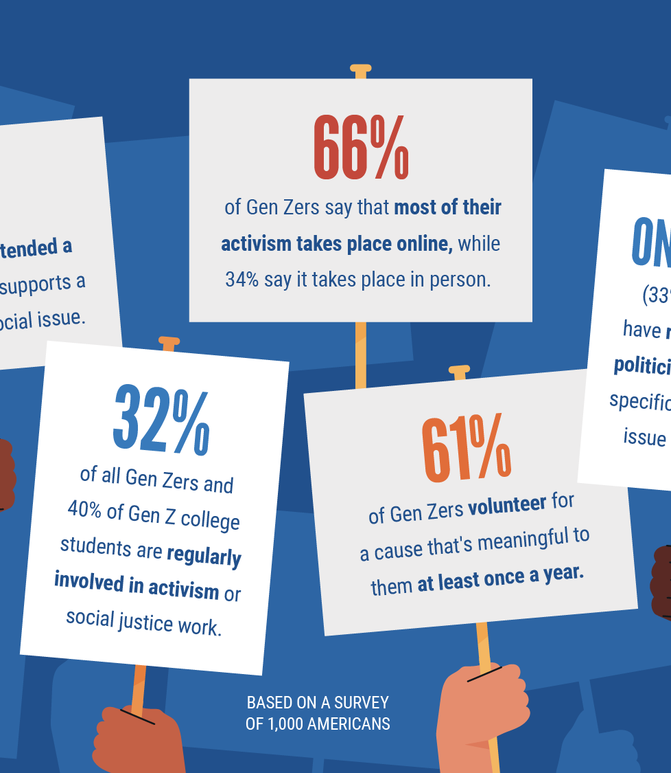
Understand Generation Z for learning behaviours
Digital natives, prefer interactivity and tech-driven
Shorter attention span – need for microlearning
Less self reflection
Less able to handle stress
Comfortable with visually rich learning materials
They are competitive - Growing up with social media means constant exposure to the achievements of peers

Slide 5
How do we recruit aspiring
Fisos today?
Cognitive recruitment tests, e.g. FEAST
Interviews
Group exercises, assessment centre?
Anything else?

Slide 6
Recruiting from Generation Z
According to studies (Deloitte, Randstad), almost half of Gen Z are organisational surfers and within their first 5 years they stay on average 1.1 years; recruitment needs to target the rest half
New behaviours, new personalities. We have to embrace the change; need to recruit for the future
With technological advancements, monitoring becomes a wider element of the work position; research suggests those qualities are equally found in women
Do we currently get what we want? Are new recruitment approaches / tools needed?

Slide 7
Recruiting from Generation Z
Most tools today take a candidates IQ as a cheap and effective predictor for performance
How about adaptiveness as an important trait?
How about cultural fit to the unit?
How about leadership qualities?
How about resilience?
How long will they stay in their job?
We developed a suit of recruitment tools (STAR) and assessment centres for the younger generation

Slide 8
How do we Train aspiring
Fisos today?
Having covered some generation Z’s learning behaviours, is our current training approach still valid?

Slide 9
How do we Train aspiring
Fisos in 5 years from now?
Highlighting a couple of approaches:
Training Culture
Investing in instructors
Embracing technology

Slide 10
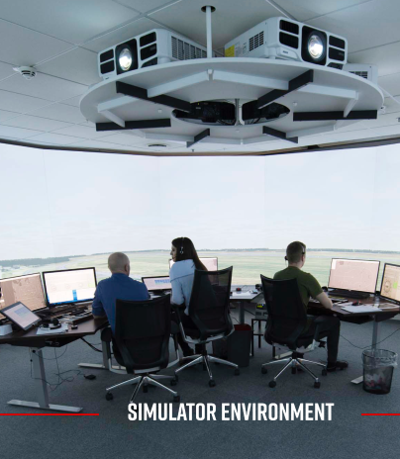
Building a new training culture in ANSP’s and training organisations
Shift from hierarchical to collaborative structures
Embracing Psychological Safety – creating environments where learners feel safe (high failure rates may not create a safe learning environment)
Recognizing diverse perspectives in today's learning
Adapting quickly to changes within the aviation
industry incl. possibility to train at customer site
Learner focussed training concept incl. well-being elements for learning behaviours of a new generation

Slide 11
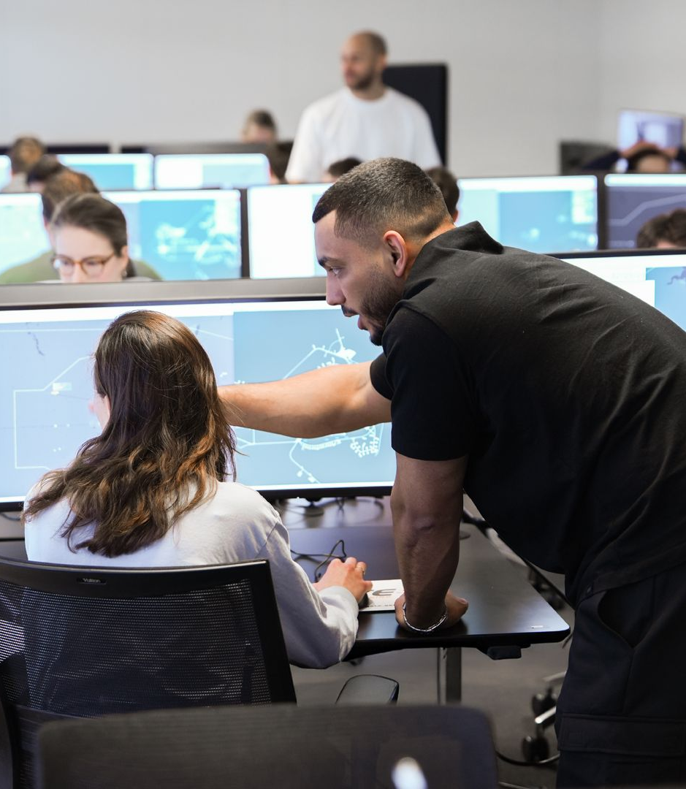
Educating instructors for todays and Tomorrows learning generations
Enhancing interpersonal skills – empathy, communication and adaptability to connect with Gen Z
Mentorship and coaching – shifting from authoritative teaching styles to mentorship / coach roles that foster more supportive learning environments than what we see today
Upscaling the understanding for pedagogical Instructor skills
Continuous Professional Development – encouraging ongoing learning and development for instructors to stay current with evolving training methodologies and technologies
Preparing instructors also for the ability to teach life skills in addition to theoretical and practical FISO skills
IS THAT WHAT WE DO TODAY?

Slide 12
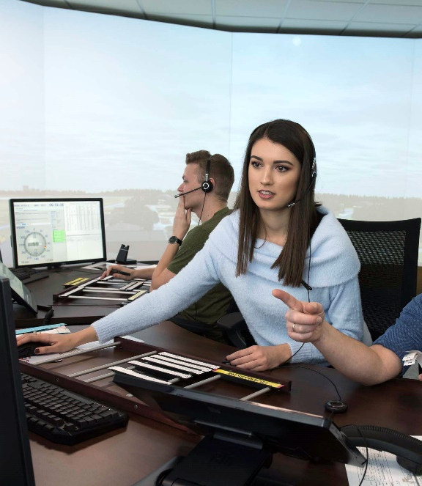
Training for future generations
OJTI culture - instructors are coaches enabling an ATS learning journey
Integrate mental health and wellbeing into training solutions
Create a safe learning environment
Invest in the development of people, their knowhow and skills
Out of the box thinking is required

Slide 13

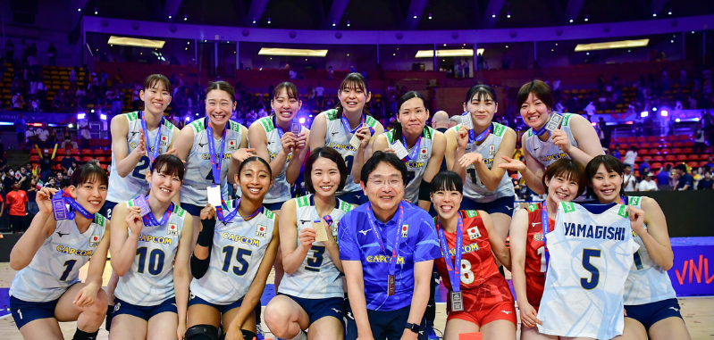

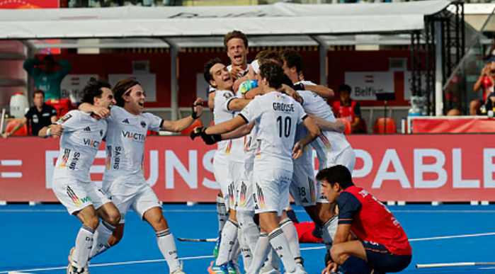


What makes a Sports team successful?
=> Practice

Slide 14
Constraints/Considerations for Practice in FISO Training
Practice (simulator-) environments have limited resources
OJTI shortage / Rostering – especially during summer rush
Cost of instructors
Cost of simulator pilots
# of simulators etc.

Slide 15
Embracing Technology to increase practice
Having offered a 24/7 academy for years for self practice, it’s dependent that a colleague acts a simulator pilot
AI offers new ways to increase practice (Randal 2025: 75% of Gen Z are using AI to upskill)
AI simulator pilots enable more independent practice in-/outside the academy
Simulator providers offer increasingly tablet versions

Slide 16
Embracing Technology to increase practice
Not to replace the human but to offer additional opportunities for practice – this is a transition journey
The AI needs to be thoroughly instructed and tested so it has realistic behaviours and does not allow students to learn wrong behaviours
Exercises covered by students should be up to instructor led exercise objectives

Slide 17















GATE’s training experience
GATE trains pan European and beyond - civil and military customers in:
  EUROCONTROL MUAC, Armenia, Croatia , Denmark, Estonia, Latvia, Lithuania, Greenland, Kosovo, Netherlands, Oman, Sweden, Thailand, The Republic of North Macedonia, Malta, Peru, Columbia, Kazakhstan, Kirgizstan, Croatia, Ghana, Iceland, Bosnia & Herzegovina etc.

Slide 18
Thank you!

