Slide 1
IFISA SEMINAR 2026
Flight Information Service in Germany
Service provision
AFIS operations
Regulatory framework

Slide 2
Introduction
Jan Rose
2009 Entry DFS & GdF
Instructor in several ATM-systems projects
2018 FIS Bremen
2019 zFIS Langen
OJT instructor, examiner, assessor

Slide 3
FIS in Germany: one country, several administrative levels
Federal level
ANS oversight / certification
Federal States – 16 Länder
aerodrome approval / supervision
Local / municipal level
aerodrome ownership / staffing
En-route FIS / zFIS: central, DFS, cross-regional
Aerodrome FIS / AFIS: local, aerodrome-based, mixed providers
Notes:
Federal level
national aviation legislation
supervision of air navigation services
certification of ANS providers
Federal States – 16 Länder
aerodrome approval and supervision
different administrative structures across Germany
Local / municipal level
ownership and operation of many regional aerodromes
sometimes also employment of operational personnel
En-route FIS / zFIS
cross-regional service
centrally provided by DFS
Aerodrome FIS / AFIS
around 25 local aerodromes
local operators / local staffing models
federal ANS oversight meets local aerodrome structures

Slide 4
Two operational KINDS of FIS
 | zFIS | AFIS
Scope
Provider
Frequency
Traffic
Structure
en-route
DFS
FIS
VFR only
central
aerodrome
Several providers
AFIS
VFR + IFR
local
Notes:
Central FIS – “zFIS”
en-route / area-based
provided by DFS
centralised at Langen
nationwide sector structure
dedicated FIS frequencies
operational focus on VFR traffic
large geographical areas
Aerodrome FIS – “AFIS”
aerodrome-based / local
provided at around 25 aerodromes
several certified service providers
often closely integrated with the aerodrome operator
local AFIS frequency
service for aerodrome traffic
VFR and IFR traffic
Both provide Flight Information Service – but under very different operational concepts.

Slide 5


Same airspace – two services
CLASS E
VFR aircraft
Flight Information Service
zFIS frequency
FIS Specialist
IFR aircraft
Air Traffic Control Service
ATC frequency
Air Traffic Controller
Notes:
Class E
VFR aircraft
zFIS frequency
FIS Specialist
IFR aircraft
ATC frequency
Air Traffic Controller
Class G + RMZ around an AFIS aerodrome
IFR + VFR
same AFIS frequency, same AFIS Specialist ➔ Flight Information Service
For IFR operations:
predefined and published IFR procedures
RMZ around the aerodrome
coordination / transfer between ATC and AFIS
IFR remains on the published routing while operating in Class G
At an AFIS aerodrome, VFR and IFR traffic finally share the same frequency and the same FIS provider

Slide 6

Same airspace – SAME SERVICE
CLASS E
G
CLASS G + RMZ
G
IFR + VFR
Flight Information Service
same AFIS frequency
same AFIS Specialist
Notes:
Class E
VFR aircraft
zFIS frequency
FIS Specialist
IFR aircraft
ATC frequency
Air Traffic Controller
Class G + RMZ around an AFIS aerodrome
IFR + VFR
same AFIS frequency, same AFIS Specialist ➔ Flight Information Service
For IFR operations:
predefined and published IFR procedures
RMZ around the aerodrome
coordination / transfer between ATC and AFIS
IFR remains on the published routing while operating in Class G
At an AFIS aerodrome, VFR and IFR traffic finally share the same frequency and the same FIS provider

Slide 7
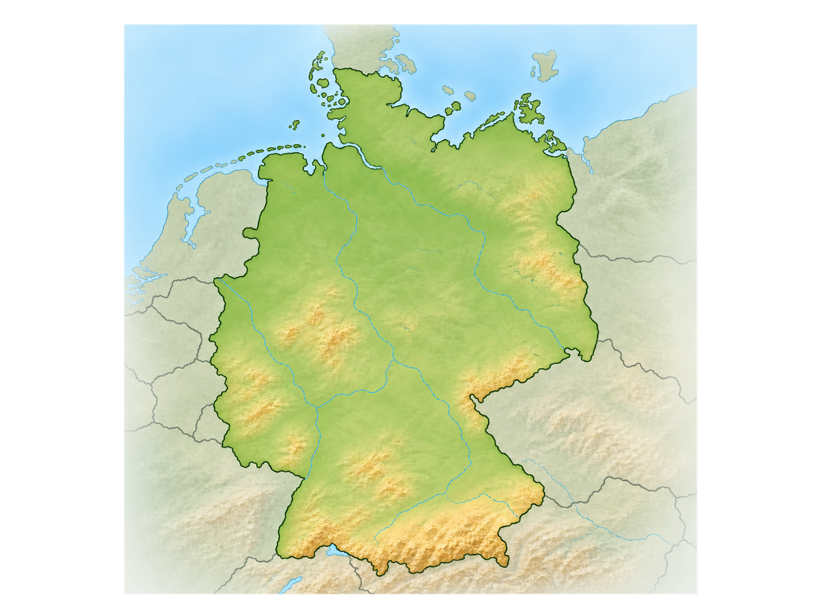
AFIS in Germany today
25 officially designated AFIS aerodromes
Provider models:
local aerodrome operator
municipal / regional company
specialised ANSP
DFS Aviation Services
Notes:
26 officially designated AFIS aerodromes
Provider models:
local aerodrome operator as AFIS provider
municipal / regional aerodrome companies
specialised ANS providers
DFS Aviation Services at selected locations
German AFIS is not one central organisation – it is a network of local aerodromes with different provider and staffing models under federal ANS oversight.

Slide 8
Becoming – and remaining – an AFIS Specialist
ICAO
European Union /
EASA
Germany
AFIS is european – AFISO qualification remains national
Notes:
ICAO
Annex 11 – Air Traffic Services
FIS as an ATS
States determine where and how ATS is provided.
Circular 211 – Aerodrome Flight Information Service (AFIS)
no worldwide harmonised AFISO licecing system
European Union / EASA
Regulation (EU) 2017/373 – Part-ATS / Part-ATM/ANS.OR
Common requirements for ATS providers, including competence / training obligations
no European AFISO licence comparable to the ATCO licensing
Germany
FSPersAV: Detailed national regulation

Slide 9
Becoming – and remaining – an AFIS Specialist
Entry requirements
Initial training
Unit training
Local authorisation
Validity 12 months
Minimum operational hours, medical fitness, language proficiency
Notes:
1. Entry requirements
minimum age 18
medical fitness
German + English language capability
reliability/security requirements
FSPersAV §§ 30–31.
2. Initial FIS training
general ATM training
dedicated Flight Information Service course
theory + practical/simulator assessment
language proficiency
FSPersAV §§ 33–35 + Annex 5
3. Operational / unit training
training at the actual operational unit
local procedures and airspace
coordination arrangements
equipment
local traffic environment
practical training under supervision
FSPersAV § 37 + Annex 7
4. Local authorisation
Local workplace / unit authorisation
German legal term: “Berechtigung”
FSPersAV § 38
Qualification is not permanent
Operational authorisation valid for 12 months
requires minimum operational activity for renewal
medical fitness must remain valid
required language proficiency must remain valid
expired authorisation requires renewal / reassessment
FSPersAV §§ 31, 43 & Medical Fitness Guideline – NfL II 78/01
Operational competence must be continuously maintained.
AFIS is European – AFISO qualification is still largely national.

Slide 10
From local AFIS to central FIS
AFIS
local
VFR and IFR
local qualifications
zFIS
central
VFR only
DFS
Same FIS family –
different operational worlds
Notes:
AFIS
local service at around 25 aerodromes
locally organised provider structures
VFR and IFR on the same frequency
IFR operations limited to published procedures
local qualification of AFIS personnel
zFIS
nationwide / cross-regional service
centrally provided by DFS
VFR only
separate from ATC, even where IFR operates in the same airspace
dedicated FIS specialists and frequencies
Same purpose – fundamentally different operational implementation

Slide 11
Enroute Flight Information Service
Germany
Langen, 01. September 2026

Slide 12


Langen???
DFS-Campus
Headquarter
Center Langen
  ATC lower airspace Langen FIR
  centralized FIS
  AIS/ARO
Academy
Powerplant
IT company
Technology center
Hamburg
Bremen
Berlin
Düsseldorf
Frankfurt
Langen
Karlsruhe
Munich
Quelle: Google Maps

Slide 13

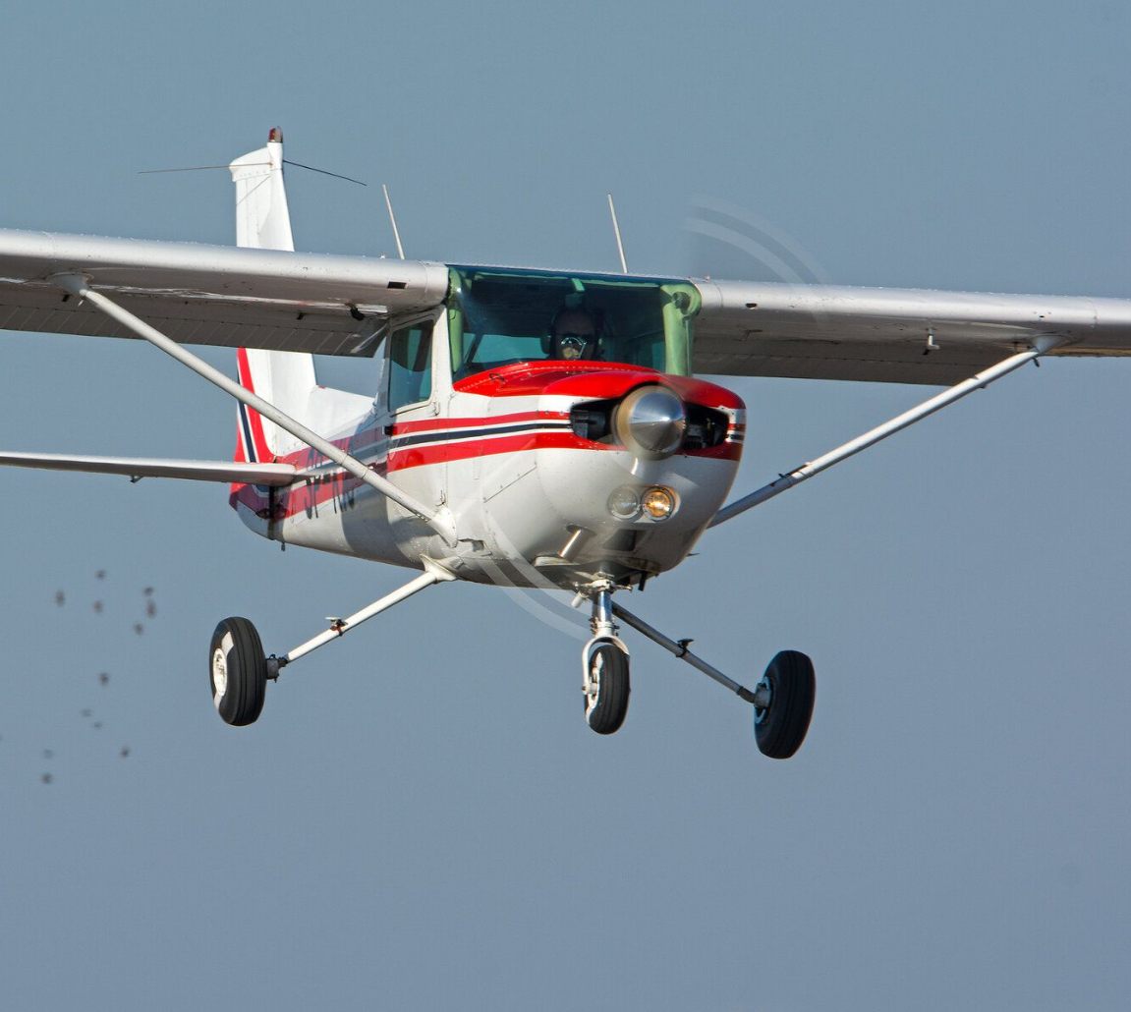


Flight Information Service in Germany
Since 1999 enroute FlS in DFS is provided by FISOs
Centralization of service in 2018
More than 430.000 contacts in 2025
Registered aircraft in Germany: ~ 25.000
45 FISOs and 5 Supervisors ensure daily service
Over 60 emergencies and 120 airspace infringements in 2025

Slide 14
Centralization of FIS in Langen 2018
Flexible use of staff
Sectors fit to the demand regardless of ATC or FIR boundaries
More sector combinations possible
Standardized training
Coverage of the whole country leads to additional technical requirements
More incidents at one site

Slide 15
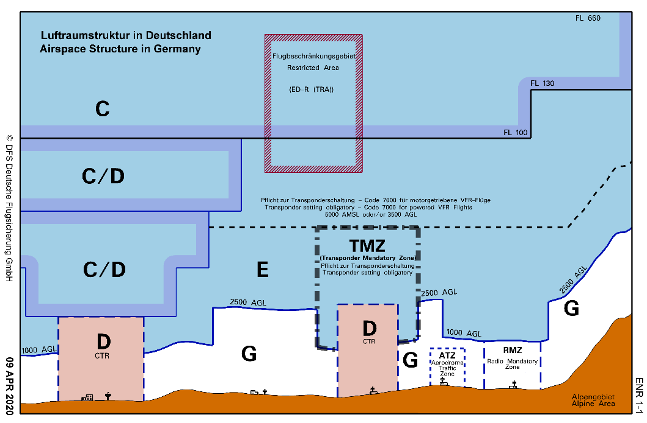
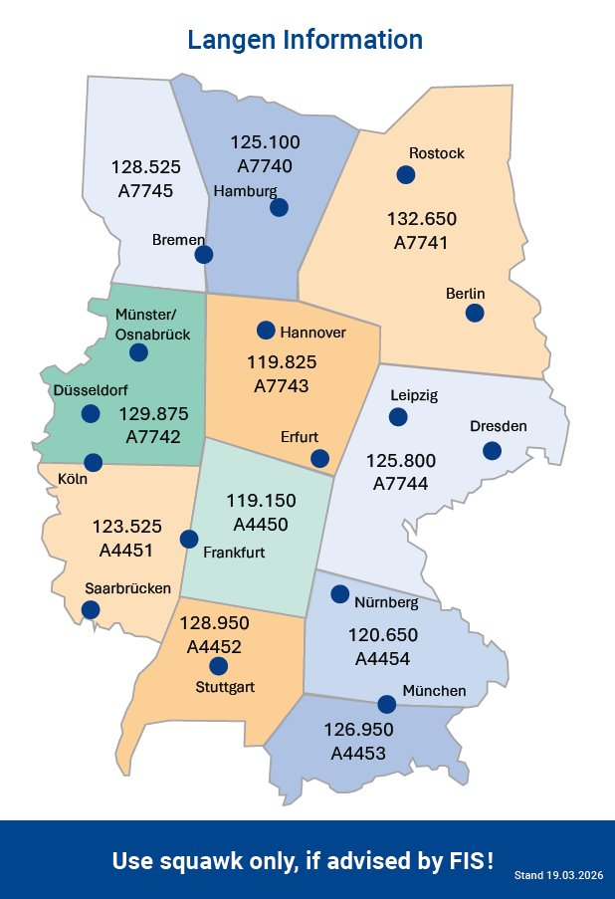
Airspace Structure in Germany

Slide 16
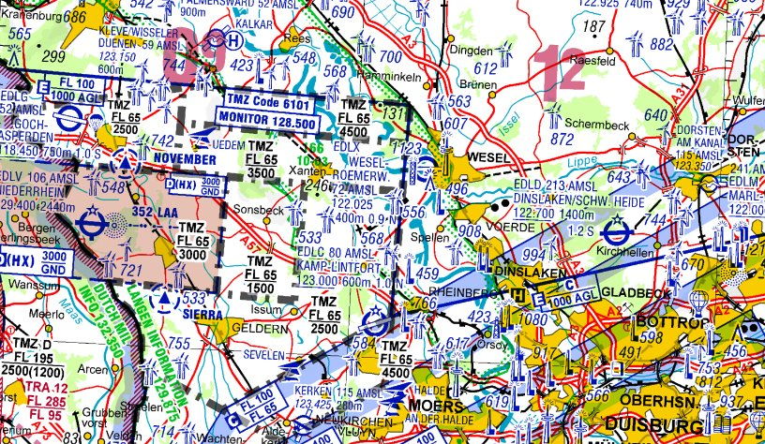
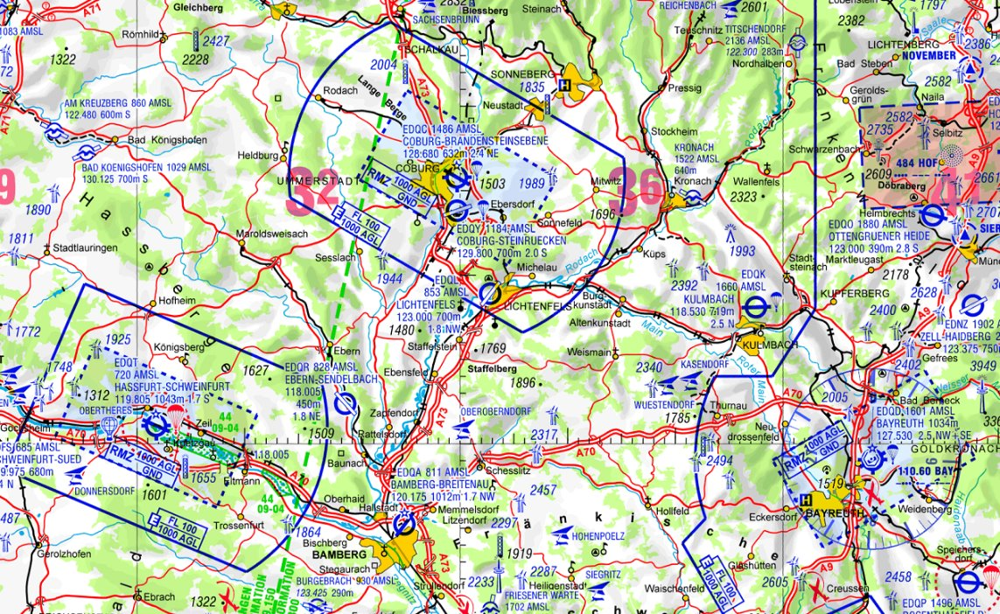
TMZ, RMZ, ATZ, flexible use of C/D airspace
TMZ – Transponder Mandatory Zone
established at regional airports
Class E Airspace – no clearance required
MODE-S transponder
Monitoring of ATC-frequency mandatory
Pilot‘s obligation to follow the procedure
RMZ – Radio Mandatory Zone
established at AFIS-aerodromes with IFR-procedures
Class G airspace – no clearance required
GND-1000ft/AGL
radio contact mandatory

Slide 17
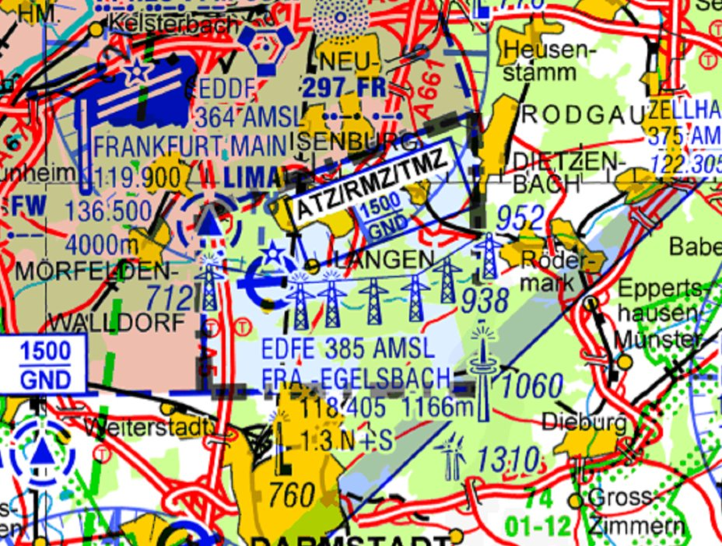
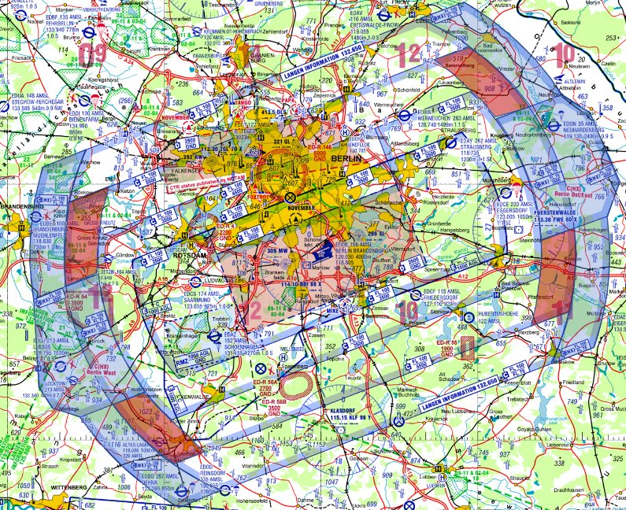
TMZ, RMZ, ATZ, flexible use of C/D airspace
ATZ – Aerodrome Traffic Zone
established at EDFE, EDLE, EDBC
Class E/G Airspace – no clearance required
only for arriving and departing traffic
Flexible use of C/D airspace
Use of airspace depends on RWY in use
disemmination on ATIS-frequency or FIS

Slide 18

Flightplan
No flightplan required for VFR-flights departing and arriving in Germany
Cross border flights, if necessary (depends on the country)
VFR at night leaving the vicinity of an aerodrome
IFR-, Z- and Y-flights
Aerobatic flights

Slide 19
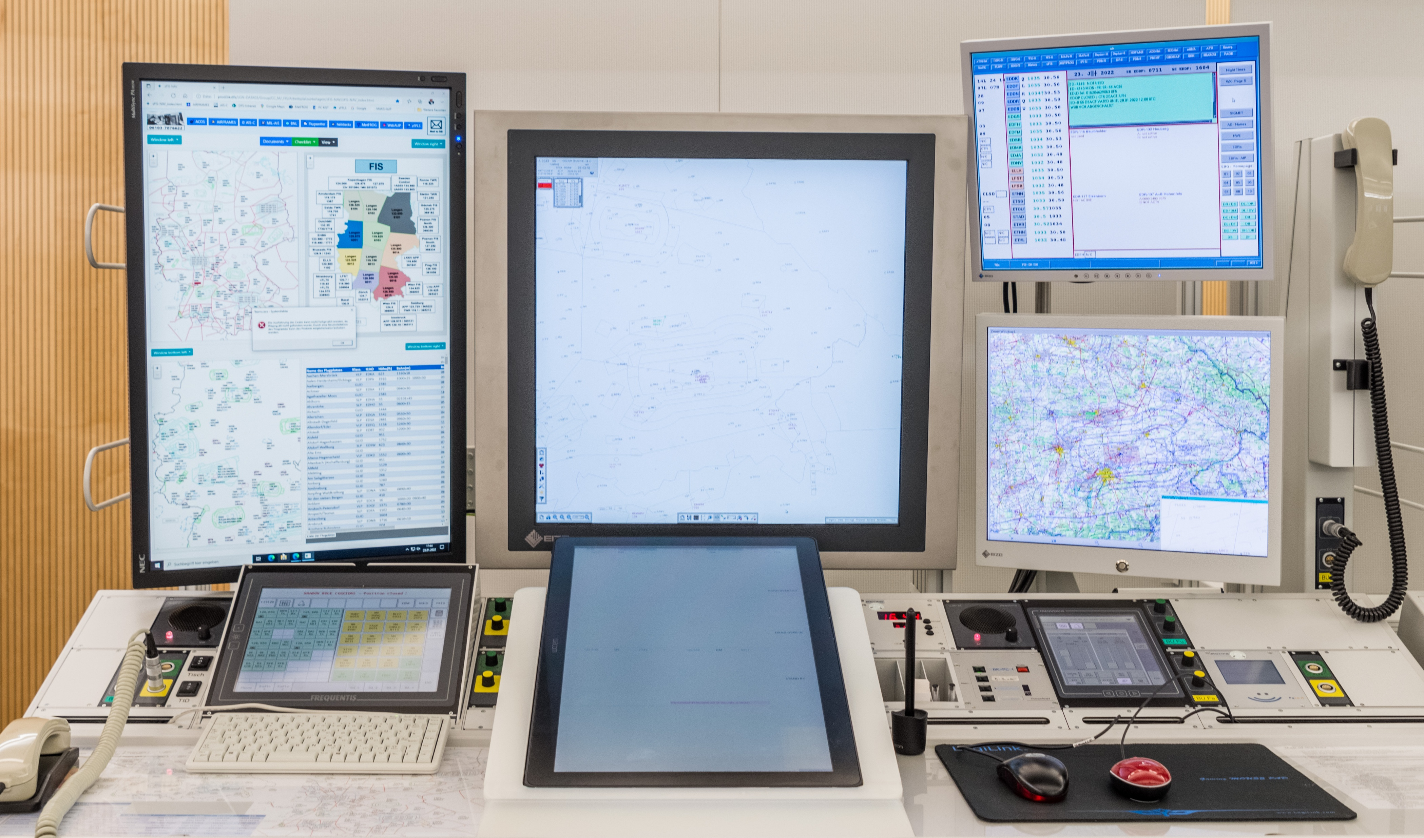
FIS Working Position
Internet
ATCISS
Primary Radarscreen
Secondary Radarscreen
Frequency-/ Phonepanel
EKOFIS

Slide 20

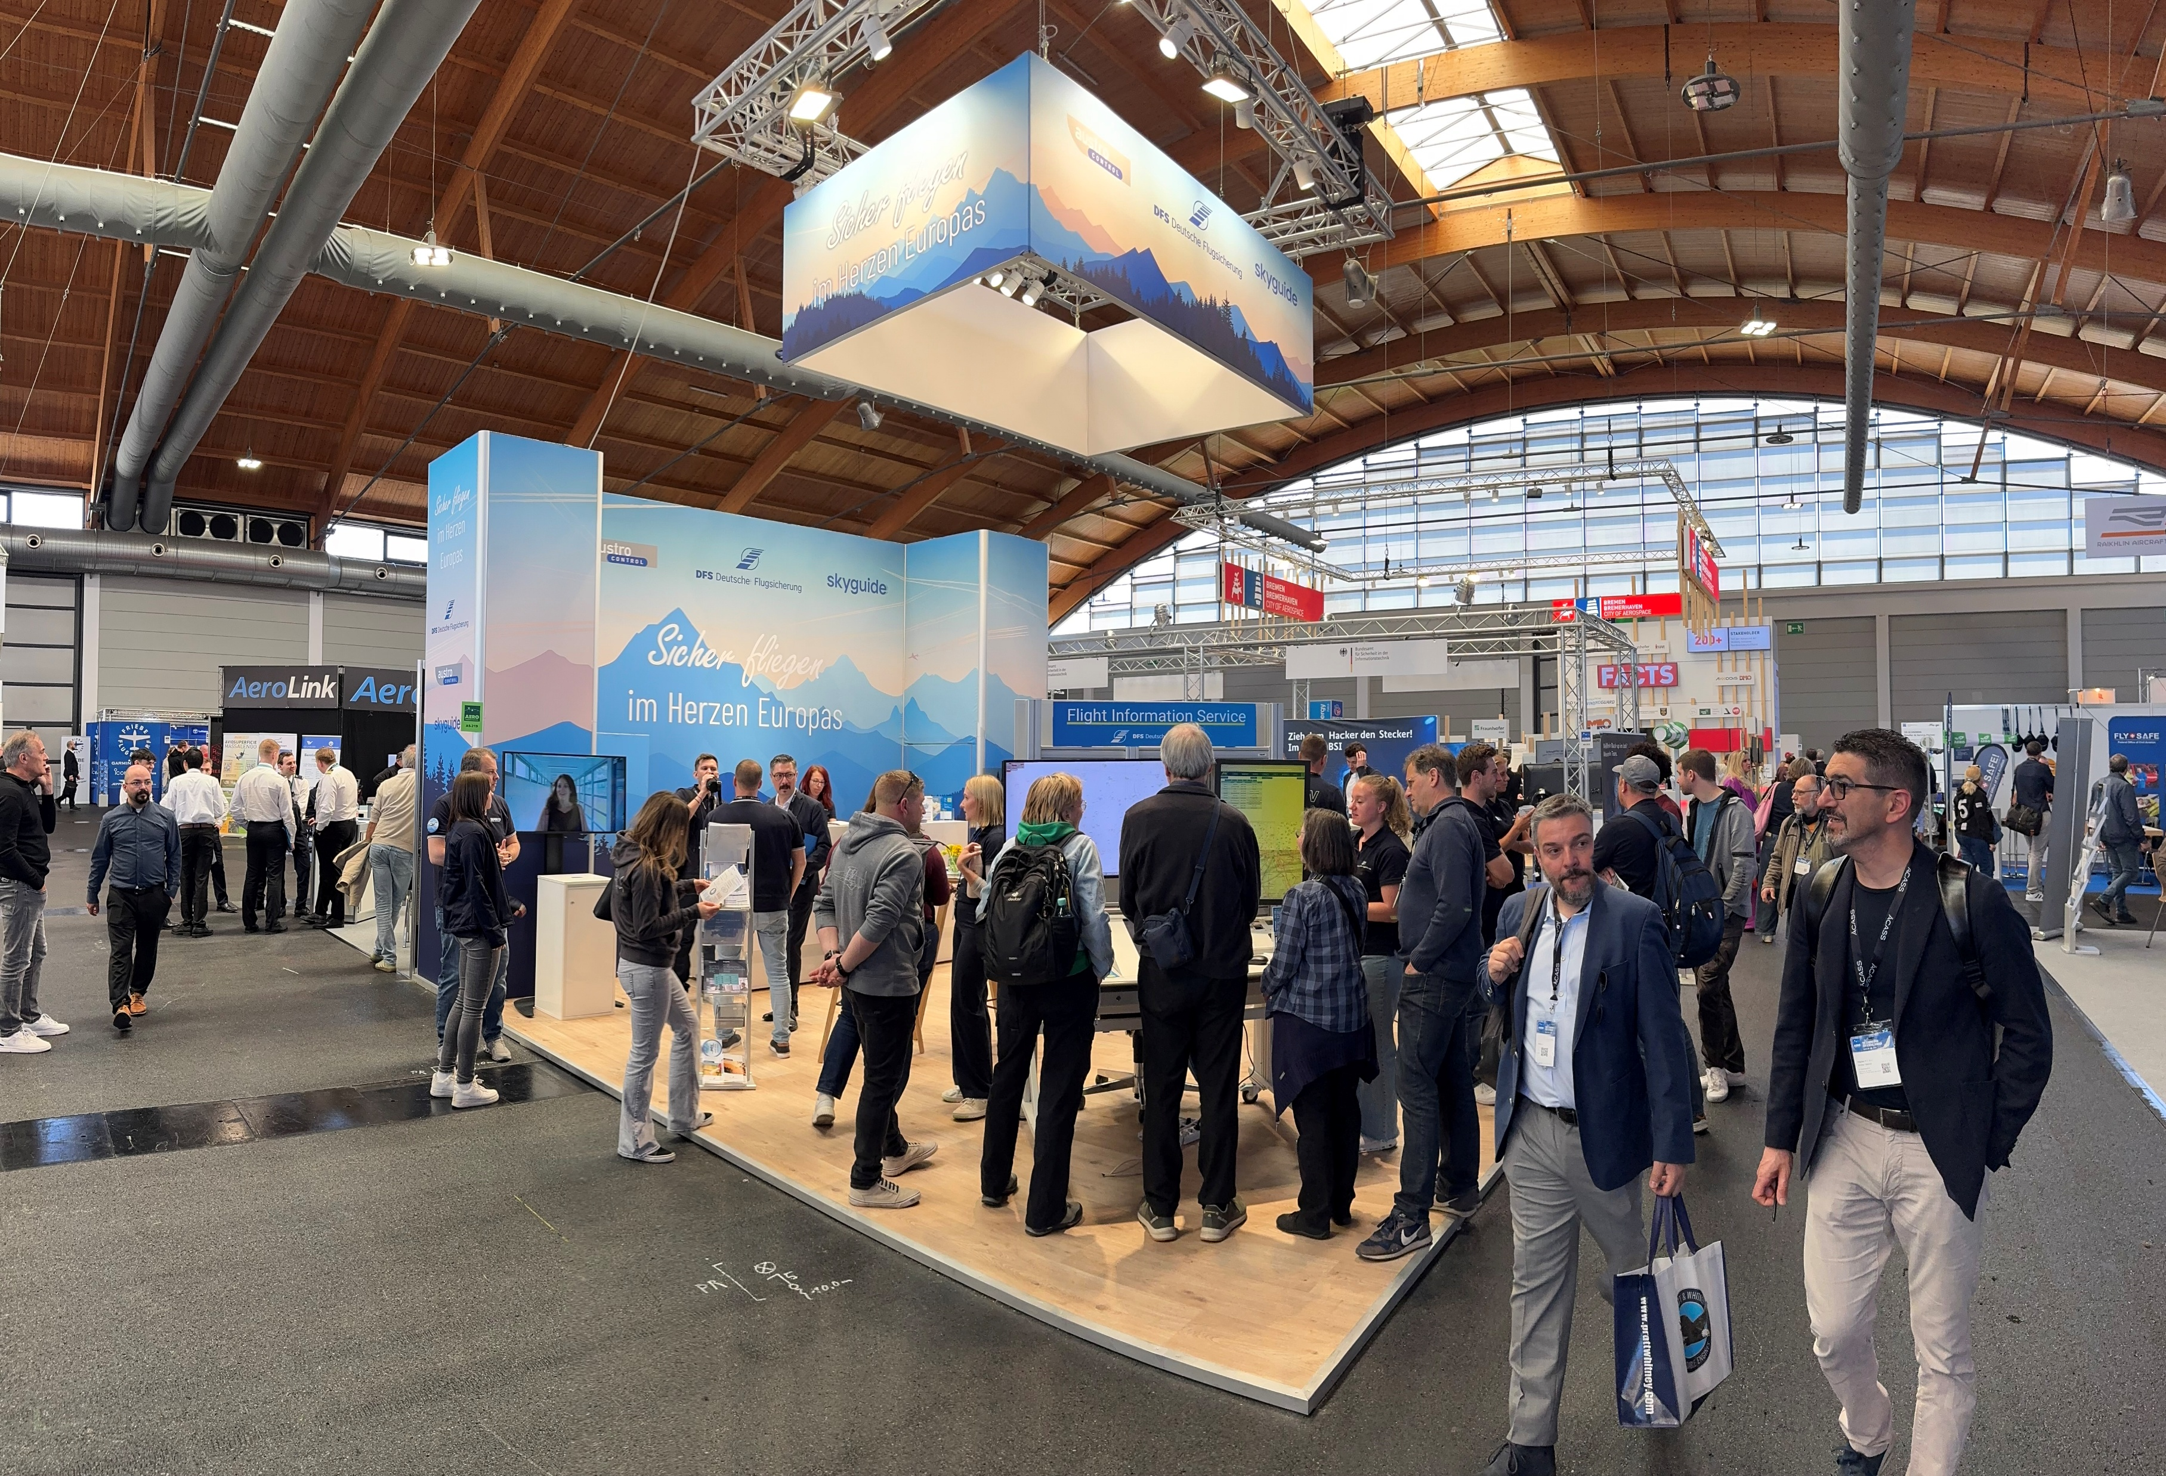
Use of staff during winter
Lectures at flying clubs
YouTube Tutorials
Instagram
VFR-Visitor‘s Day
Trade Fair AERO in April in Friedrichshafen / Lake Constance
Internal Emergency Training (UNIN/TRM)
Updating of documents
Training courses
Hosting visitors at DFS Premises

