Slide 1
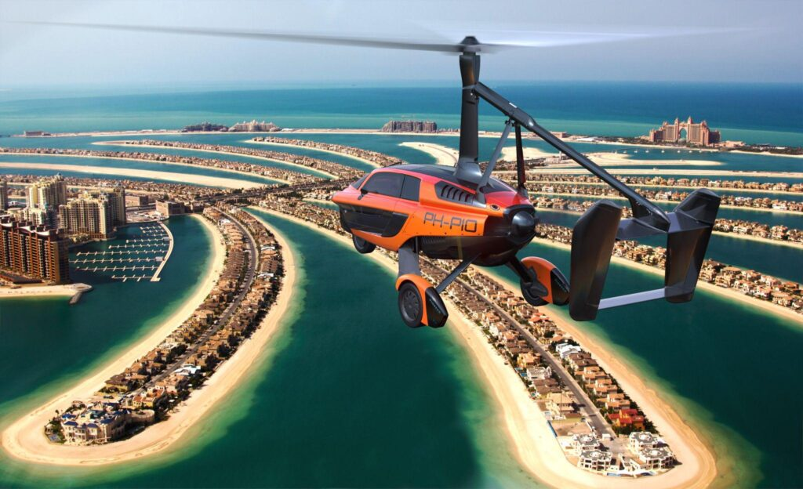
UTM and FIS: Challenges in the uncontrolled environment
Fiso Seminar, 2025

Slide 2
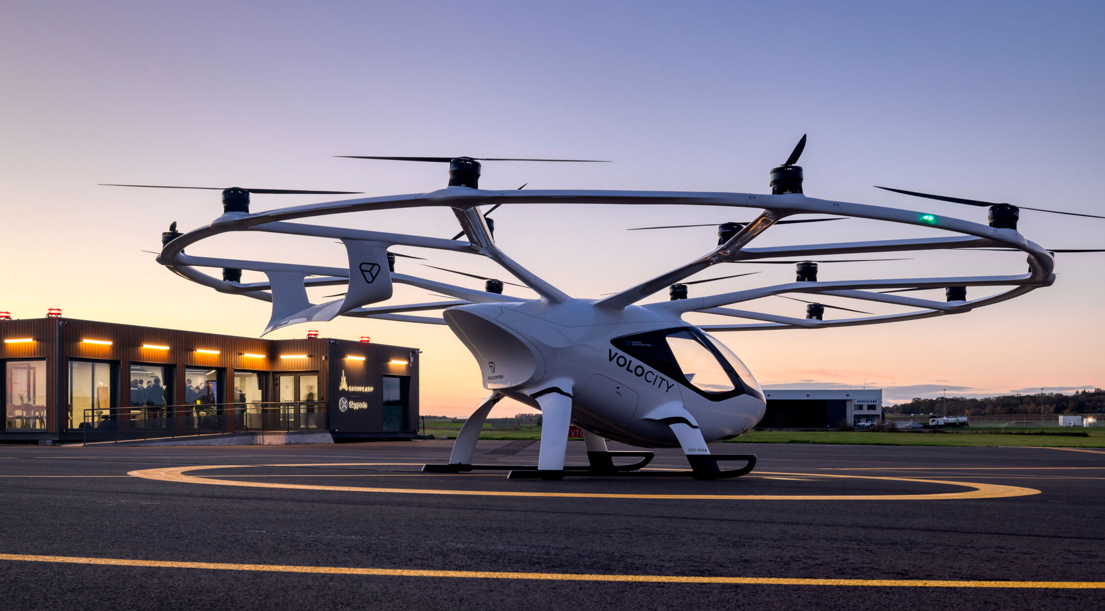
Introduction | Current UTM Landscape | Strategic Vision | Roadmap | Collaborative Approach | Technology | Engagement and Leadership
POSITIONS AND EXPERIENCE
President, IFISA
Head of Procedures, Naviair
EC Expert Group on Human Dimensions
EC Industry Consultation Body
EC CORUS
Danish AMC
GENIUS
U-SPACE FYN
INSIGHT 22-25
Health Drone
UTM and FIS: Challenges in the uncontrolled environment

Slide 3
Introduction | Current UTM Landscape | Strategic Vision | Roadmap | Collaborative Approach | Technology | Engagement and Leadership
PERSPECTIVE ON THE ROLE OF UTM IN FUTURE AIRSPACE MANAGEMENT
Integration with ATM
Establish situational awareness without information overload for (A)FISOs
Flexible use of airspace
Scalability
Increased requirements to enable BVLOS operations in U-Space
Including requirements for manned aviation
Establish contingency requirements for both system and aircraft
Automation
Dynamic live geofencing
Dynamic sectorization
Dynamic
P/R/D areas
UTM and FIS: Challenges in the uncontrolled environment

Slide 4
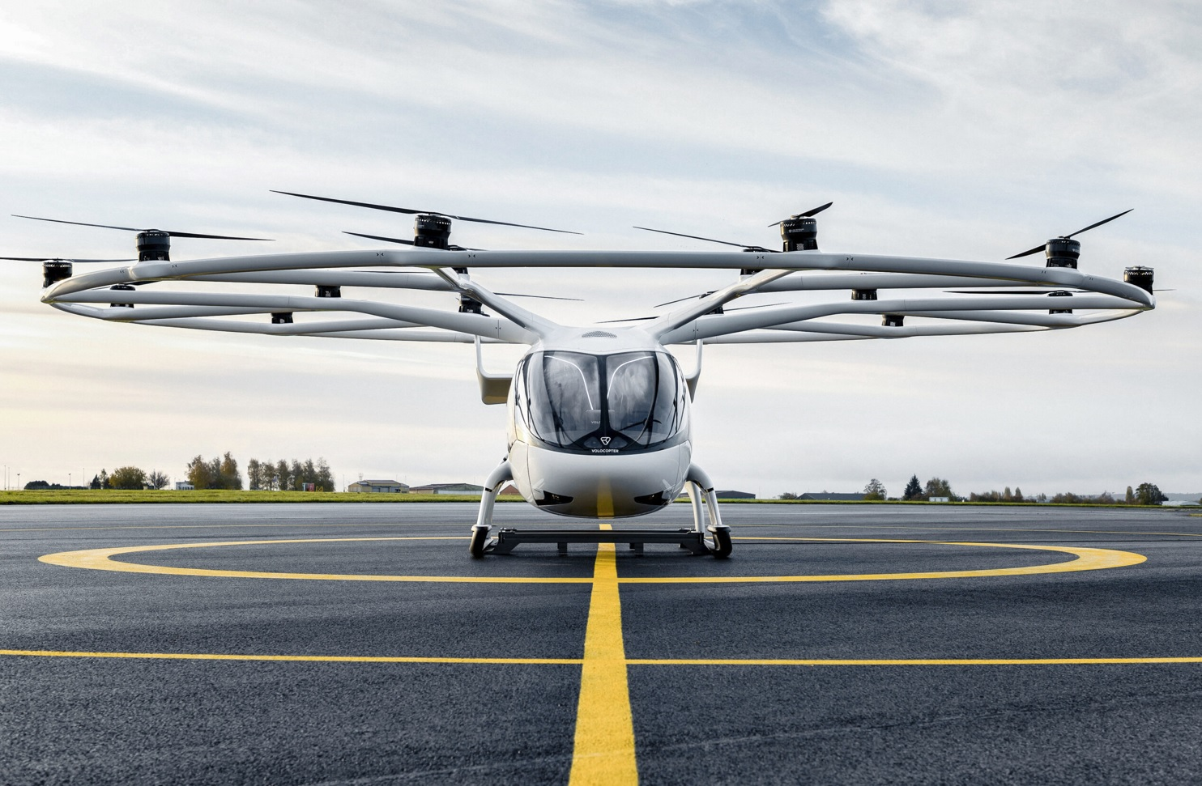
Increased requirements for all traffic
Introduction | Current UTM Landscape | Strategic Vision | Roadmap | Collaborative Approach | Technology | Engagement and Leadership
To enable BVLOS flights outside segregated areas, you need electronic visibility
Establish rules to ensure electronic visibility
Specific Operations Risk Assessment (SORA)
ACHIEVING FULLY INTEGRATED AND AUTOMATED UNIFIED TRAFFIC MANAGEMENT

Slide 5
Introduction | Current UTM Landscape | Strategic Vision | Roadmap | Collaborative Approach | Technology | Engagement and Leadership
GLOBAL TRENDS
Advanced Air Mobility (UAM, RAM)
Vertiports
BVLOS deliveries and taxi services
Digital automated ATM solutions
AI
C-UAS
UTM and FIS: Challenges in the uncontrolled environment

Slide 6
KEY CHALLENGES
Introduction | Current UTM Landscape | Strategic Vision | Roadmap | Collaborative Approach | Technology | Engagement and Leadership
Integration
Rules and regulations
Scalability
U-space
Automation
Uncontrolled Airspace
Cybersecurity
Electronic Visibility
Cloud-based services
SWIM
UTM and FIS: Challenges in the uncontrolled environment

Slide 7
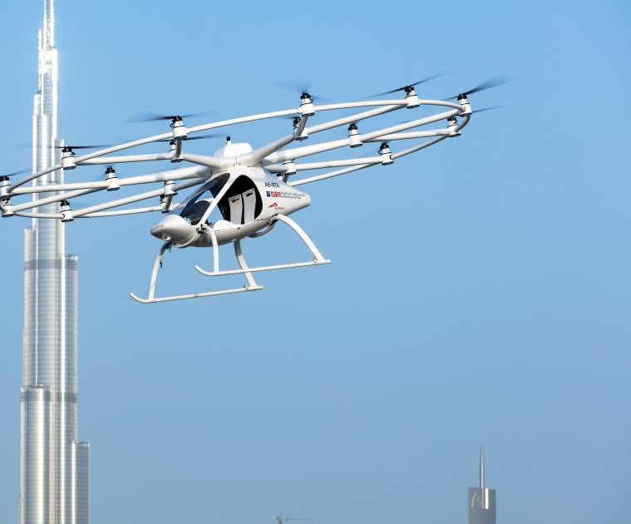
future UTM
Introduction | Current UTM Landscape | Strategic Vision | Roadmap | Collaborative Approach | Technology | Engagement and Leadership
Establishing corridors for UAVs
Geofence & C-UAS
Provide relevant data to the ATM
Expanding the UAV Services
Automated drone flights
Uncrewed Taxi Flights
From segregation to integration
UTM and FIS: Challenges in the uncontrolled environment

Slide 8
Introduction | Current UTM Landscape | Strategic Vision | Roadmap | Collaborative Approach | Technology | Engagement and Leadership
ROADMAP
Fully integrated UAV flights in all airspace classes
Automated flights
Unified Traffic Management
Objective: Establishment and integration of UAS services
Scaled BVLOS flights outside corridors
Automated taxiflights to vertiports
5+ years
Obtain permits to do Unmanned flights in corridors
Uncrewed taxi flights (RPAS)
3-5 years
1-2 years
UTM and FIS: Challenges in the uncontrolled environment

Slide 9
Introduction | Current UTM Landscape | Strategic Vision | Roadmap | Collaborative Approach | Technology | Engagement and Leadership
ROADMAP
Information scope expands
Digital integration (U-space / UTM)
Responsibility split
Workload impact
Effects on FIS
FIS is often not involved beyond warning pilots about the restricted area
Drone activity inside is not usually something manned pilots get tactical info on
Shared
Airspace
No real change for FIS
The airspace is simply closed off
Restricted Airspace
Segregated Airspace
UTM and FIS: Challenges in the uncontrolled environment

Slide 10
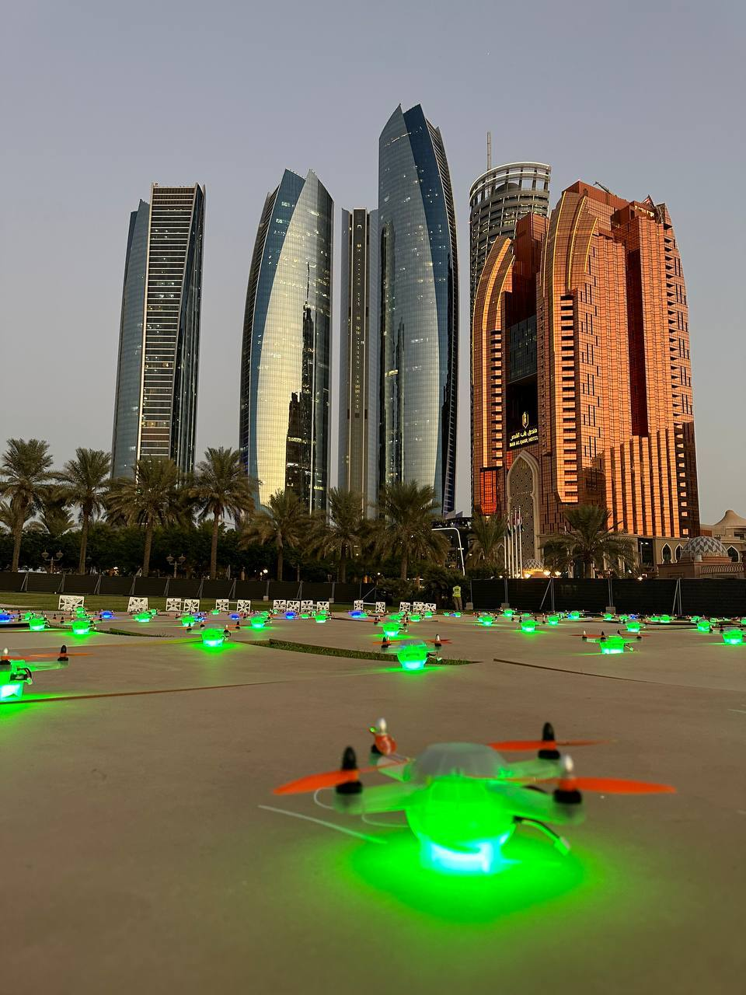
Fis in Shared airspace
Introduction | Current UTM Landscape | Strategic Vision | Roadmap | Collaborative Approach | Technology | Engagement and Leadership
Information scope expands:
  FIS may now provide information about drone operations in the vicinity — much like regular traffic information
Digital integration:
  Instead of relying only on voice, drone activity is published via digital platforms
  In some cases, this feeds directly into FIS displays
Responsibility split:
  Traditional ICAO principle still holds: manned aircraft have priority and drones must yield.
Workload impact:
  With U-space: much of the drone traffic information is handled automatically.
  Without U-space, FIS will need to coordinate when BVLOS drones operate near known routes/airfields
UTM and FIS: Challenges in the uncontrolled environment

Slide 11
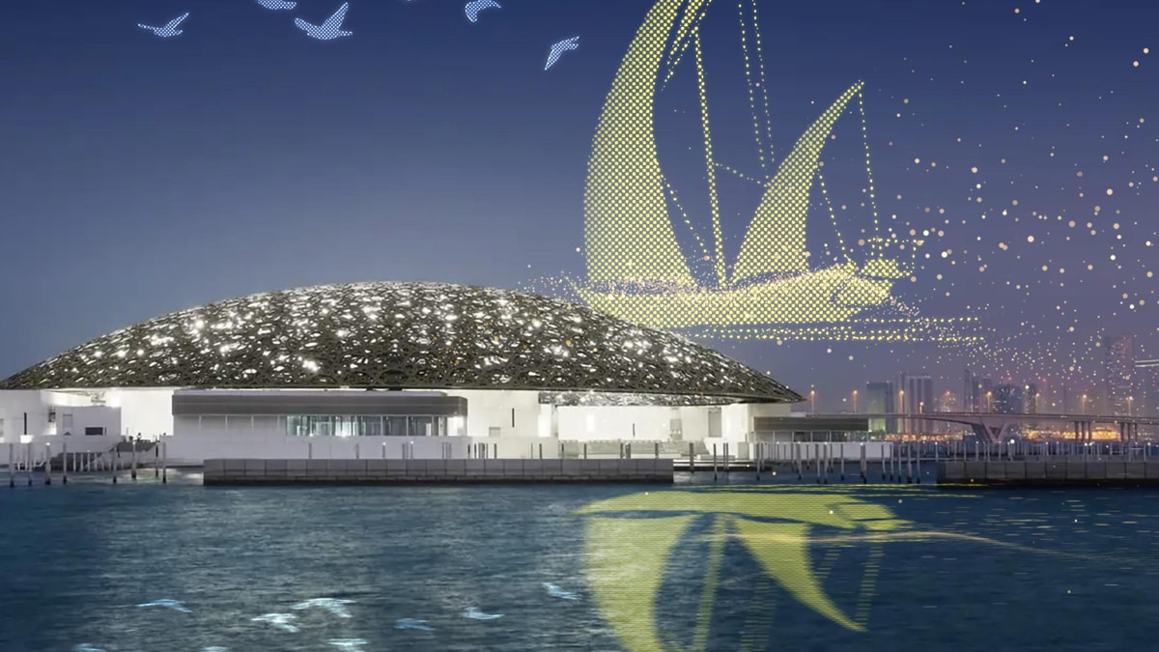
Introduction | Current UTM Landscape | Strategic Vision | Roadmap | Collaborative Approach | Technology | Engagement and Leadership
Operational and Regulatory Approach
SORA
Compliance
Contingency
UTM and FIS: Challenges in the uncontrolled environment

Slide 12
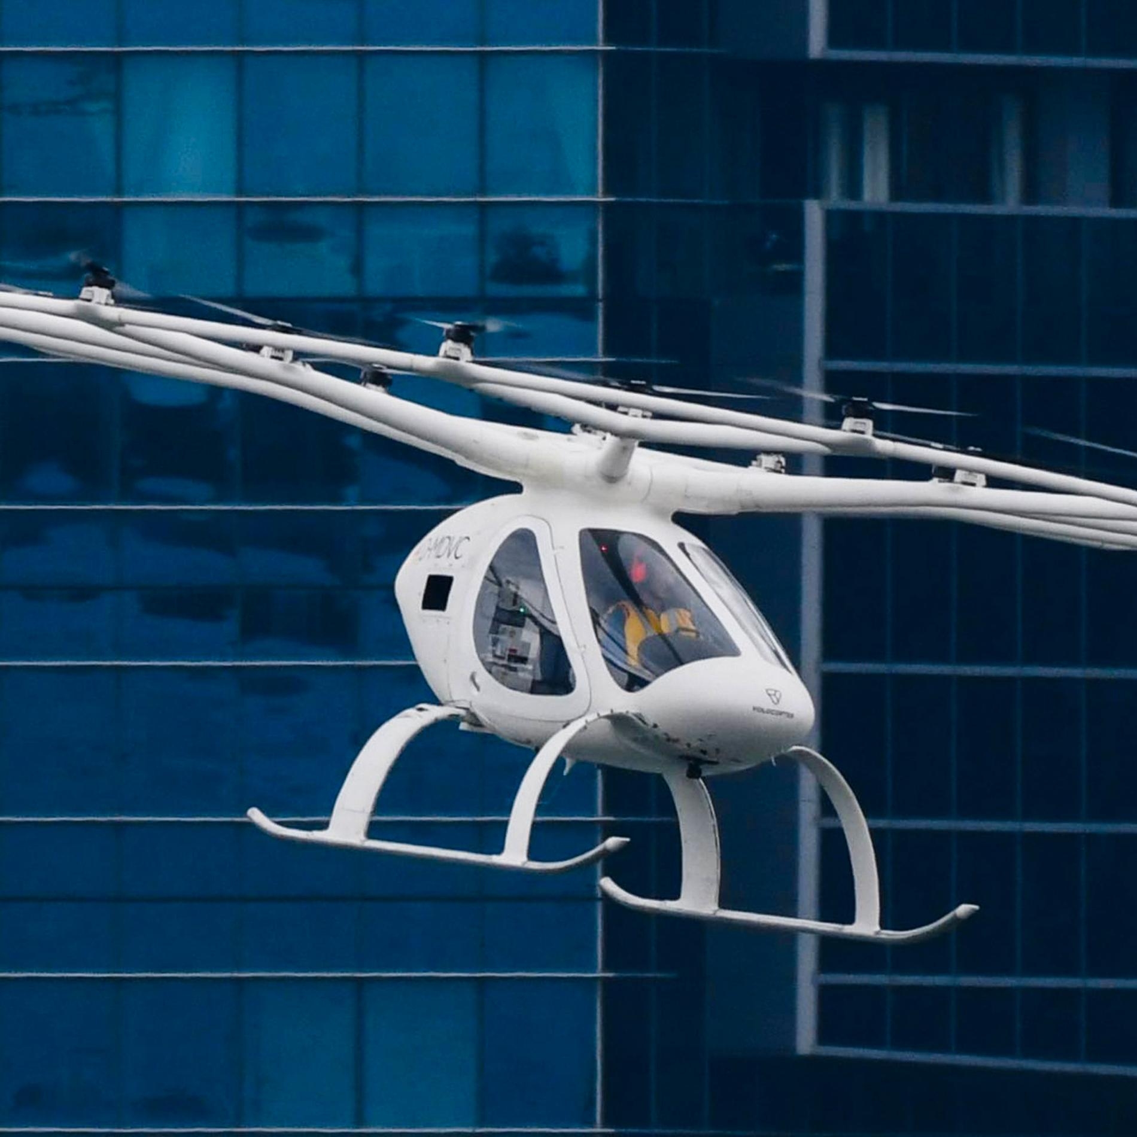
technology
Introduction | Current UTM Landscape | Strategic Vision | Roadmap | Collaborative Approach | Technology | Engagement and Leadership
AI
Surveillance
  GENIUS-Project (5G ENabled communication Infrastructure for Unmanned Aerial Systems)
  ADS-B light
  X-band Doppler radars
Detect and Avoid equipment
UTM and FIS: Challenges in the uncontrolled environment

Slide 13
AI/Automation
Introduction | Current UTM Landscape | Strategic Vision | Roadmap | Collaborative Approach | Technology | Engagement and Leadership
Transitioning will be a challenge
Human centric approach
Support and enhance (A)FISOs/ATCOs
It will take longer than anticipated
Technology will come first
UTM and FIS: Challenges in the uncontrolled environment

Slide 14
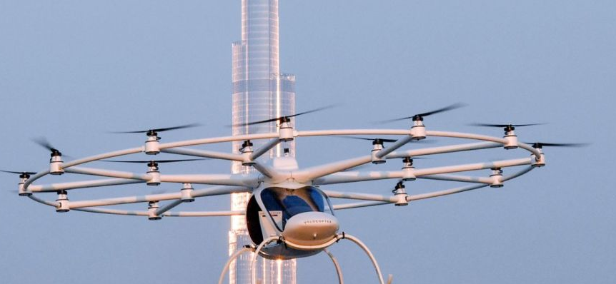
Surveillance/Visibility
Introduction | Current UTM Landscape | Strategic Vision | Roadmap | Collaborative Approach | Technology | Engagement and Leadership
Electronic visibility
Detect and avoid systems
Digital autonomous traffic management
UTM and FIS: Challenges in the uncontrolled environment

Slide 15
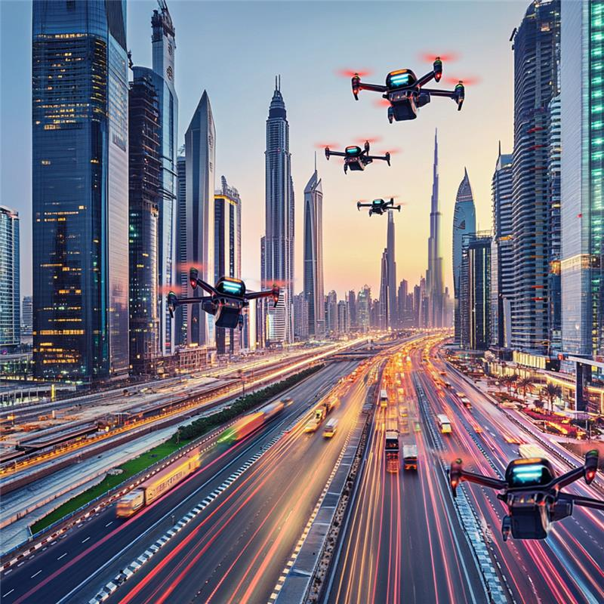

Stakeholder
Management
Introduction | Current UTM Landscape | Strategic Vision | Roadmap | Collaborative Approach | Technology | Engagement and Leadership
Step-by-step approach
Make sure each progressive step is successful
Celebrate the wins publicly
Collaboratory approach
Control the narrative
UTM and FIS: Challenges in the uncontrolled environment

Slide 16
THANK YOU FOR YOUR ATTENTION

