Slide 1

AKO SA PRACUJE
NA STANOVIŠTI FIC
Branislav Horváth
FISO at FIC Bratislava
Bratislava 10.9.2025

Slide 2
How we work at FIC Bratislava
Introduction of Flight Information Center
G class airspace in Slovakia (Uncontrolled)
Flying in Gee

Slide 3
Flight information center Bratislava (working position)
The Flight Information Centre (FIC Bratislava) is established for the purpose of providing flight information and emergency services in uncontrolled airspace within the Slovak Republic.
The working hours of the FIC Bratislava unit are continuous and the staffing of the workplace is determined by the shift roster.
The FIC Bratislava unit is organizationally subordinate to the Head of ACC Bratislava and the employees are subordinate to the ES ACC Bratislava during the performance of their duties.
The employees of the FIC Bratislava unit (DFIC) work during their duties in accordance with international and national aviation regulations, directives and regulations, coordination agreements with other ATS units and other documents related to the activities of the FIC Bratislava unit.
Callsign: Bratislava Information Frequency: 124,300 MHz
Future EAST Freq: 131,325 MHz
Callsign: Bratislava Information
Frekvencia: 124,300 MHz

Slide 4
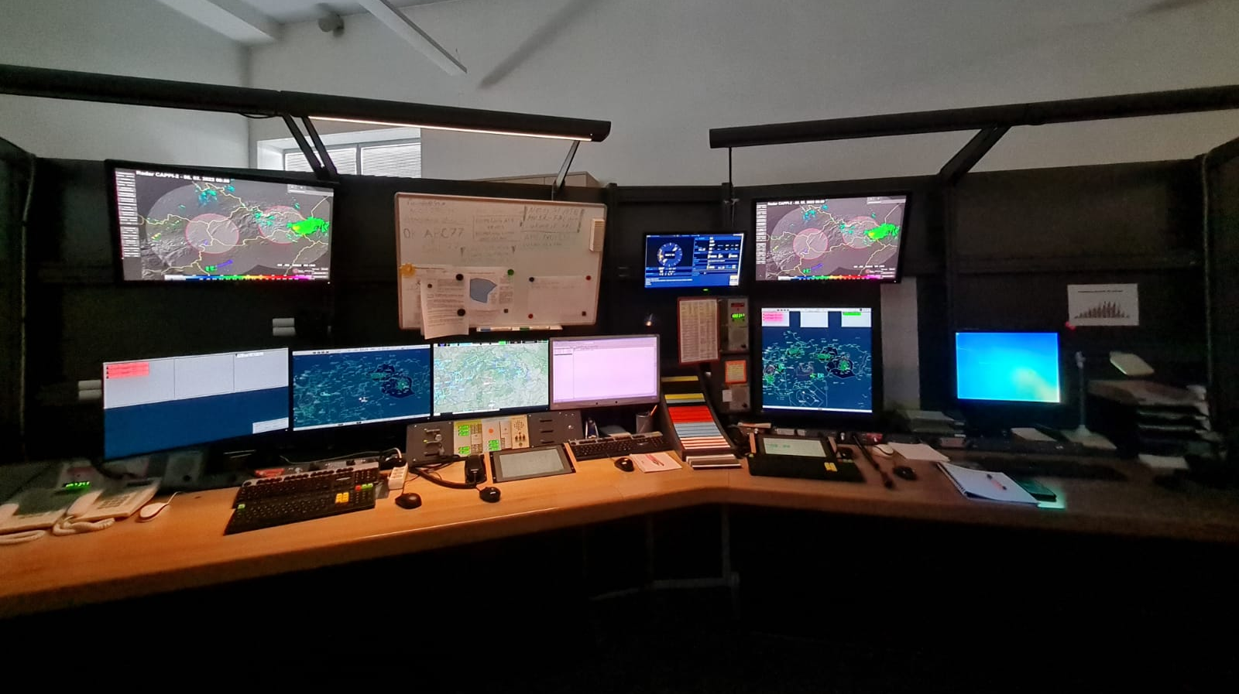
Flight information center Bratislava (working position)

Slide 5
Flight information center Bratislava (services povided)
Main:
Providing information and alerting service:
    Activation and closure of FPL
    Information about local and regional QNH
    Weather information
    Information about active military areas
    Traffic information
    Help in emergency situations

Slide 6
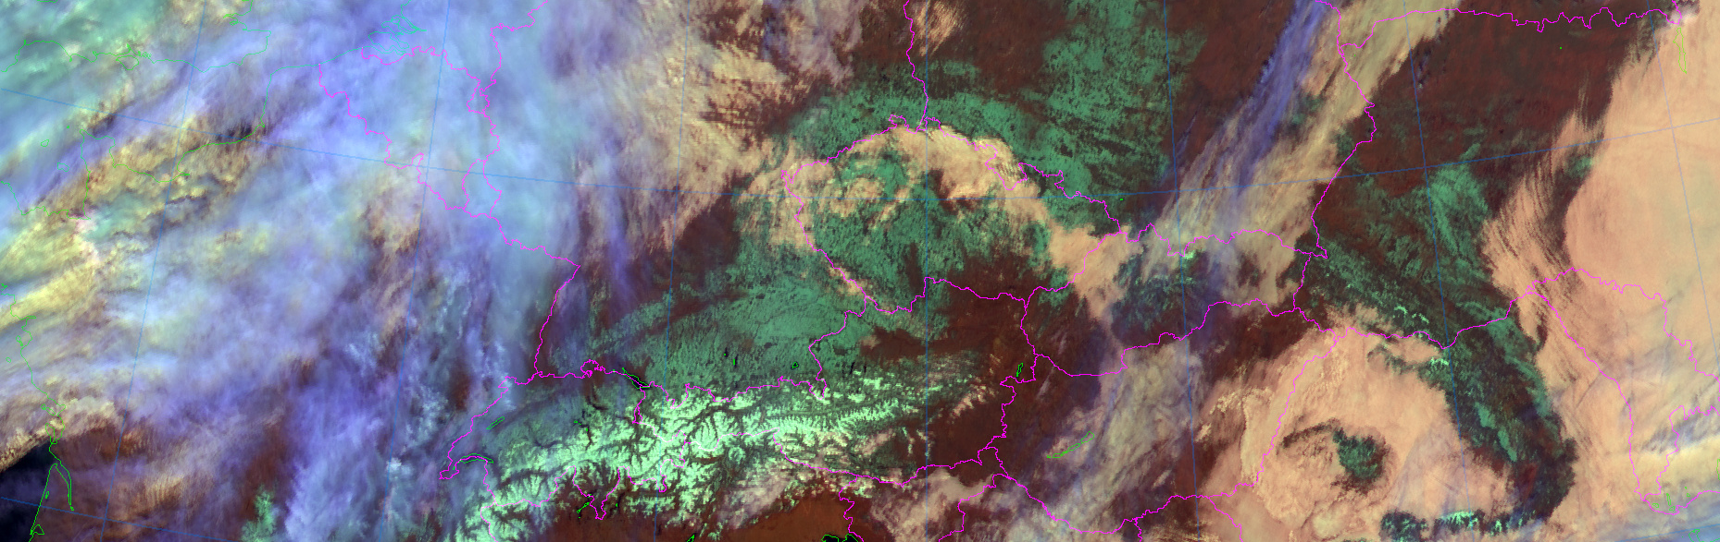
Flight information center Bratislava (services provided)
Weather information:
Information about hazardous weather phenomena, provision of regular airport weather reports and forecasts
Provision of information about weather on the flight route that could make flight under visual flight rules impossible
Animácie meteo produktov sú poskytované SHMÚ

Slide 7
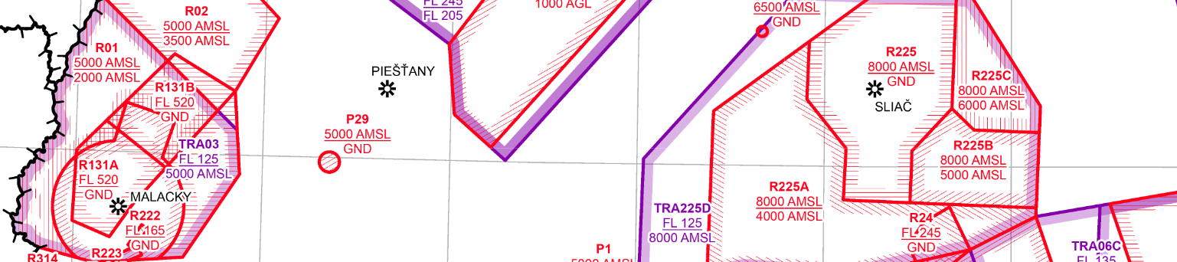
Flight information center Bratislava (services provided)
Information about active military areas:
Real time activation times as of AUP/UUP
Information published via NOTAM
AIP SR ENR 6.5

Slide 8

Flight information center Bratislava (services provided)
Traffic information:
Information about operation using the surveillance system
Information about local air activity or landings in ATZ/RMZ
(FIC can only provide information about known operation)

Slide 9

Flight information center Bratislava (services provided)
Help in emergency situation:
Loss of orientation of navigational deviation
Weather condition worsening
Reduction of aircraft operability
Coordination with Search and rescue

Slide 10
Flight information center Bratislava (alerting service)
Alerting service is provided:
to all aircraft to which ATC is provided;
to all other flight with FPL filed-in or otherwise known;
to all aircraft which are, or it is suspected that can be subject of unlawfull act.

Slide 11
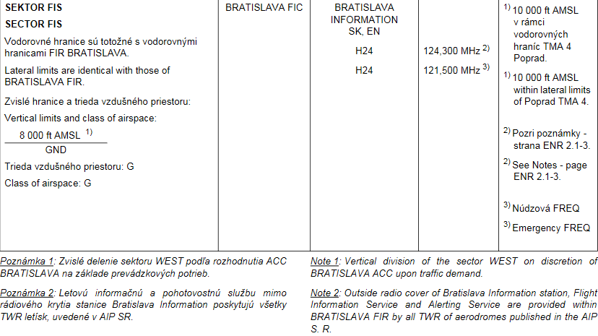
Airspace class G
AIP SR ENR 2 AIR TRAFFIC SERVICES AIRSPACE
131,325 MHz

Slide 12
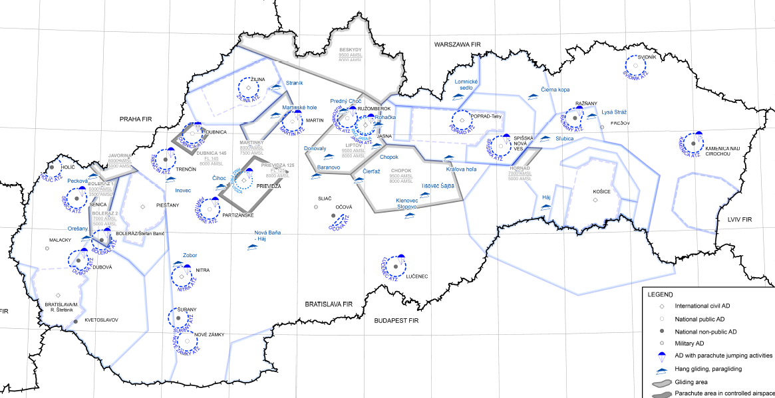
Airspace class G
Within territory of the Slovak republic from ground up to 8000 ft AMSL, resp. 10000 ft AMSL within horizontal boundary of TMA 4 of TMA Tatry.
VIAC INFO:
AIP SR ENR 1.1
AIP SR ENR 2.2
AIP SR ENR 5.5
AIP SR ENR 6.15

Slide 13
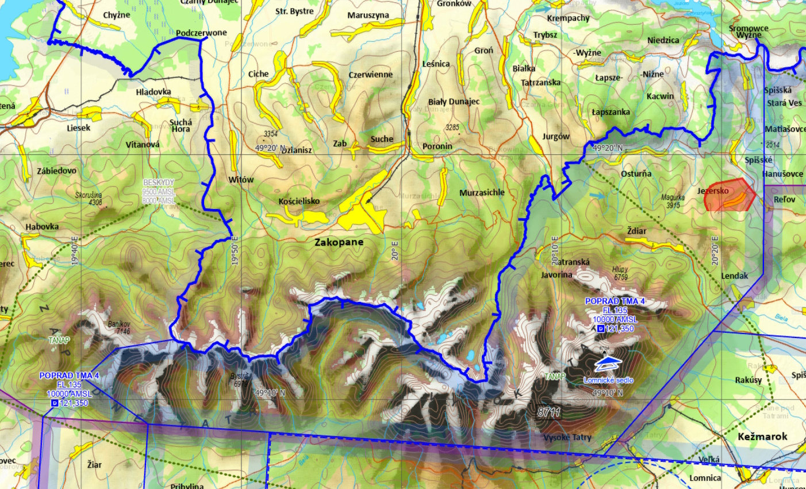
Airspace class G

Slide 14
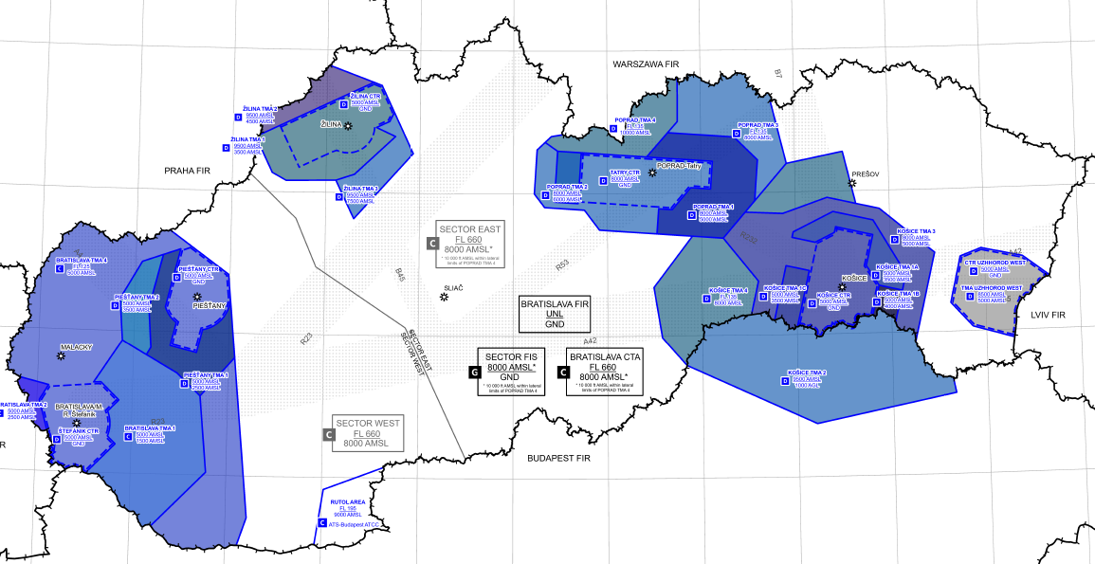
Airspace class G
Outside of active CTR / TMA´s
VIAC INFO:
AIP SR ENR 1.1
AIP SR ENR 1.4
AIP SR ENR 2.1
AIP SR ENR 6.13

Slide 15
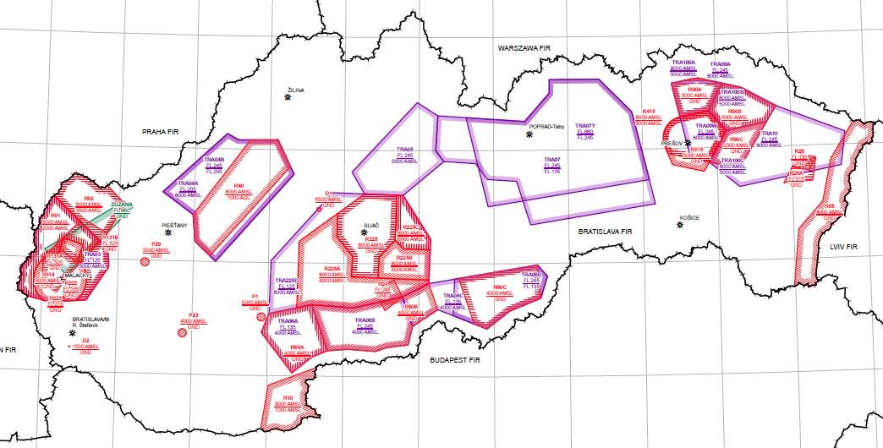
Airspace class G
Except of prohibited, restricted, dangerous
and temporarily reserved areas
VIAC INFO:
AIP SR ENR 5.1
AIP SR ENR 5.2
AIP SR ENR 6.5

Slide 16
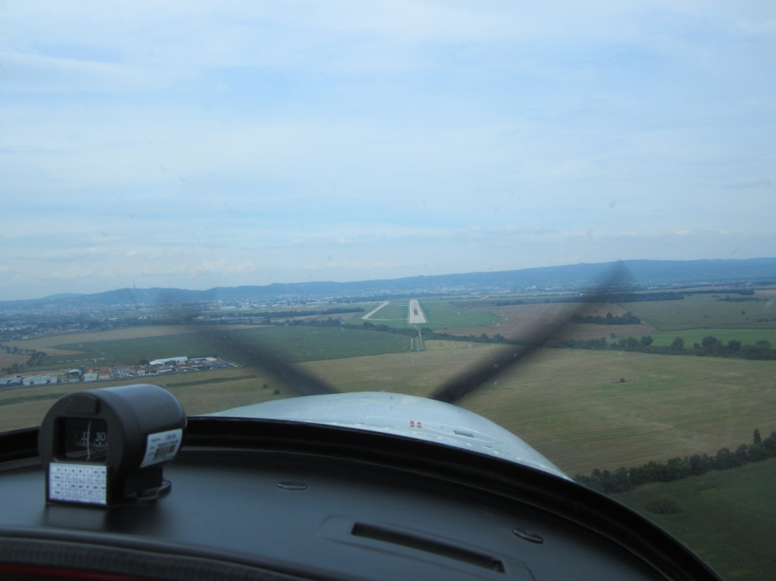
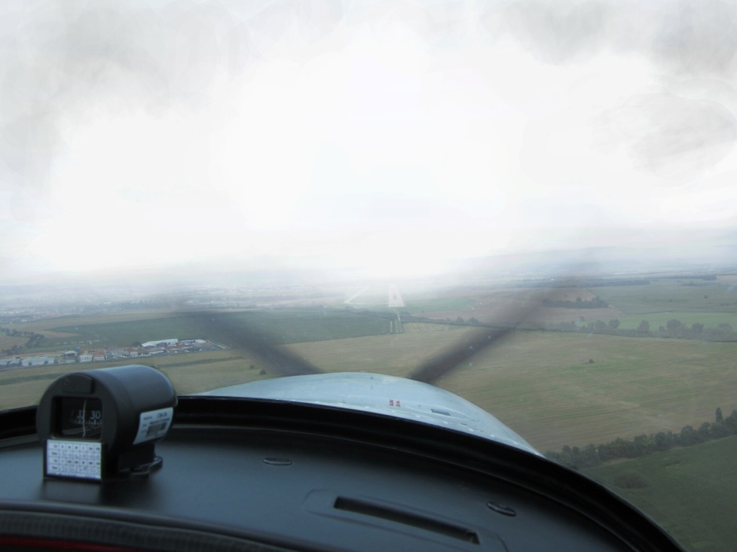
Airspace class G
VFR and IFR flights performed within
VFR – Visual Flight Rules
IFR – Instrument Flight Rules

Slide 17
Airspace class G
All flights are provided with flight information service upon request.
All flights for which a flight plan has been filed-in or are otherwise known to air traffic services, alerting service is also provided to;
Flights in this area are not subject to flight clearance and are not provided with separation control service.

Slide 18
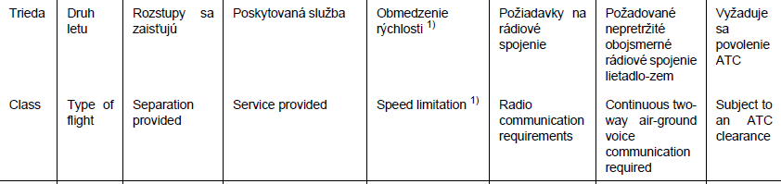
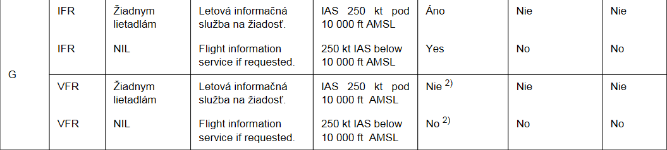
Airspace class G
AIP SR ENR 1.4 Klasifikácia vzdušného priestoru
Poznámka 2): S výnimkou letov v RMZ (radio mandatory zone), kde sa uplatňujú požiadavky na rádiové spojenie.

Slide 19
FIC Bratislava recommends:
Contacts:
FIC R55 Entrance
02/4857 2230 AMC +421/960/46 22 31
02/4329 3229 30 mins in advance in SK
(ENR 5.1.6)
CARO
02/4857 2280
02/4342 2102

