Slide 1
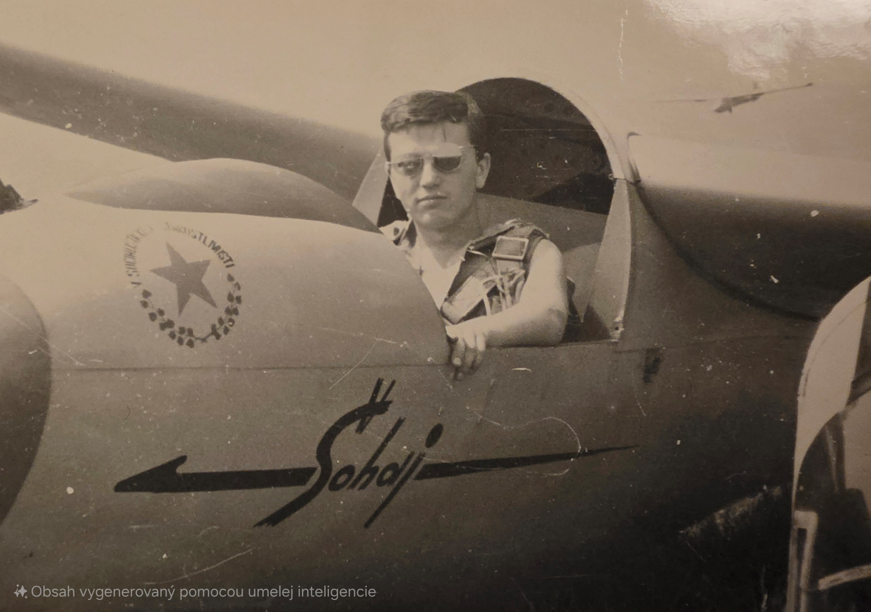
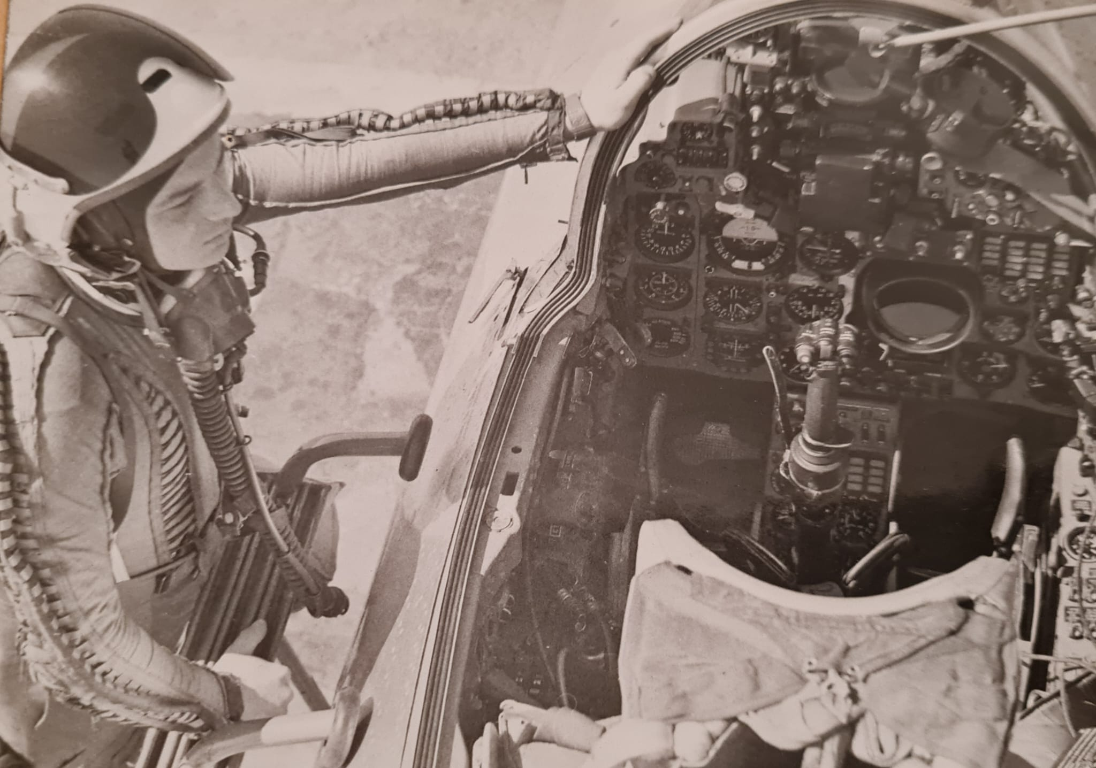
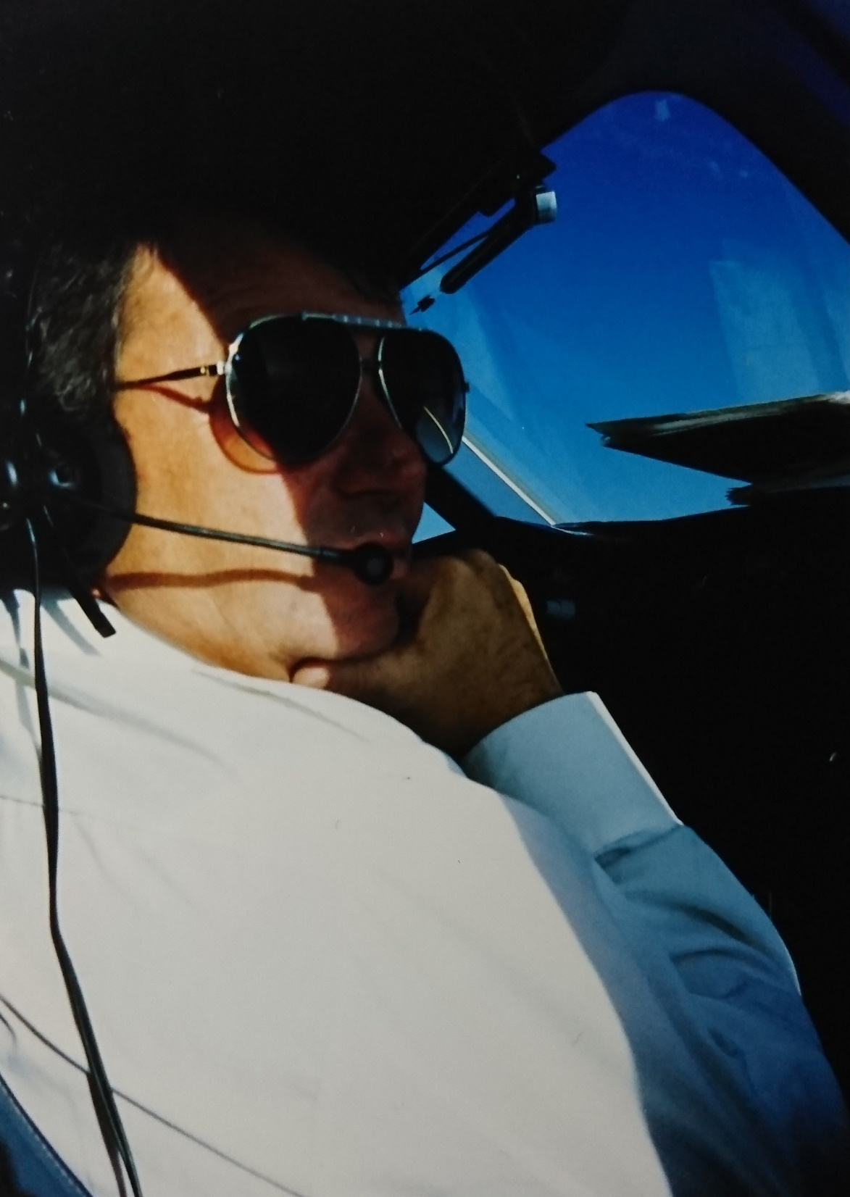
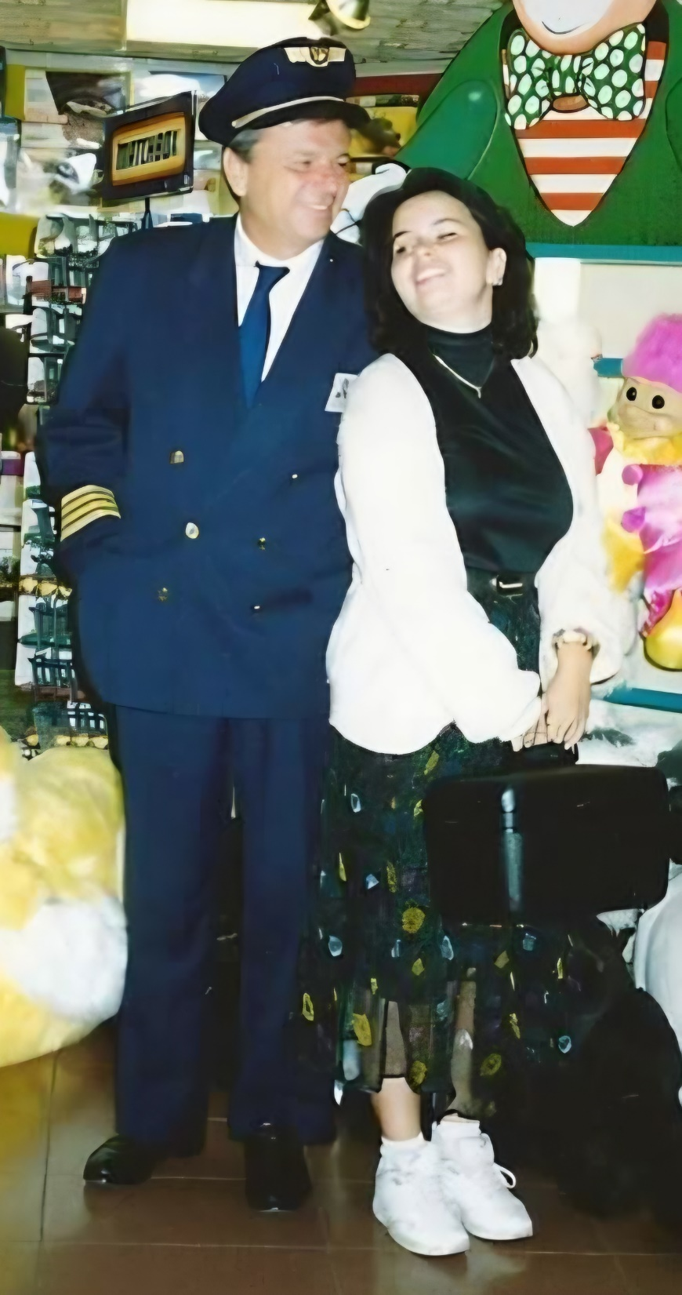
Seminars and workshops
Mgr. Jana Bakošová
FIC

Slide 2
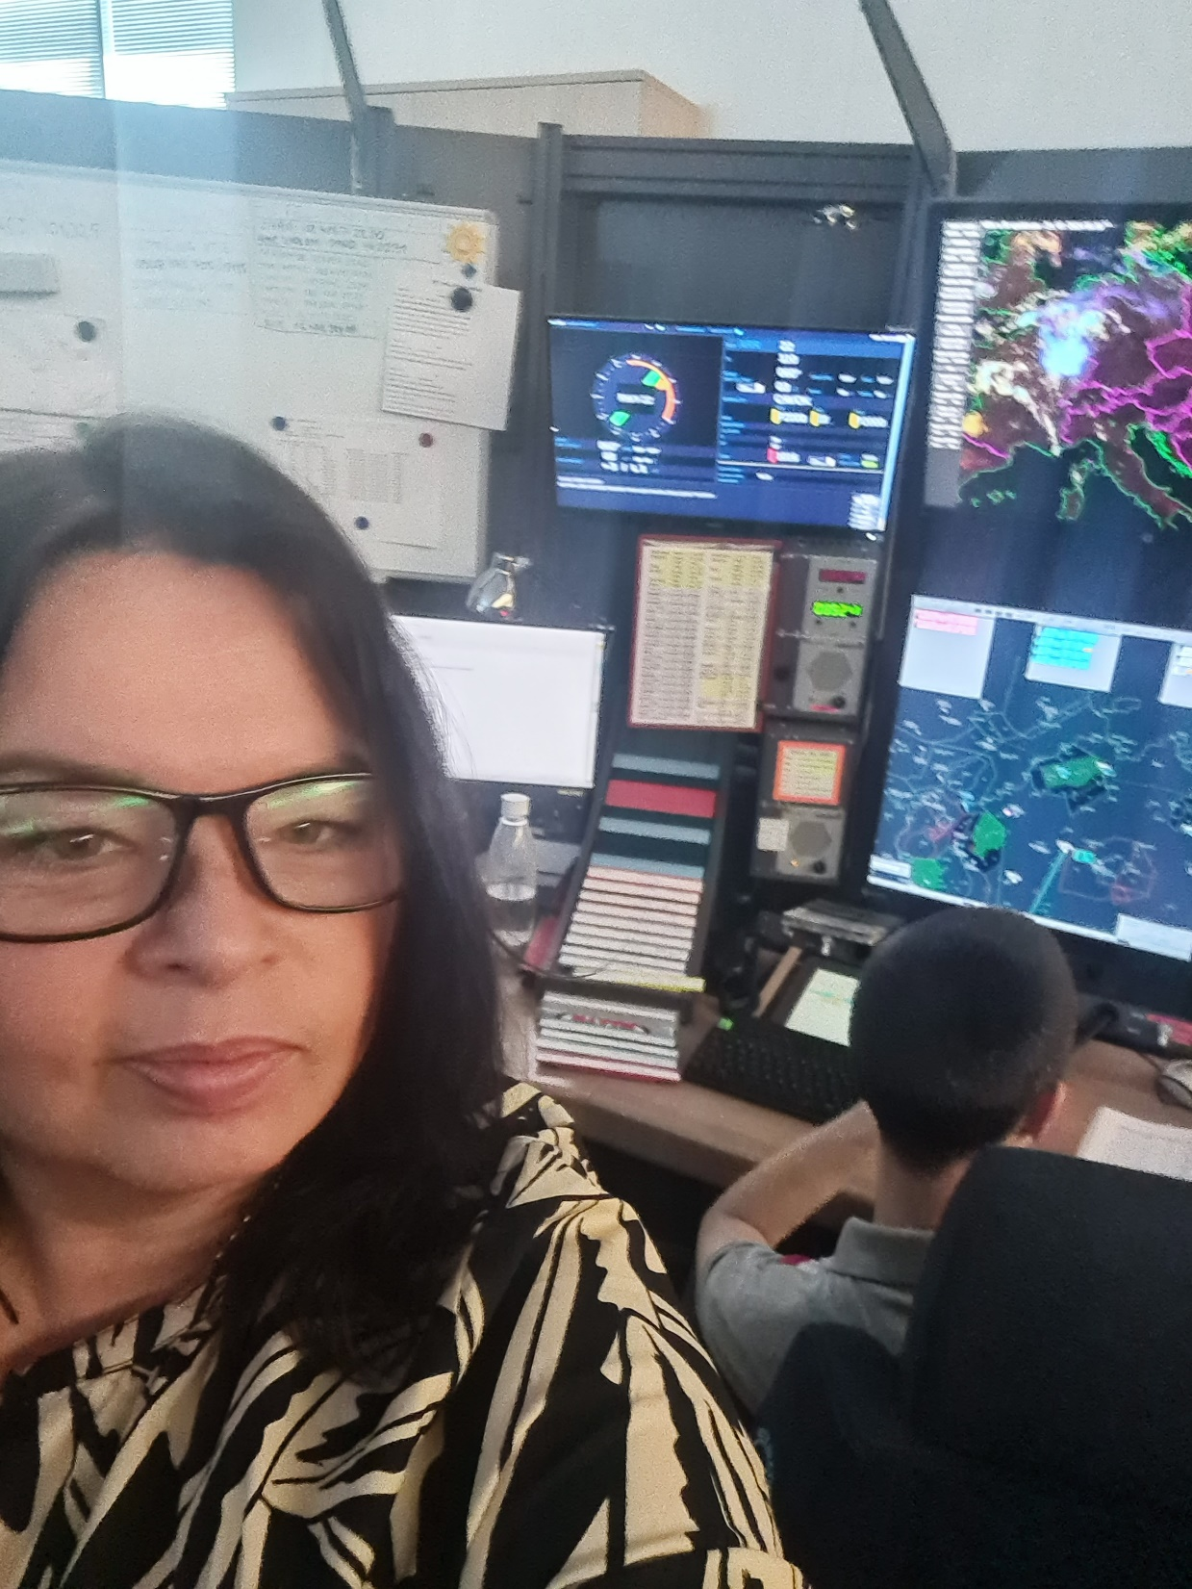
100% FISO
Project Leadership
Managing cross-functional teams and guiding projects for general aviation pilots
Main goal
Building and maintaining strong relationships with pilots, partners, and internal teams.
Achievements
I've had the privilege of contributing to several impactful initiatives with visible results and positive change.
Challenges and Solutions
I've encountered some challenges, but each one has been a valuable learning experience.

Slide 3
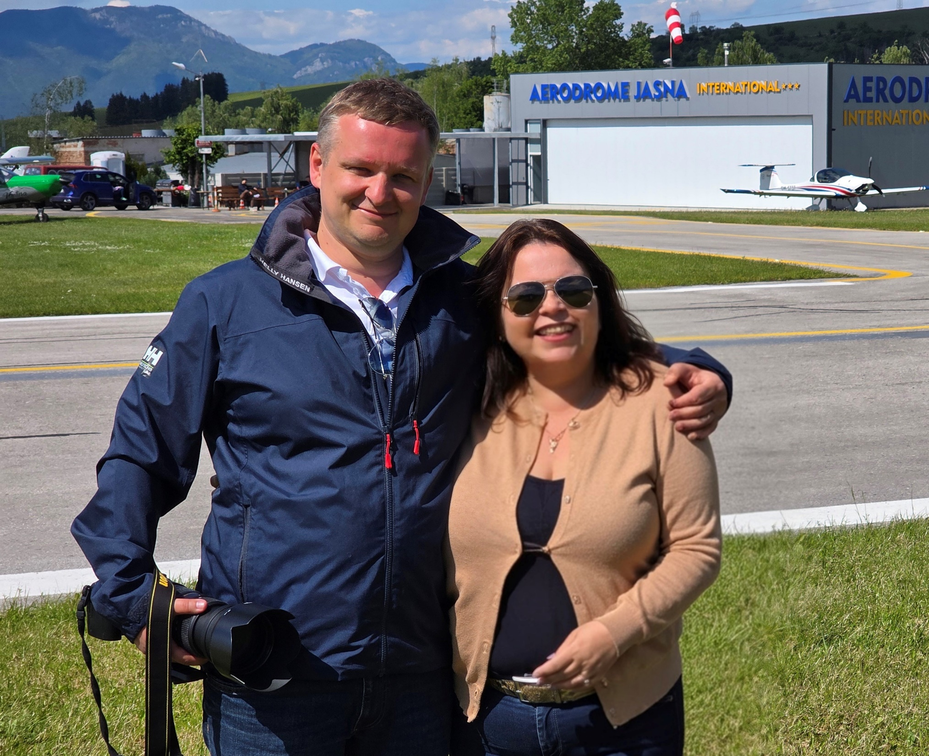
Partners
Internal Teams
Working closely with Štefánik APP/TWR, Tatry TWR, RCC
External Partners
Forging strategic alliances to expand capabilities.
ŘLP ČR Mgr. Martin Klumpler ATCO, LKMT
PANSA Mr. Maciej Krajewski FISO, EPKK
Mentors & Advisors
Benefiting from the wisdom and guidance of experienced professionals who provide critical insights and support.
SLF Slovak Aviation Federation, LAA Amateur Aviation Association, Elmontex, flight schools, aeroclubs

Slide 4
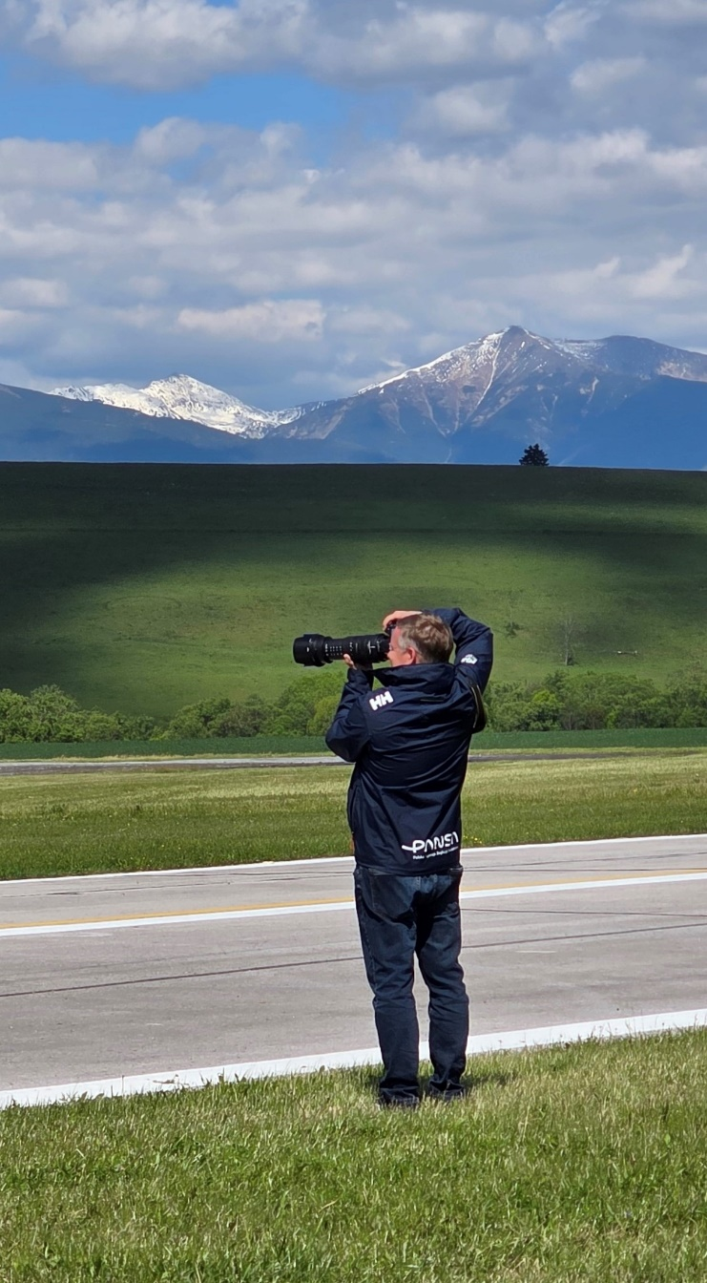
Specific Project Examples
2022 Excursions for GA pilots – 226 visitors
2022 Aviation Youth meeting LZLU
2023 Excursions for GA pilots – 110 visitors
2024 Specialized seminar for GA pilots – 50 pilots
2024 Krakow – online presentation
2024 Proffesional workshop – University of Transport Žilina
2024 Proffesional seminar – Technical University Košice
2025 Specialized seminar for GA pilots – 80 pilots
2025 Fly-in and workshop for GA pilots in LZJS
Safety Days – SLF LZLU – each year different topic – Human performance, Weather, Equipent...
Military, Civil Aviaton Authority, Ministry of Transport, Technical University Košice, University of Transport Žilina, TOMARK, SHARK, CIRRUS Aircrafts, etc.
Winter / Summer course – LZDV, LZTR, LZTN, LZSE, LZDB, LZSY, LZSD
V4 Helicopter Fly-in, Žilina, Vendryně Czech Republic

Slide 5
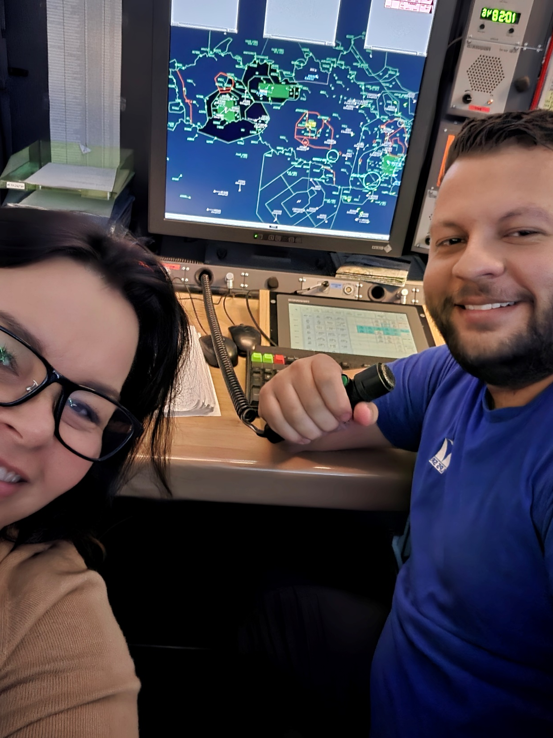
Plans for the Future
Looking ahead, my focus remains on continuous growth and implementation of impactful change.
Expand Expertise
Deepen knowledge through continuos learning and advanced
training.
Lead Innovation Initiatives
Pioneer new projects to solve complex problems and create new opportunities.
Mentor Next-Gen Leaders
Invest time in coaching and empowering aspiring professionals, fostering a culture of growth and shared success.

Slide 6
Recommendations
Knowledge of aviation rules, regulations and procedures, correct planning and pre-flight preparation, (NOTAM, AUP...)
Valid frequencies
Don’t be afraid to communicate
We have heard on our frequency everything: laughter, cry, insults, singing, meowing...
Do not reduce the frequency listening volume
Remember, that pilot is in charge of only one aircraft, but ATCO or FISO is responsible for all traffic in his his area.
Unfamiliarity with regulations guarantees comfort on board and subsequent report

Slide 7
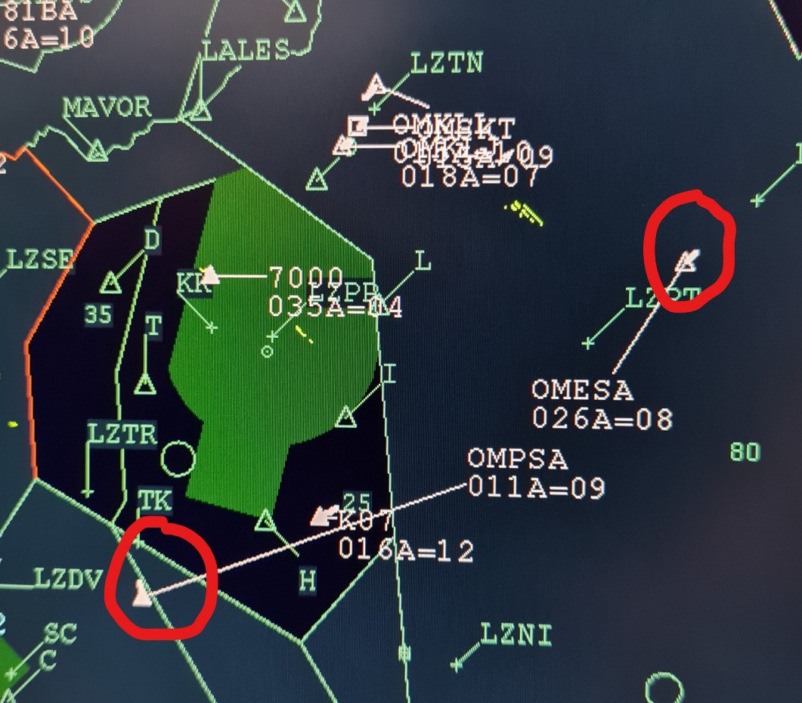
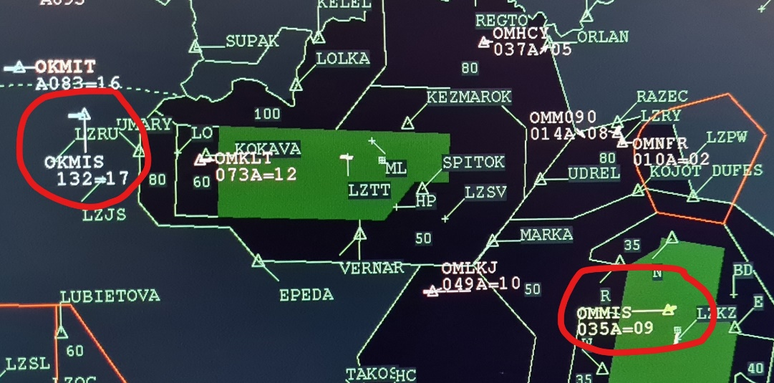
Recommendations
Do NOT shorten your callsign – short version can be used only after it has been shortenned by ATCO or FISO

Slide 8


Slide 9
Ďakujem za pozornosť
Thank you for your attention jana.bakosova@lps.sk
00421903268839

