Slide 1

Human Dimesnion in Single European Sky
V 1.0

Slide 2

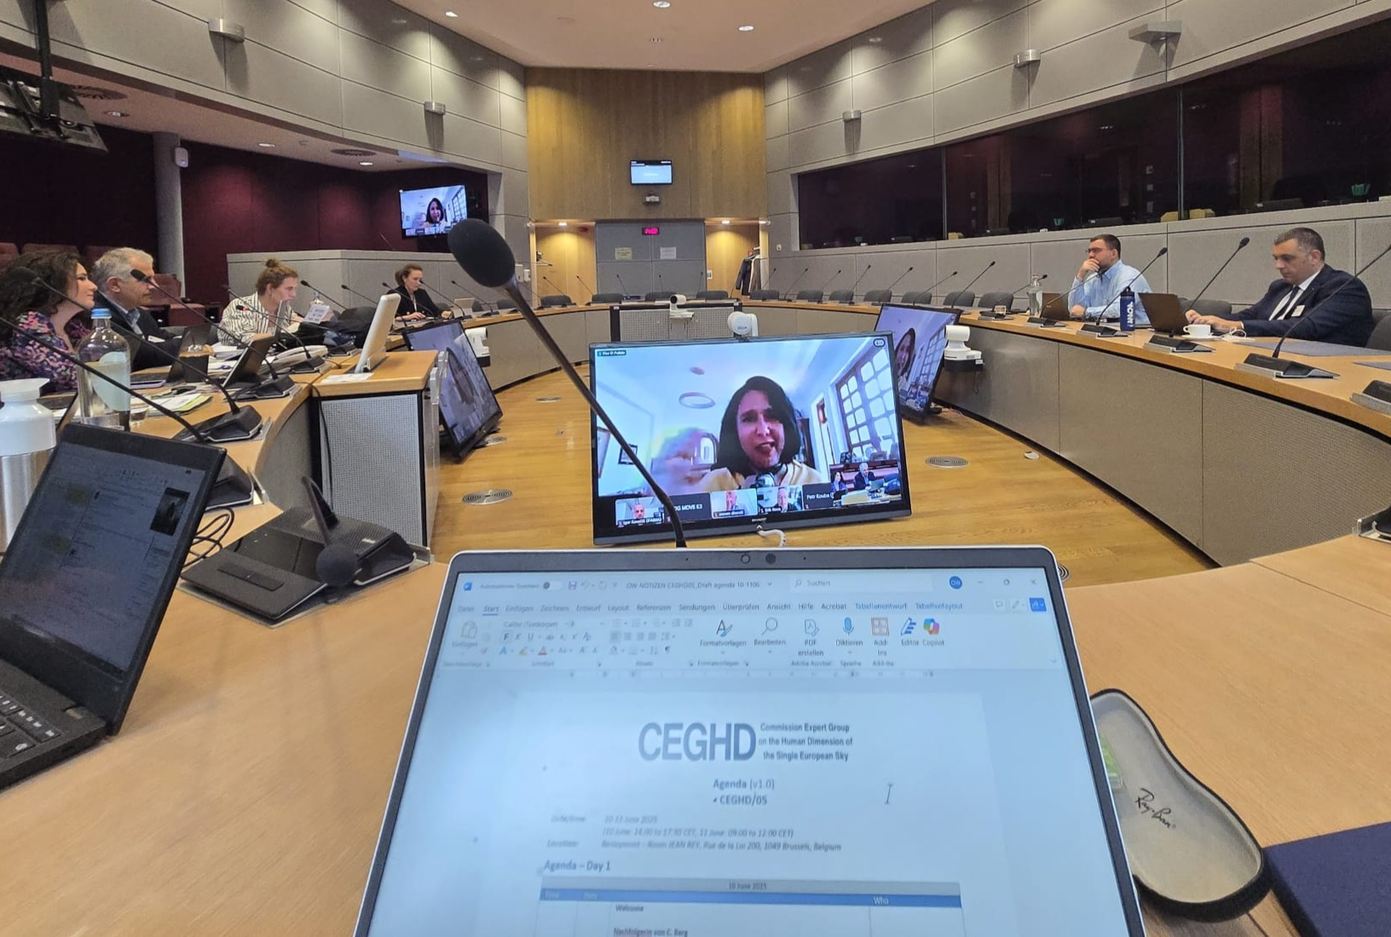

Slide 3
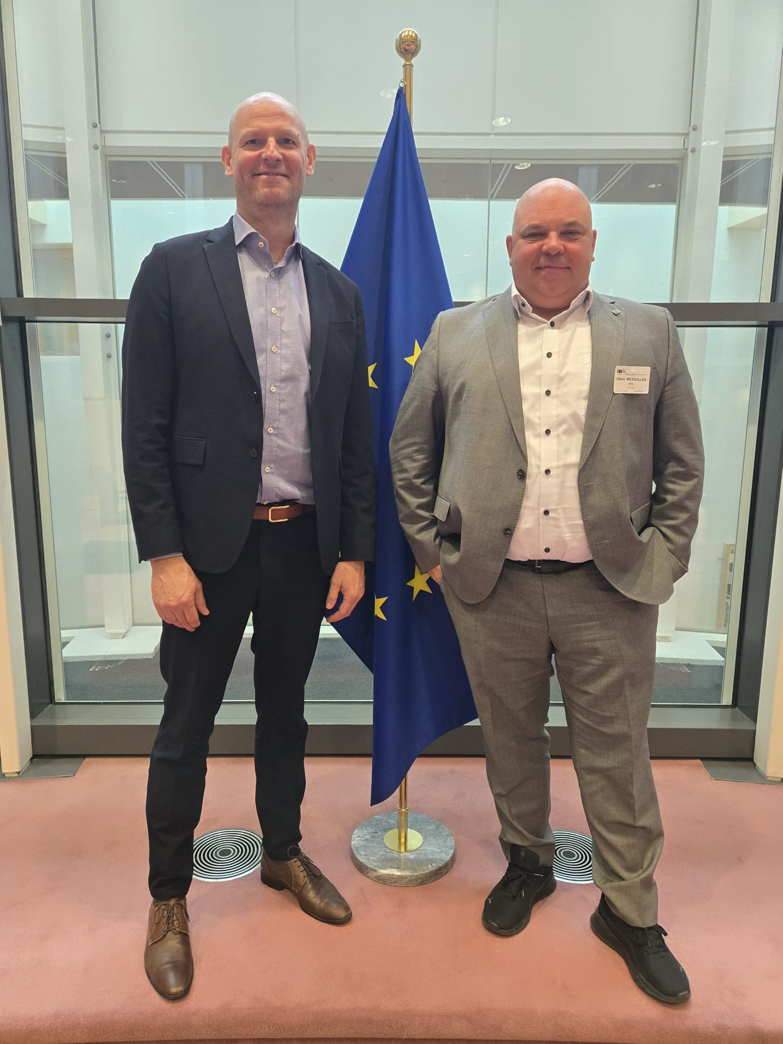
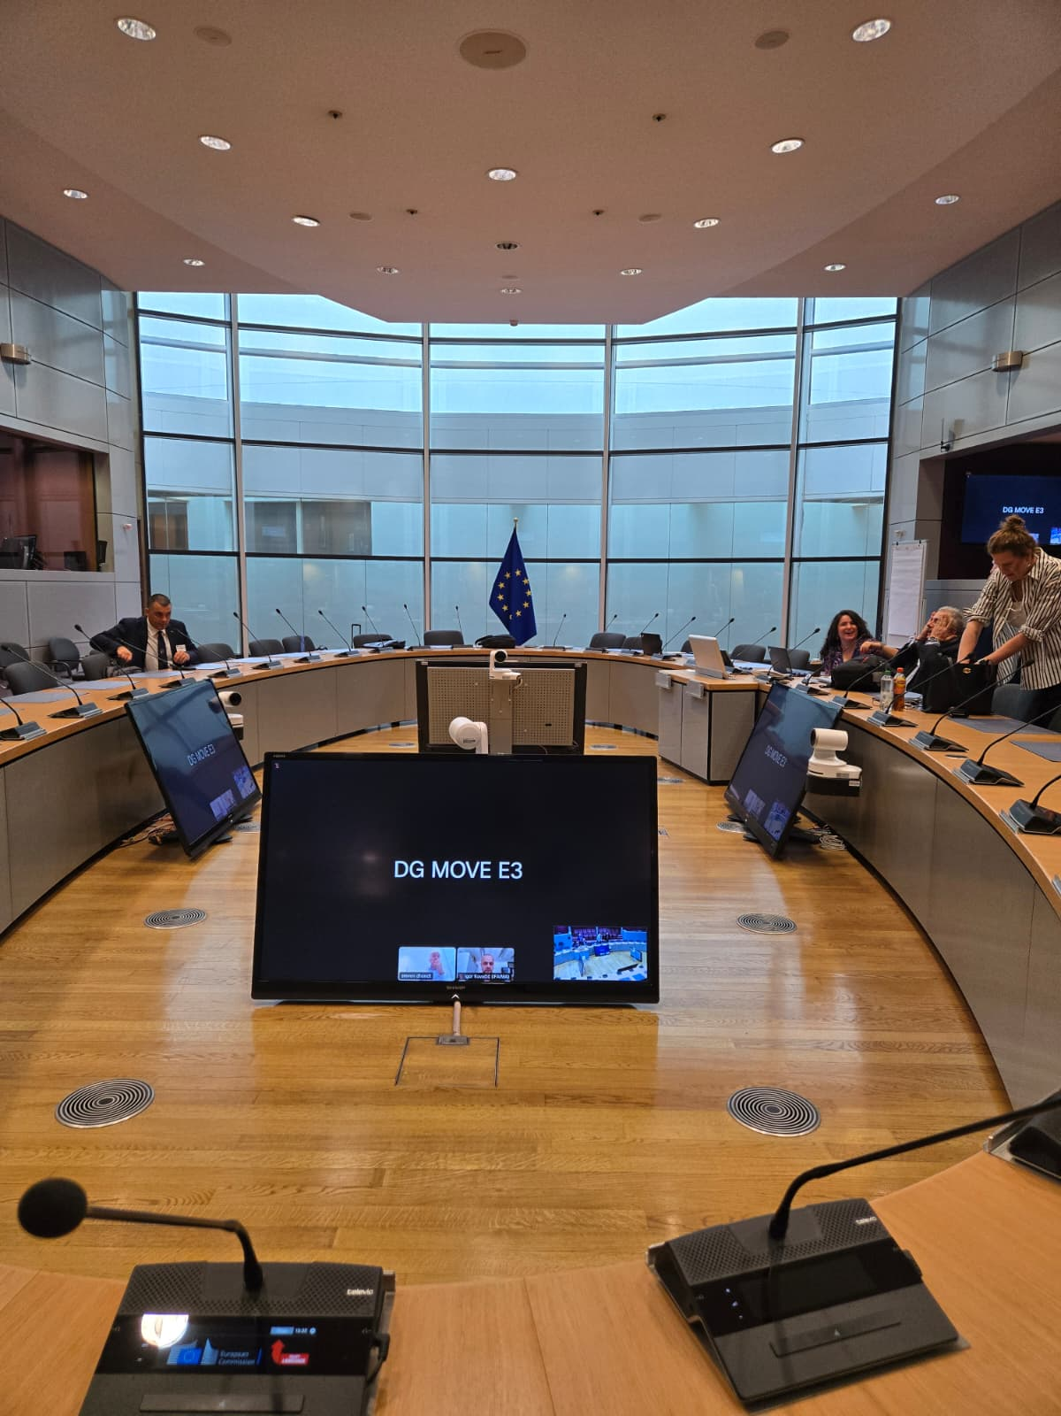
IFISA is represented by President Mikkel Drescher and Vice-President Oliver Wessollek in the CEGHD.
Meetings take place in Brussels at the European Commission premises. Travel costs will be reimbursed by the European Commission.

Slide 4
The “human dimension”
What is known as the 'human dimension' of the single European sky includes the technical and operational changes to working practices and procedures, which impact individuals and groups of actors in the implementation of the single European sky.
Working conditions and other social aspects of air traffic management are addressed in the Committee set up under Decision 98/500/EC and fall outside the scope of the group.

Slide 5
The “CEGHD Tasks”
The group’s tasks shall be:
to provide expert advice to the Commission on the implementation of the single European sky as regards measures that have significant human dimension implications;
to facilitate cooperation and coordination between the Commission and relevant stakeholders on questions relating to the implementation of Union legislation, programmes and policies on the single European sky, notably its human dimension;

Slide 6
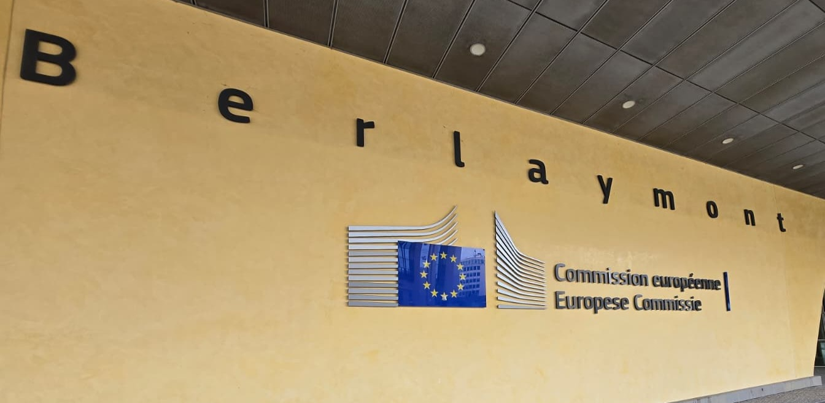
The “CEGHD Tasks”
to ensure an exchange of expertise, experience and good practice among members as regards the human dimension of the single European sky.

Slide 7
The “CEGHD Papers”
The ‘Human Dimension’ implications of the European ATM Master Plan
Human Centricity in new technology, AI and Automation and Dynamics of Efficiency
Well-being and Human Sustainability in ATM
Staff competencies management, licensing, and training (ATOS) + ATSEP)
Survey on personnel Training and Licensing (ATOS)
(ATOS includes: FISO and AMS)

Slide 8
Way ahead?
IFISA is recognised in the European landscape of aviation stakeholders.
We are invited and are cooperating with many organisations on the European Level. As a result of our committment on the aviation industry and our ongoing work IFISA is now also member of the EASC group.

Slide 9
EUROPEAN ATM STAFF
REPRESENTATIVES CONFERENCE
The principal purpose of the EASC shall be, inter alia, to:
a) promote and facilitate the sharing of information and communication between the Director General of the Agency and the European ATM Staff Representatives;

Slide 10
EUROPEAN ATM STAFF
REPRESENTATIVES CONFERENCE
The principal purpose of the EASC shall be, inter alia, to:
b) enhance communication and understanding by the European ATM Staff Representatives of the Agency’s activities in the pan-European ATM environment and of the key issues arising therefrom; and

Slide 11
EUROPEAN ATM STAFF
REPRESENTATIVES CONFERENCE
The principal purpose of the EASC shall be, inter alia, to:
c) allow the European ATM Staff Representatives to put their views to the Director General of the Agency before proposals are submitted to the Provisional Council/Permanent Commission for decision on strategic planning and implementation relating to the Agency’s activities in the pan-European ATM environment where these may have a social impact.

Slide 12
And the world?
IFISA is a multinational and worldwide Federation. The core members are in Europe. But we have members from Canada, USA, Africa and also Asia.
Our future is in the global extend of cooperation and membership. Therefore, we support any member/member association from all over the globe to establish the same cooperation and collaboration level, as we have in Europe.

