Slide 1
Updates on EASA regarding FIS/AFIS
15th International FISO Seminar, 10 September 2025, Bratislava
ATM/ANS Senior Expert Augustin Klus
ATM Standards & Implementation Section, EASA

Slide 2
Outline
EASA Rulemaking activities
ATM/ANS regulation
SERA regulation
What’s new in FIS/AFIS?
Feedback to some questions posted before seminar
EASA Standardisation activities
Scope of ATM/ANS STD inspections
Questions?

Slide 3
Aligning to SES2+ by a phased approach (1)
Step 1
RMT.0763 ‘Alignment of common requirements for ATM/ANS providers with SES 2+’
Execution by accelerated procedure i.a.w. MB Decision 01-2022
EASA develops the regulatory proposal, coordination with EC
ToR/CRD published on 11th August 2025, following MAB/SAB consultation
Scope: alignment of provisions concerning roles and responsibilities of NCA/NSA and contracted activities
Timeline
Consultation of draft Opinion with MAB/SAB, from 12th to 26th September
Includes proposed amendments to Reg. 2017/373 and related AMC/GM
Publication of resulting Opinion by 31st October (including draft AMC/GM for info)
ED Decision in Q3 2026 (subject to publication of the amending Regulation)

Slide 4
Aligning to SES2+ by a phased approach (2)
Step 2
RMT.0719 Subtask 5 ‘Regular update of air traffic management/air navigation services rules (IRs and AMC & GM)’
Scope: inter alia, ensure general consistency of EASA IA/DA and associated AMC/GM with requirements of Regulation 2024/2803 (SES2+)
Timeline (by draft EPAS 2026 Vol.II): NPA Q2 2026; Opinion Q4 2026; ED Decision 2027
Step 3
RMT.0762 ‘Creation of Part-ADS’
Scope: detailed requirements for certification and oversight of ADS providers, which will be incorporated into Regulation (EU) 2017/373 by creating a dedicated new Annex ‘Part-ADS’
Timeline (by draft EPAS 2026 Vol.II): ToR 2027, NPA 2028, Opinion 2029, ED Decision 2029

Slide 5
Highlights – Contracted activities
Specification of categories of contracted activities
Definition of ancillary activities
Ultimate responsibility of the ATM/ANS service provider on its contracted activities (impact on individual AFIS providers)
Applicability of requirements for ATM/ANS provision for both contracting and contracted ATM/ANS provider
Obligation to monitor the performance of contracted activities
Applicability of SES2+ Regulation conditions relating to principal place of business, ownership and control, and security and defence

Slide 6
Highlights – NCA/NSA
NSA responsibilities for:
financial robustness, liability, insurance cover, ownership and organisational structure
monitoring compliance with conditions in SES2+
Aligned requirements for independence of NCAs
Adequate resources and expertise of the NSA to execute its tasks
Empowerment of the NSAs to recommend enforcement measures
New attribution of responsibilities on the supervision of cross-border ANS provision
Cooperation between NCA and NSA to annually establish and maintain an oversight programme

Slide 7
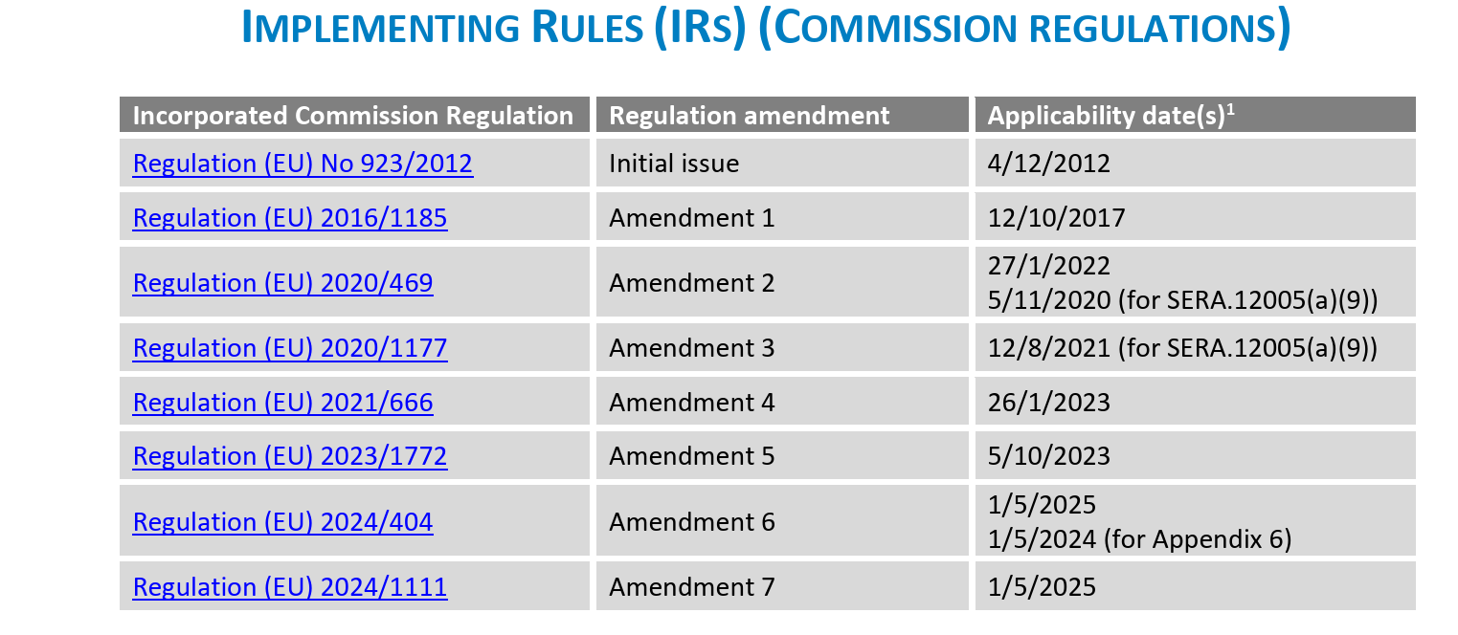
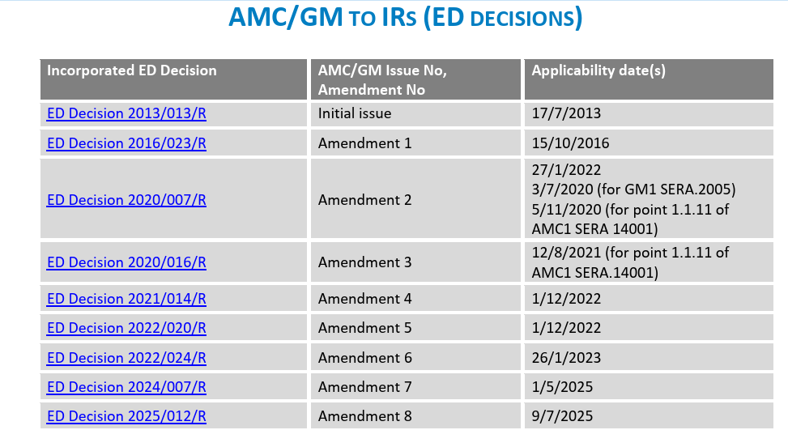
Standardised European Rules of the Air
As of 1.5.2025
RCF (SERA.14083 Radio communication failure procedures)
Amendment 7 (Reg. (EU) 2024/1111)
introduction of a regulatory framework for the operation of drones
minor SERA amendments related to the use of ‘energy’, ‘operating site’ and expansion of the FIS scope to ‘information on unmanned aircraft’ (also for Regulation 2017/373)

Slide 8
IFISA Topics:
Rules and regulations for Digital/Remote AFIS towers.
Main rule is Reg. EU 2017/373, plus EASA guidance on RT
Is multiple allowed, and if so, what rules and restrictions apply?
No restriction on multiple, but needs to be demonstrated safe operation
Development/experiences gained after EASA defined the AFIS service.
Main observations:
sometimes incorrect use of AFIS phraseology,
Clarity on the nature of AFIS vs Aerodrome ATC
Management of the movement of vehicles and persons on the manoeuvring area by AFIS
Surveillance in FIS/AFIS?
EASA view, this is not forbidden, however there should be clear instruction how AFISO/FISO can use it in the operational environment, training needed for surveillance tasks , ATCO task vs FISO task
Any development on training requirements for FIS/AFIS
No real progress made here
Any intention/plans to define Enroute FIS by EASA to uniform the service in Europe?
No clear need for amendment identified, proposals to EASA are welcome
Language endorsement for FISOs?
Left to the State decision

Slide 9
EASA Standardisation activities
Factors used when Member States determine the need for the provision of ATS.
Appropriate MET services in AFIS aerodromes.
Design of airspace structures.
Maintenance and periodic review of flight procedures.
Publication of available services and applicable differences in the national AIP.
Management of the movement of vehicles and persons on the manoeuvring area by AFIS units.
Use of the English language in the provision of FIS.

Slide 10
Thank you for your attention

