Slide 1
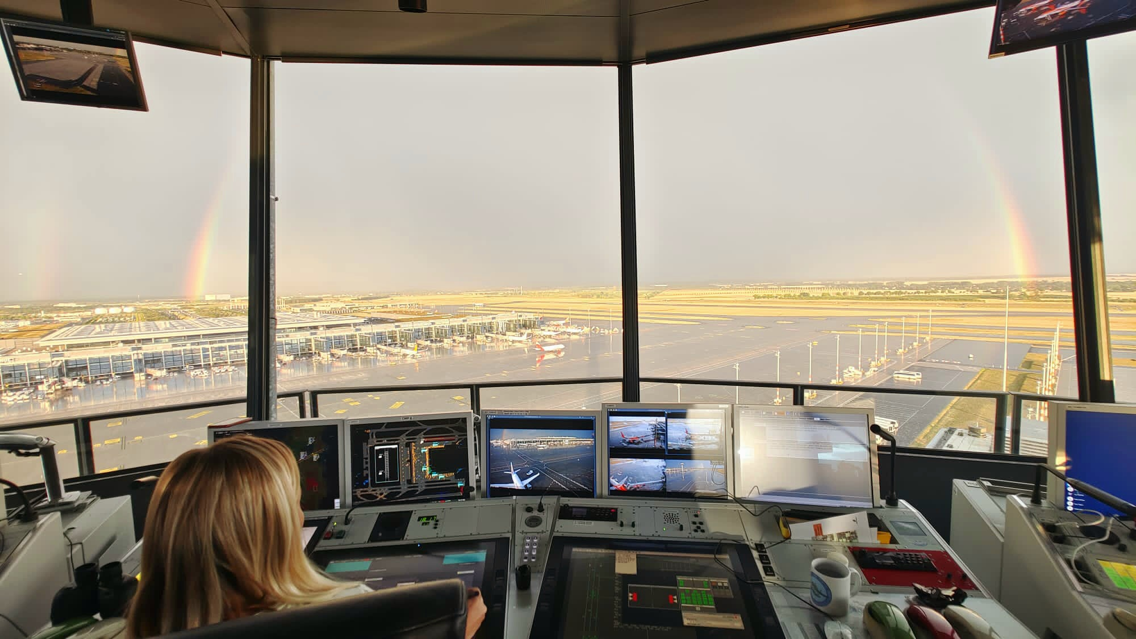
Apron Control

Slide 2
Apron Control
Agenda
What does Apron do?
Licensing & Regulation
Apron EDDB
Differences between Apron EDDB – EDDF – EDDM
→ Main Challenges and Obstacles
Movie „10 Years Apron Control EDDB“

Slide 3
Apron Control
What does Apron do?

Slide 4
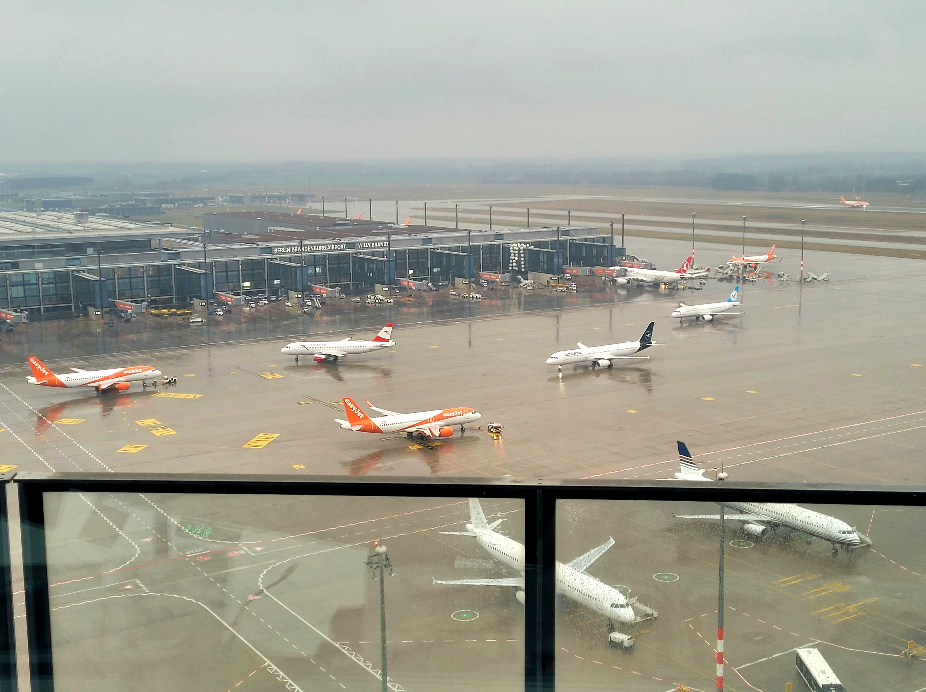
Apron Control
What does Apron do?
Managing ground aircraft movements of jurisdiction
Pushback and tow coordination
Optimizing resource allocation in cooperation with Airport Control Center
Securing smooth transition of arriving and departing aircrafts

Slide 5
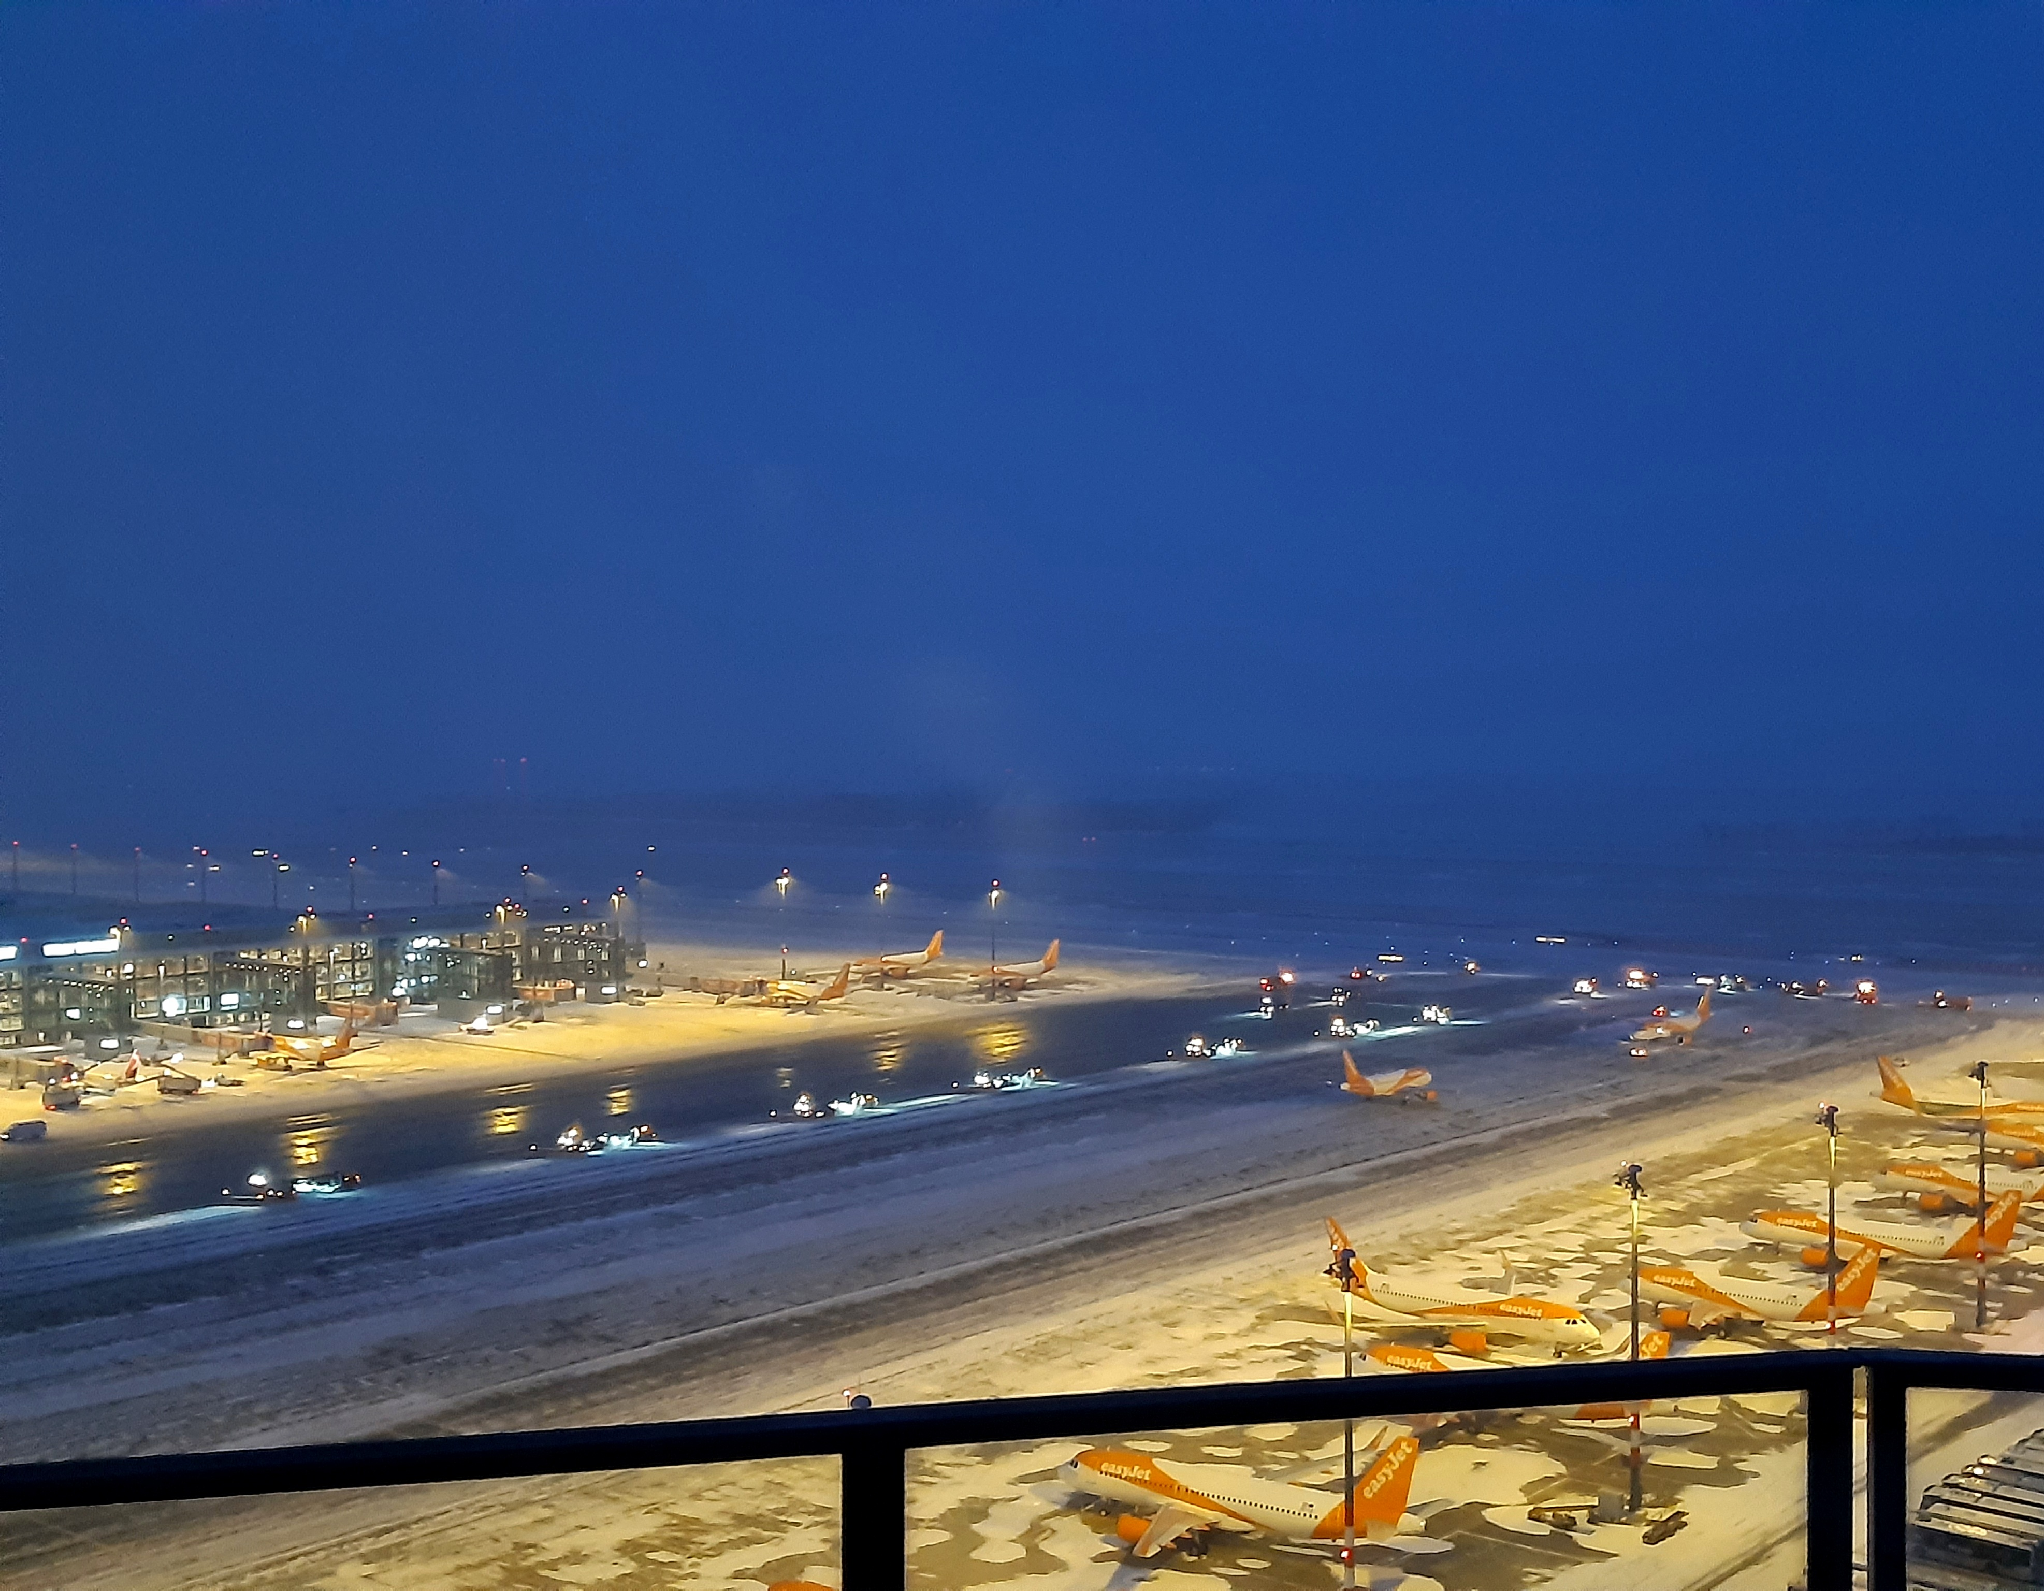
Apron Control
What does Apron do?
Monitoring ramp areas
Vehicle control
Optimizing operations at airports e. g. deicing, remote procedures
Coordination with Delievery & ATCO

Slide 6
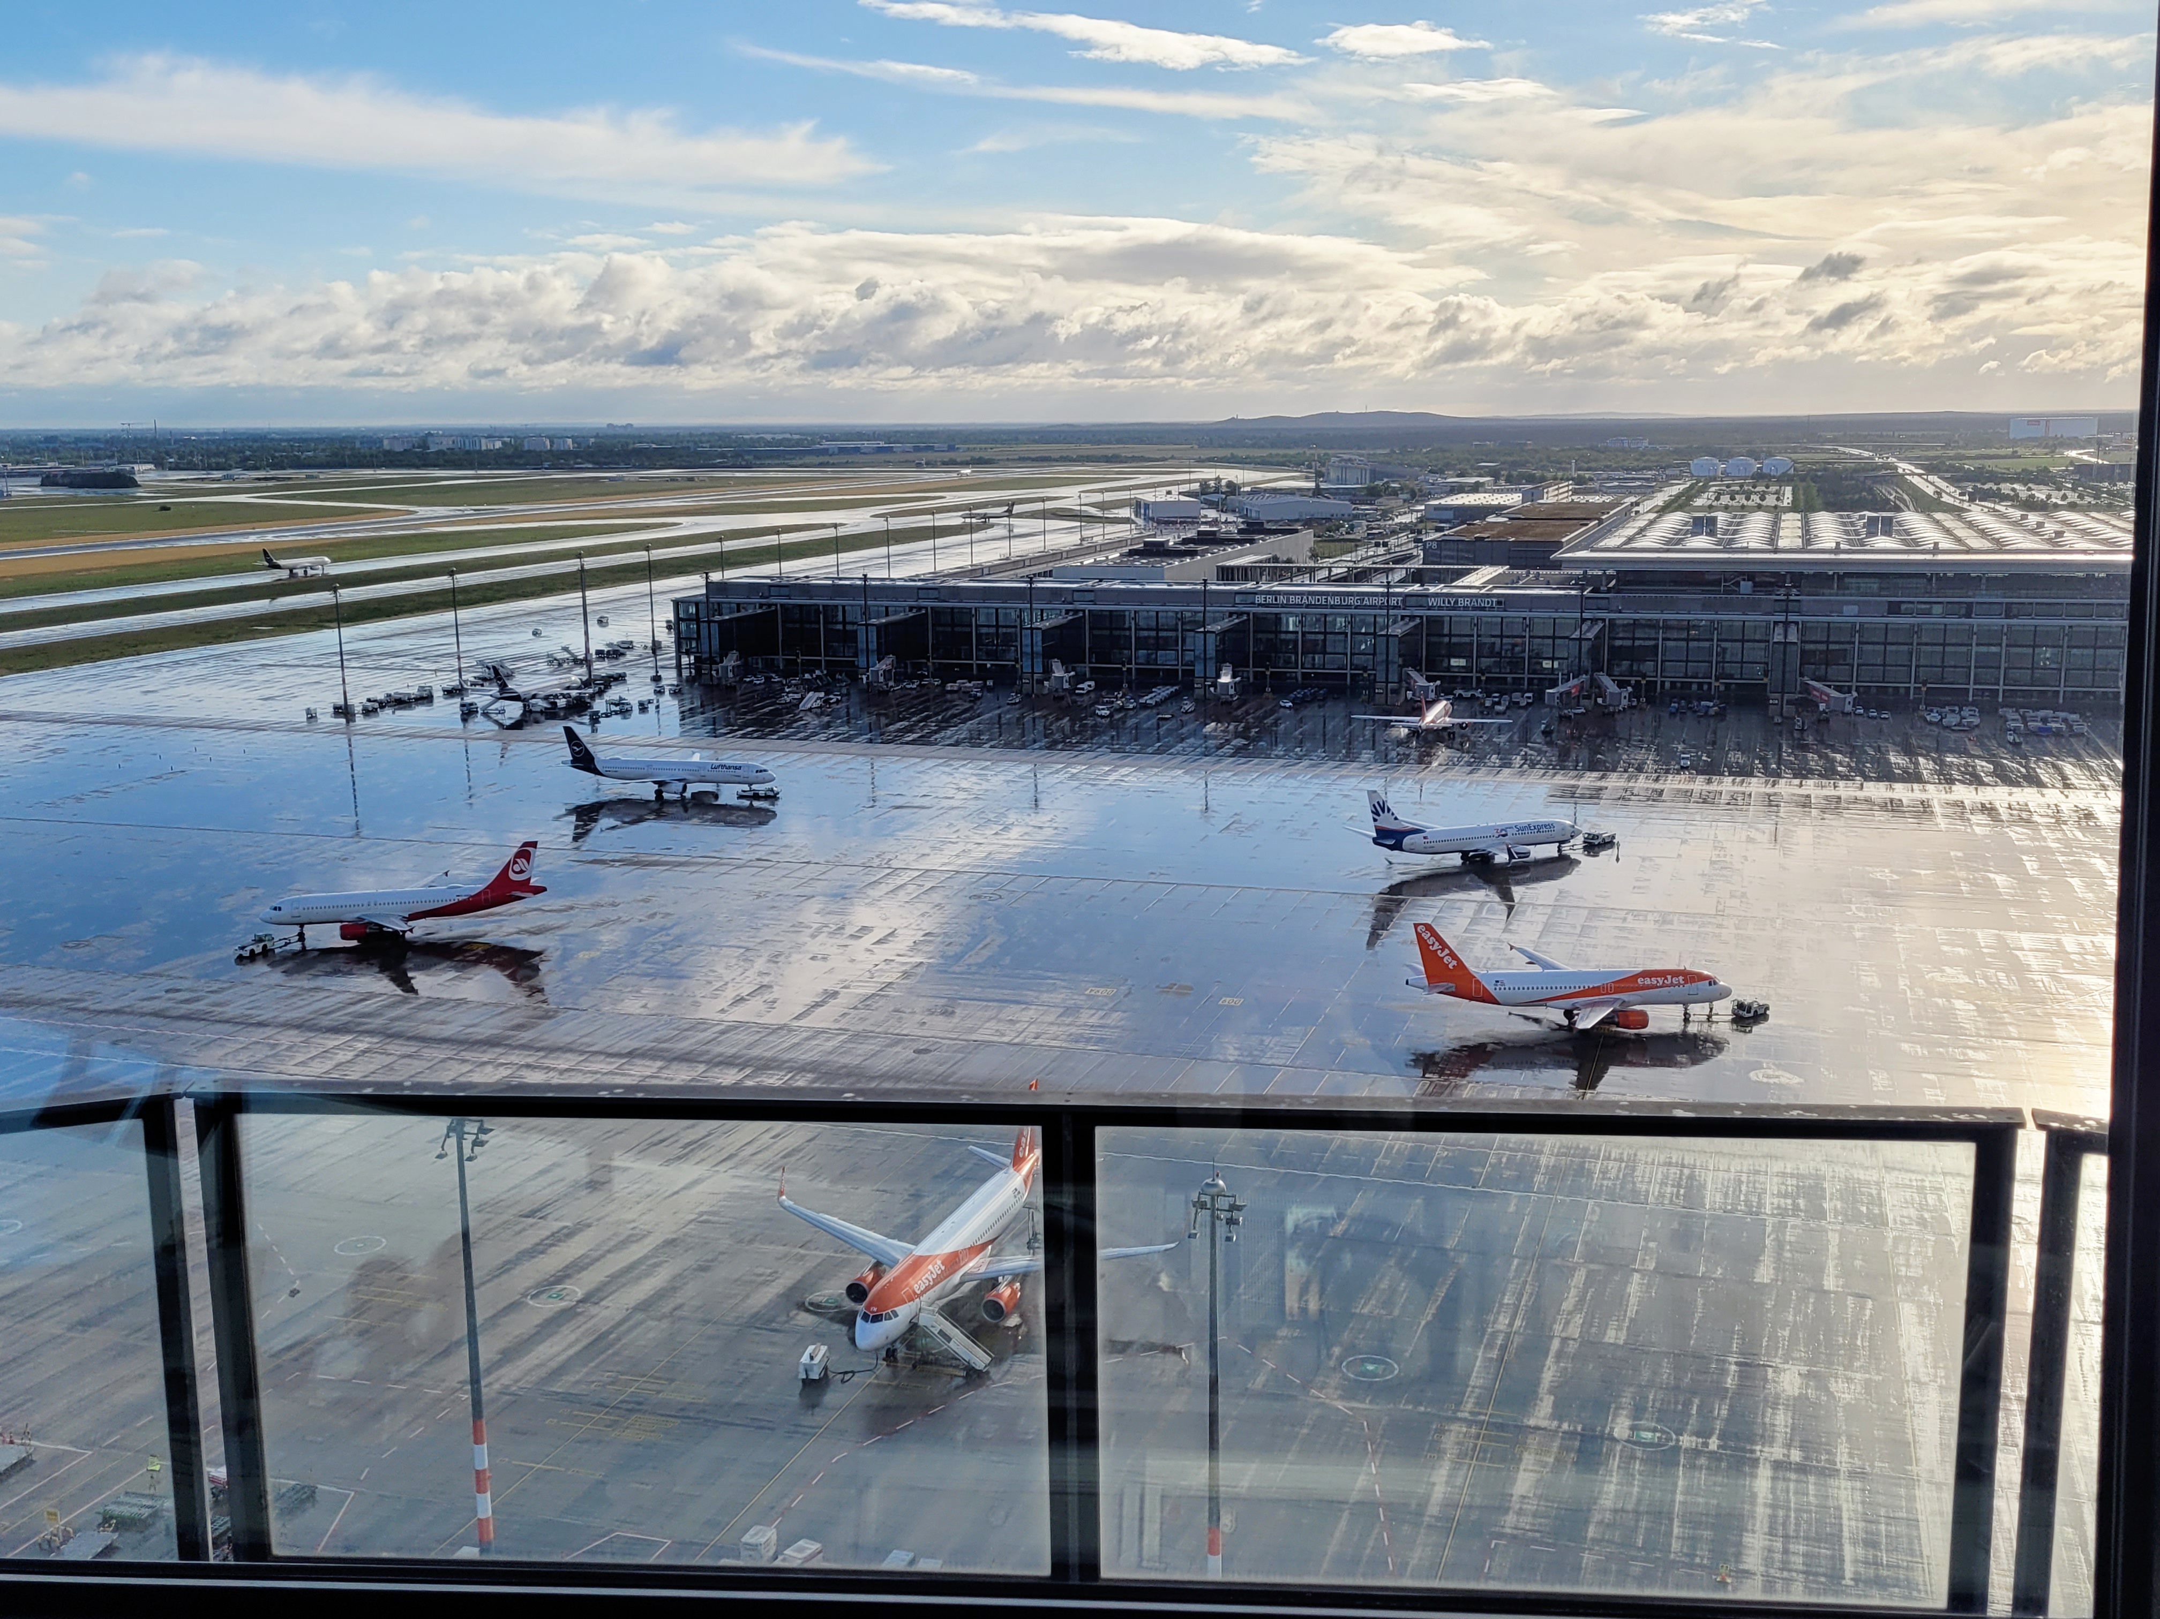
Apron Control
What does Apron do?
Mitigation of risks regarding accidents and collisions on the apron area
Focusing on efficiency and safety
Ensuring compliance with safety protocols
Customer orientation

Slide 7
Apron Control
Licensing & Regulation

Slide 8
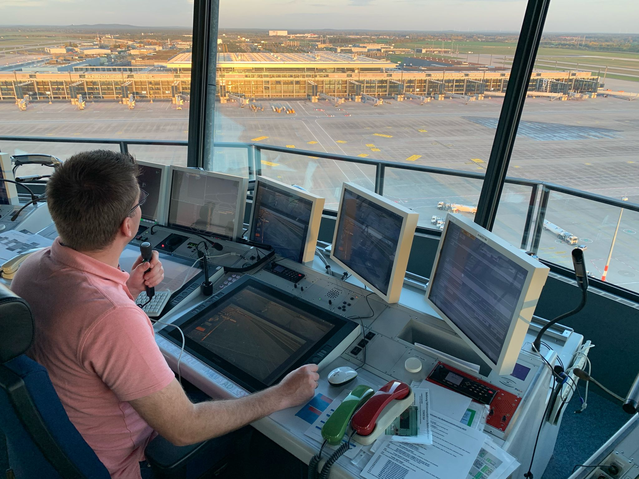
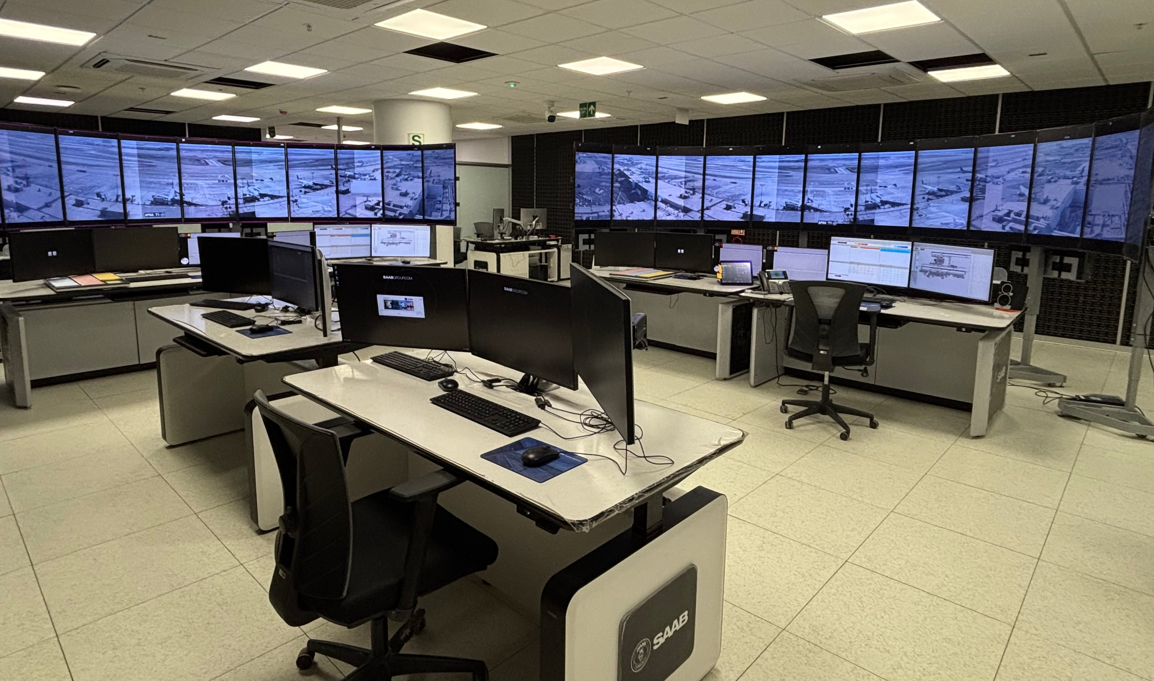
Apron Control
In General
Primary responsibility of the airport operator (Germany)
Or carried out by external providers, such as air navigation service provider (DFS/DAS)
State / Regional State Authorities
Tower and RTC

Slide 9
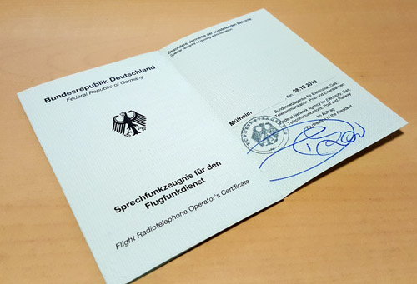
Apron Control
Licensing
No common application or licensing process compared to ATCO
Valid „General Radiotelephony Licence“, ICAO English Level 4
Partly competency-based training and assessment (CBTA)
„Medex“ every 3 years
Annual minimum proficency hours
(Annual proficency observation)

Slide 10

Apron Control
Regulation
EASA Regulation (EU) 2020 / 1234
„Apron Management Services at Aerodromes“
Written agreements between aerodrome operator and apron management service provider
Essentially regulates service requirements of apron provider, e. g.
Operating procedures (included in aerodrome manual)
Training program of personnel
Safety program
Reporting program

Slide 11
Apron Control
Apron EDDB

Slide 12
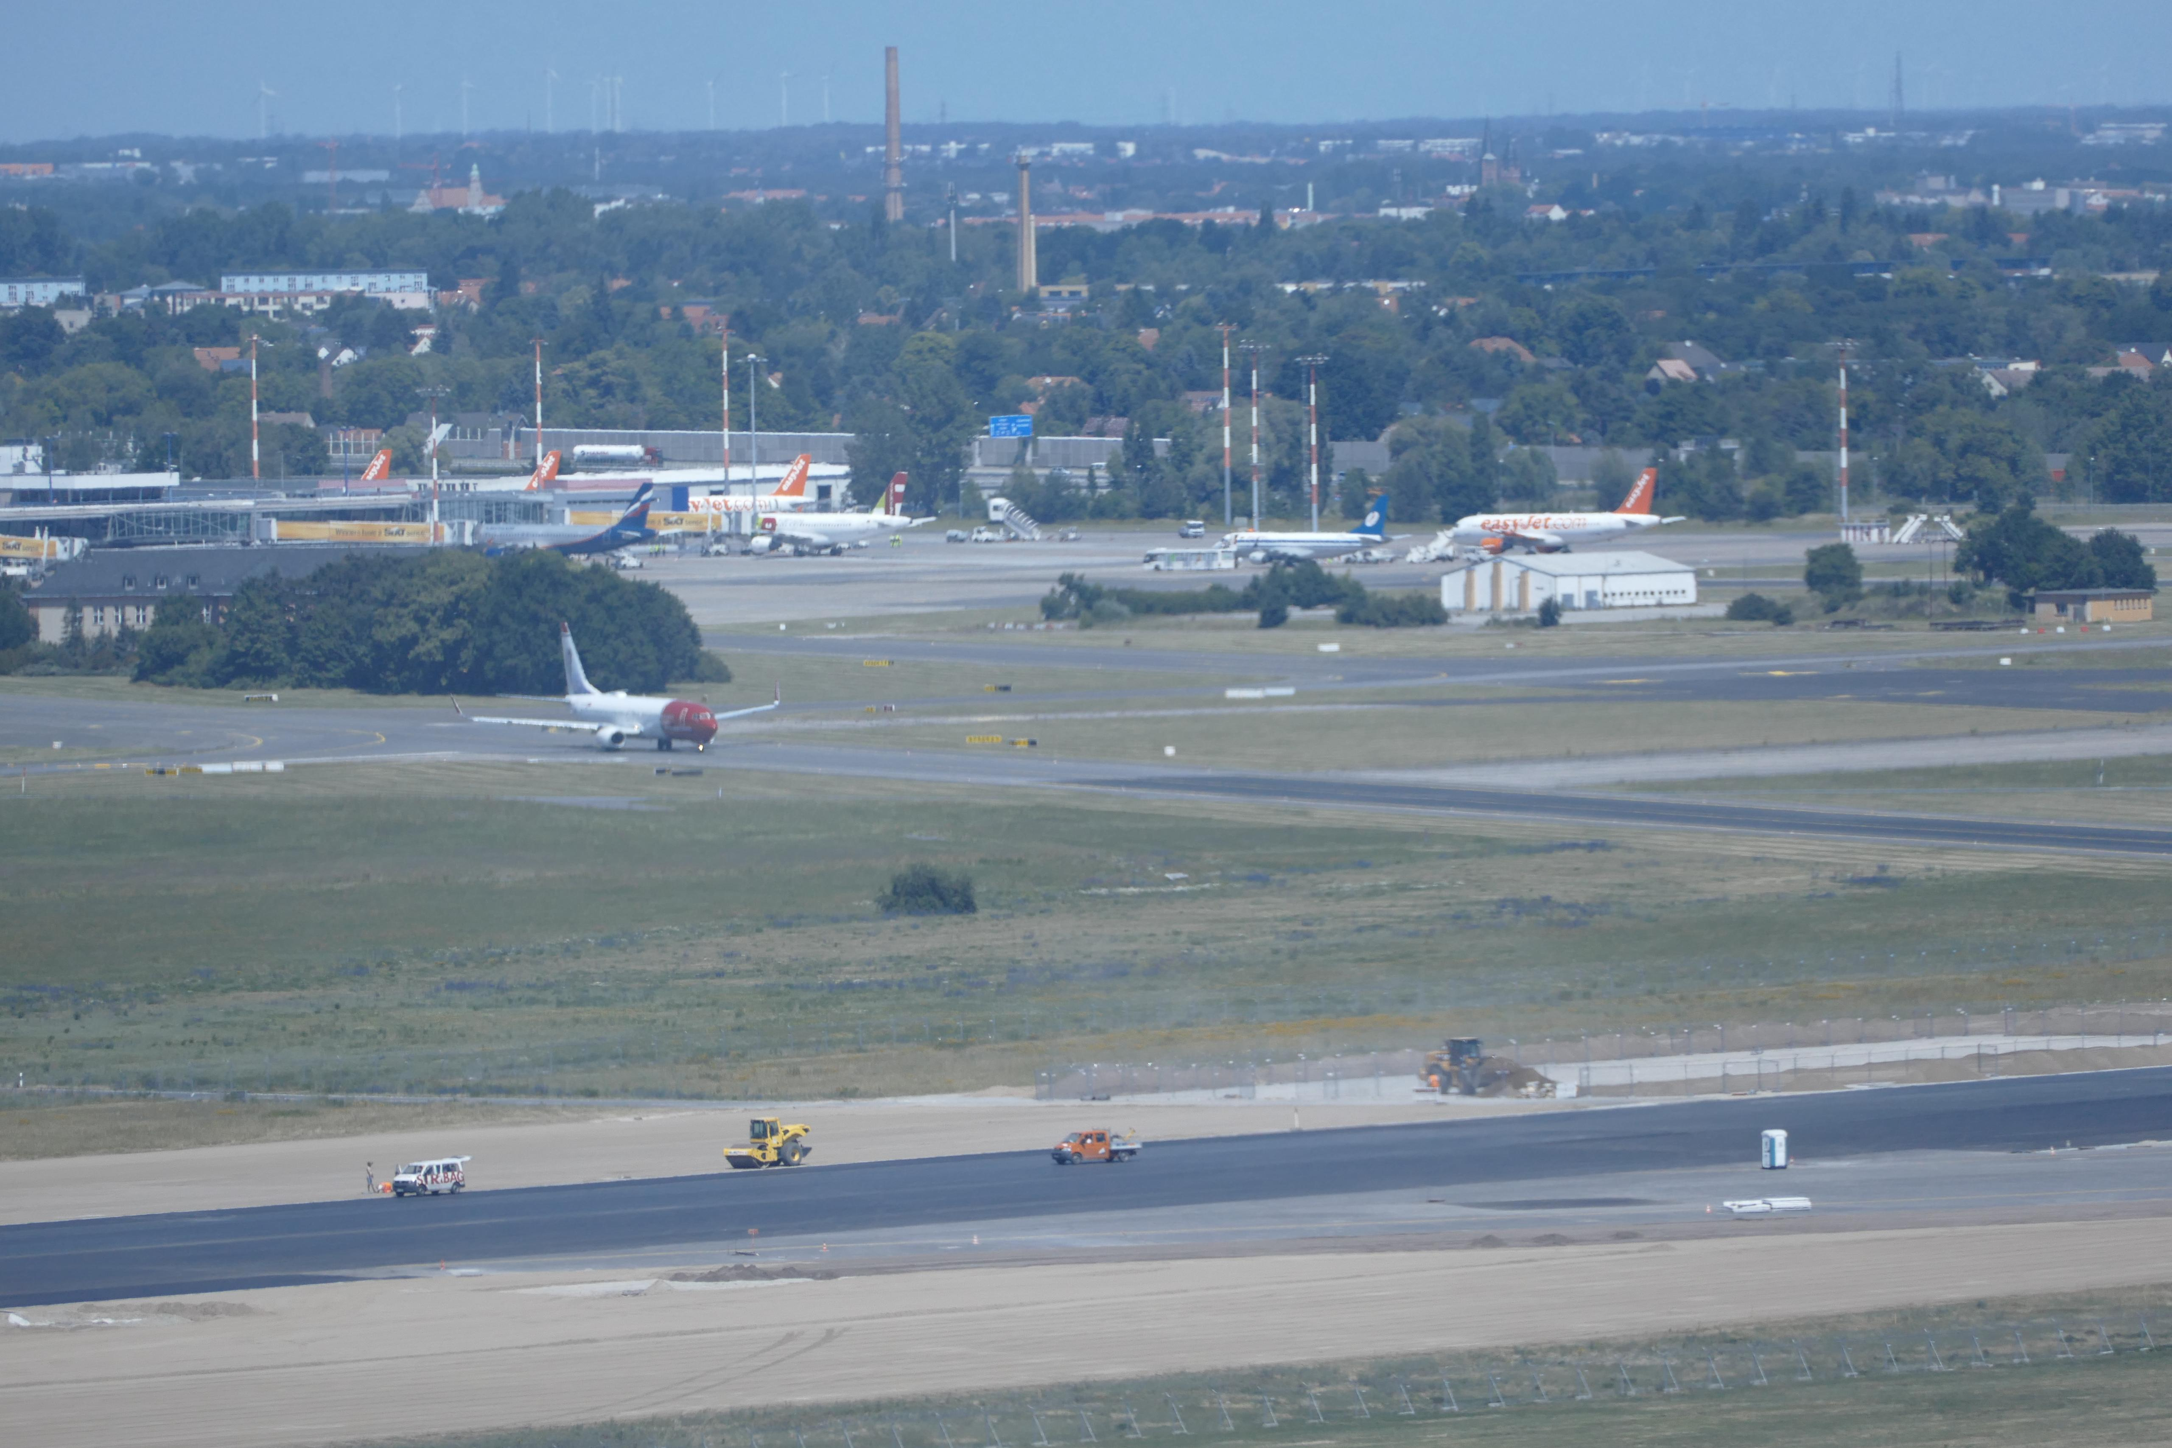
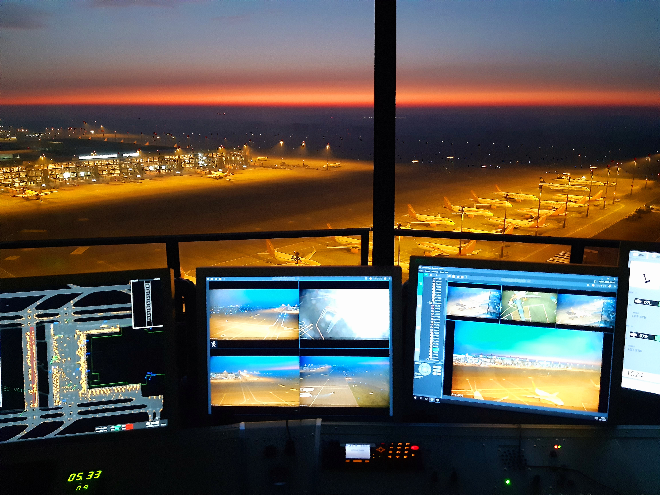
Apron Control
Short Facts „Apron EDDB“
Only apron control provided by DFS
Exists since 2011 - official operations 05/2015
Employees: once 14, today 28
Located in DFS Tower EDDB on same level with ATCO
3 working positions
VKD 1: Apron A, E & North
VKD 2: Assistence
VKD 3: Main apron

Slide 13
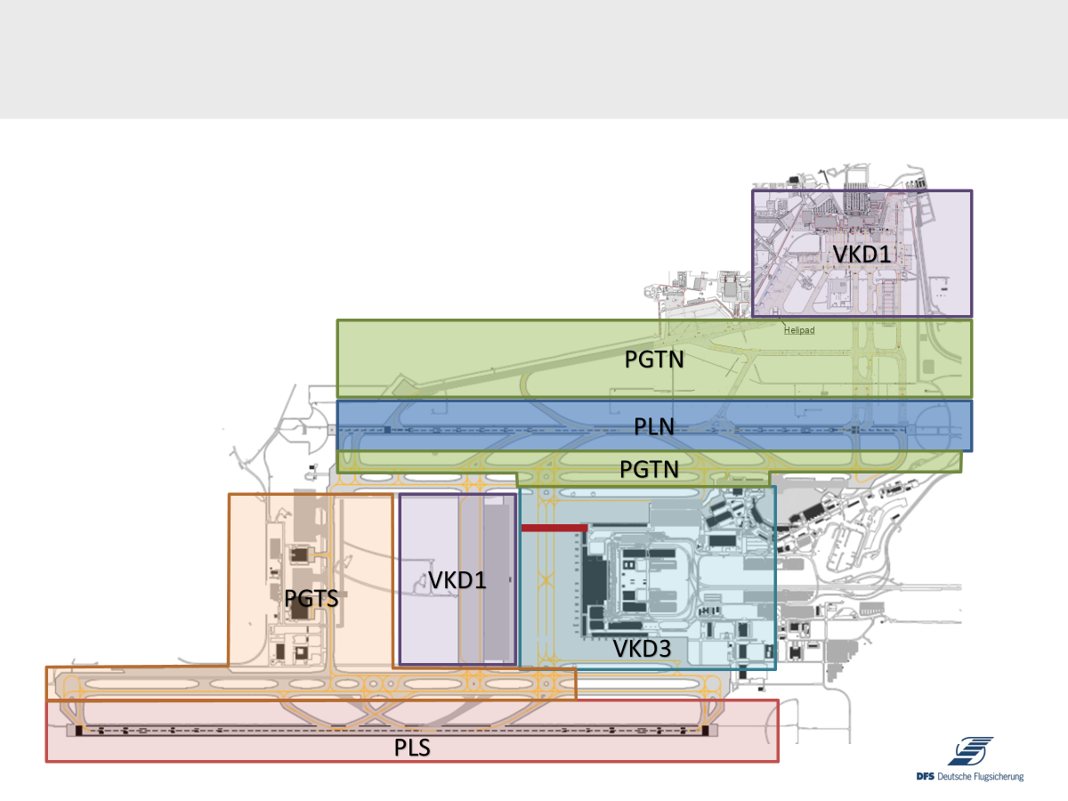
Apron Control
Layout EDDB
VKD1 – Apron A, E & North
VKD3- Main Apron
PGT N/S – Ground N/S
PL N/S – Tower N/S

Slide 14
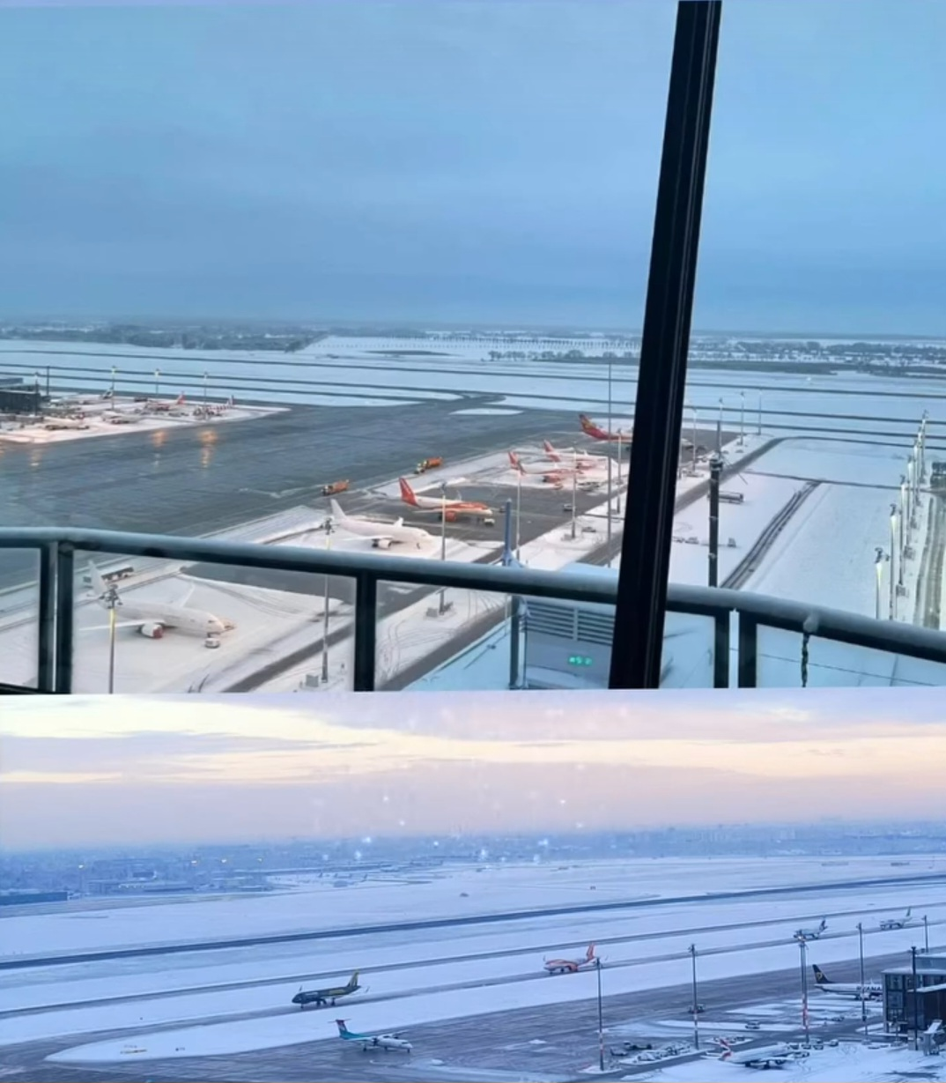
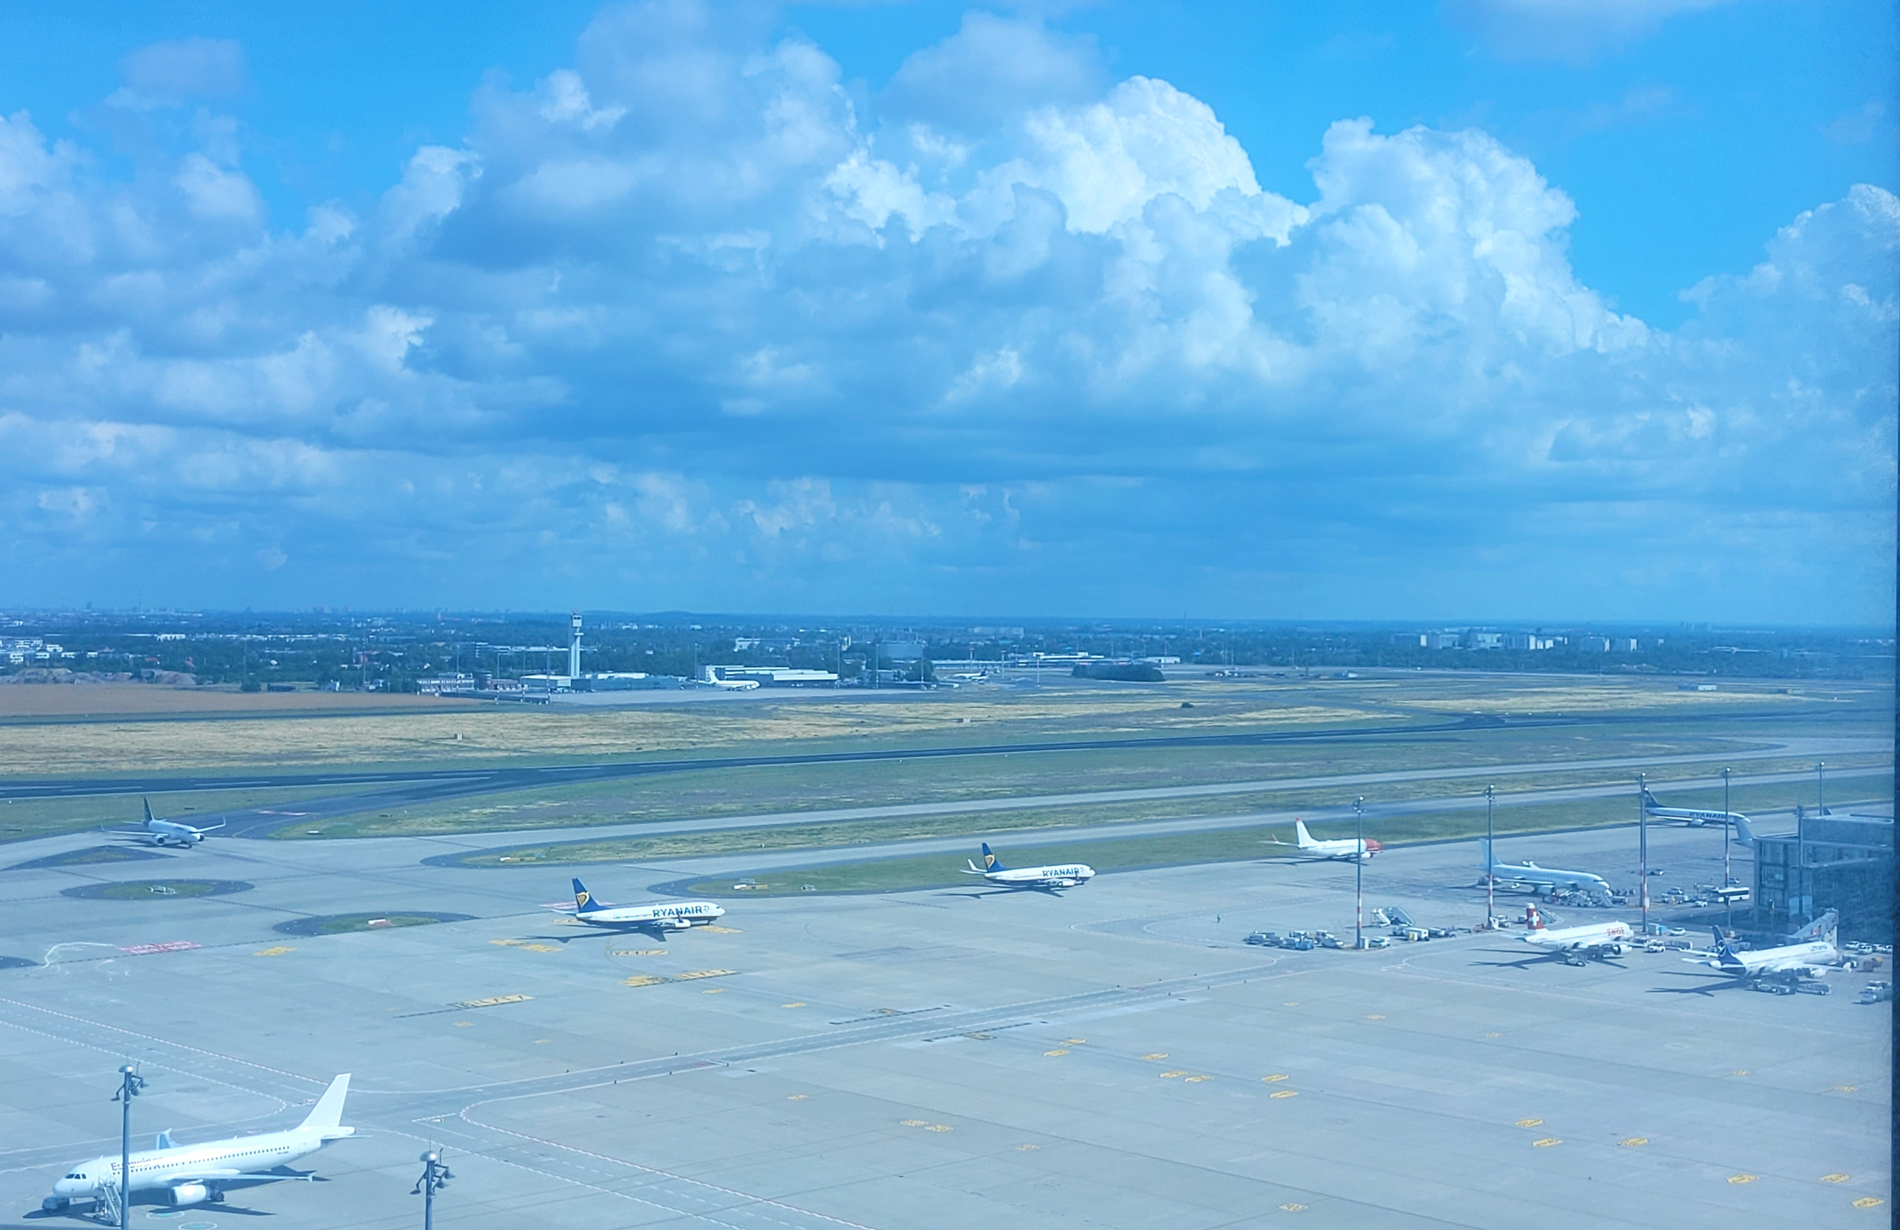
Apron Control
Working Tasks
VKD1
Apron A, E & North
Helipad
Deicing
VKD2
Assistence
Airport Communication
Reporting System
VKD3
Main Apron
Northern „Virtuel Barrier“

Slide 15
Apron Control
Differences Apron EDDB - EDDF - EDDM

Slide 16
Apron Control
 | EDDB | EDDF | EDDM
Provider | DFS Deutsche Flugsicherung GmbH | FRAVG FRA Vorfeldkontrolle GmbH | FMG Flughafen München GmbH
Traffic Movements | 191.718 | 430.436 | 327.200
Employees | 28 | ~ 90 | ~ 40
Working Environment | 1 Tower | 2 Tower (soon 3) | 2 Tower
ATC Connection | Directly | Apart | Apart
Working Positions | 3 (2x AC / 1x AA) | 7 (3xAC / 4x AA) | 6 (3x AC / 3x AA)
Assessment | Mandatory ATC / Apron/Pilot Experience Simulation Interview | General Test English Test Simulation Interview | Screening English Test Simulation Interview
CBTA | Yes | Yes | Partly
Annual Proficiency Observation | Yes | No | No

Slide 17
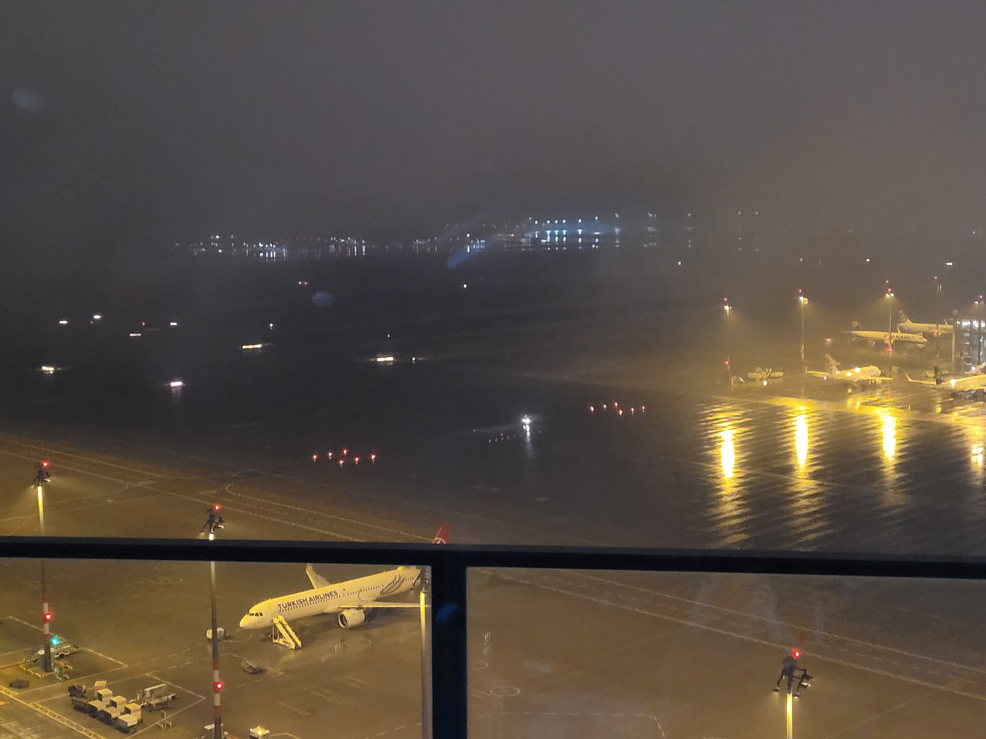
Apron Control
Main Challenges and obstacles
EDDB
Nothern „Virtuel Barrier“
→ Runway equilization
→ Low visibility
Deicing procedures
Limited airport capacity and facilities

Slide 18
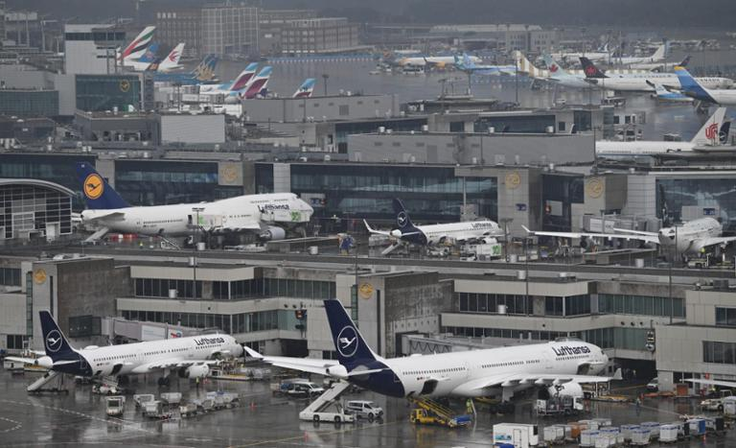
Apron Control
Main Challenges and obstacles
EDDF
Infrastructure
→ „Dead End Aprons“
Deicing procedures
High amount of tow movements

Slide 19
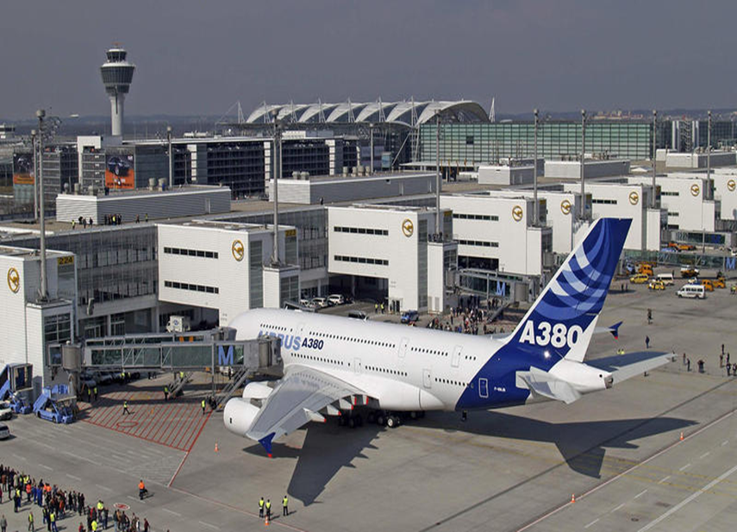
Apron Control
Main Challenges and obstacles
EDDM
Construction Work
A/C Types > C
→ All LH A380
→ Special procedures
Limited airport capacity and facilities
→ A380 on Apron 3

Slide 20
Apron Control
Video „10 Years Apron Control EDDB“

Slide 21
Apron Control
Thank you very much!

