Slide 1
Remote aerodrome advisory service (RAAS/remote afis)
Scott Hunter and Dan Horihan Canadian Flight Service Specialists (AFIS)

Slide 2
RAAS or Remote AFIS
As with AAS, the objective of RAAS is to provide information essential for the safe and efficient movement of arriving and departing aircraft
As radio coverage permits, provide RAAS on the Mandatory Frequency (MF) to aircraft departing from or arriving at a location within an MF area or transiting through an MF area where an Remote Communications Outlet (RCO) is established for providing RAAS.
RCO are established for extended communications in providing RAAS and FISE . Where RAAS is provided, the RCO frequency is designated as the MF.
Radio communication limitations may not permit complete radio coverage of all airspace and aerodromes within an MF area where an RCO is established. Any radio coverage limits are described in unit procedures.
Notes:
As with AAS, the objective of RAAS is to provide information essential for the safe and efficient movement of arriving and departing aircraft
As radio coverage permits, provide RAAS on the Mandatory Frequency (MF) to aircraft departing from or arriving at a location within an MF area or transiting through an MF area where an Remote Communications Outlet (RCO) is established for providing RAAS.
RCO are established for extended communications in providing RAAS and FISE . Where RAAS is provided, the RCO frequency is designated as the MF.
Radio communication limitations may not permit complete radio coverage of all airspace and aerodromes within an MF area where an RCO is established. Any radio coverage limits are described in unit procedures.

Slide 3
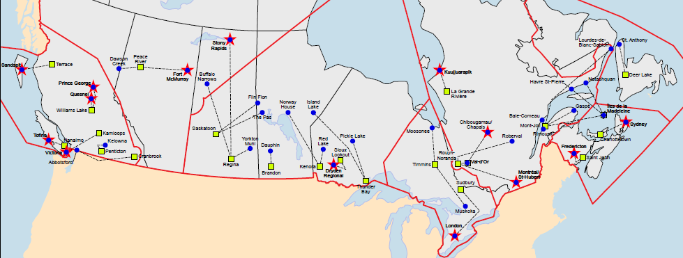
Remote aerodrome advisory service (raas or Remote afis)
NAV CANADA provides Remote Aerodrome Advisory Services (RAAS) at 38 locations across Canada. (blue dots)
These remote services are provided by 23 different Flight Service Stations (yellow squares), some of which provide services to multiple sites, including 8 ATC Towers during overnight operations.
Notes:
NAV CANADA provides Remotes Aerodrome Advisory Services at 38 locations across Canada. These remote services are provided by 23 different Flight Service Stations, some of which have multiple remote sites, including 8 ATC Towers during overnight operations.

Slide 4
Vehicle advisory service (VAS)
The objective of VAS is to reduce the potential for collision between ground traffic and aircraft on the manoeuvring area
Provide VAS to ground traffic operating on the manoeuvring area where RAAS
is provided.
When providing VAS, apply ground traffic operations procedures to the extent possible.
Provide VAS on the MF or on the assigned ground frequency, as appropriate.
At most locations where RAAS is provided, the ATS unit, aircraft, and ground traffic communicate on the same frequency.
Notes:
The objective of VAS is to reduce the potential for collision between ground traffic and aircraft on the manoeuvring area
Provide VAS to ground traffic operating on the manoeuvring area where RAAS is provided.
When providing VAS, apply ground traffic operations procedures to the extent possible.
Provide VAS on the MF or on the assigned ground frequency, as appropriate.
At most locations where RAAS is provided, the ATS unit, aircraft, and ground traffic communicate on the same frequency.

Slide 5
Vehicle advisory service (VAS)
Movement Instructions
When issuing ground traffic movement instructions:
■ Issue instructions as necessary, in plain, concise language.
■ Instruct the driver to either cross or hold short of a runway or taxiway on its route.
■ Obtain a readback of a hold or hold short instruction.
■ You may omit the route when either of the following applies:
There is only one route to the destination and no runway will be crossed.
The route crosses only one runway.
Notes:
When issuing ground traffic movement instructions:
■ Issue instructions as necessary, in plain, concise language.
■ Instruct the driver to either cross or hold short of a runway or taxiway on its route.
■ Obtain a readback of a hold or hold short instruction.
■ You may omit the route when either of the following applies:
There is only one route to the destination and no runway will be crossed.
The route crosses only one runway.

Slide 6
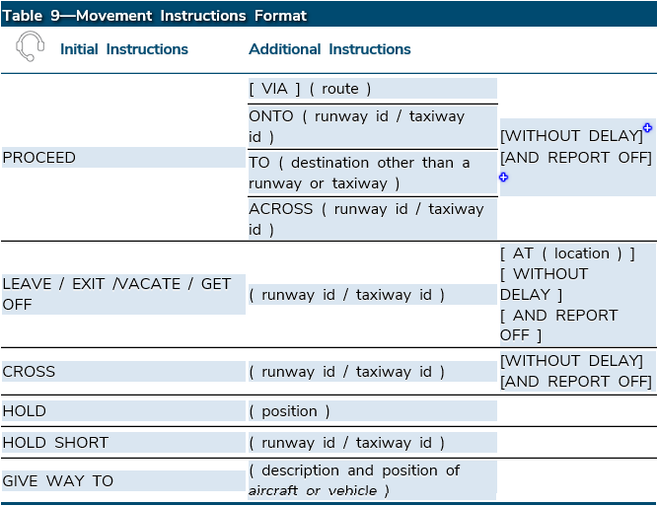
Vehicle advisory service (VAS)

Slide 7
aerodrome advisory service
On initial contact, or in sufficient time to be of use, provide advisory information to taxiing aircraft or aircraft that report ready for departure.
As appropriate, issue the initial advisory information as follows:
1. Aircraft identification
2. Unit identification
3. Runway information
4. Wind information
5. Altimeter information
6. Traffic information, include aircraft and ground traffic
7. Supplementary information. May include MANOT, wake turbulence cautionary
aerodrome conditions, weather conditions , and additional advisory information
Notes:
On initial contact, or in sufficient time to be of use, provide advisory information to taxiing aircraft or aircraft that report ready for departure.
As appropriate, issue the initial advisory information as follows:
1. Aircraft identification
2. Unit identification
3. Runway information
4. Wind information
Altimeter information
Traffic information, include aircraft and ground traffic
7. Supplementary information. May include MANOT, wake turbulence cautionary
aerodrome conditions, weather conditions , and additional advisory information

Slide 8
aerodrome advisory service
As appropriate, issue the initial advisory information for inbound aircraft as follows:
■ Aircraft identification
■ Unit identification
■ Runway information
■ Wind information
■ Altimeter information
■ Traffic information. Include aircraft and ground traffic
■ Supplementary information. May include MANOT, wake turbulence cautionary
aerodrome conditions, weather conditions+ , and additional advisory information+
■ Update advisory information, as appropriate.+
Notes:
As appropriate, issue the initial advisory information for inbound aircraft as follows:
■ Aircraft identification
■ Unit identification
■ Runway information
■ Wind information
■ Altimeter information
■ Traffic information. Include aircraft and ground traffic
■ Supplementary information. May include MANOT, wake turbulence cautionary, aerodrome conditions, weather conditions+ , and additional advisory information+
■ Update advisory information, as appropriate.+

Slide 9
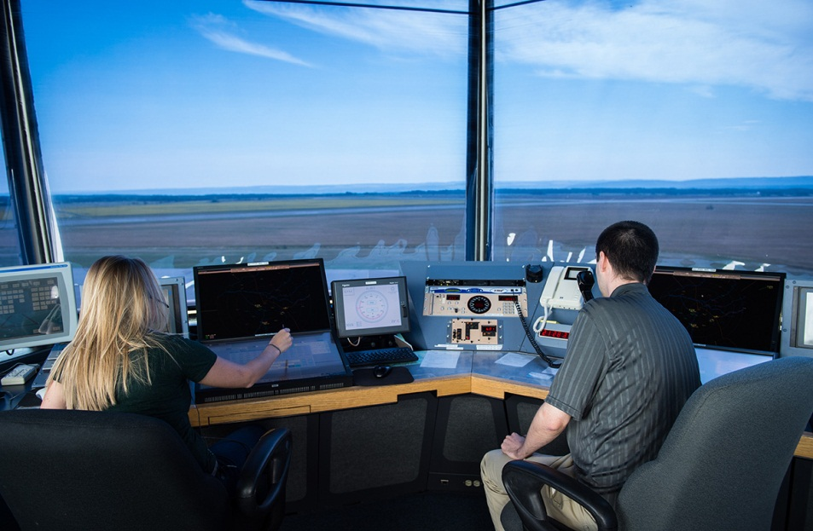
Differences between aas and raas
RAAS is a non-visual environment
VCS vs VAS
“5 minute rule” at all times
Required reports at RAAS at times for entering the runway, airborne, and exiting the runway. Surveillance assists at some sites
Reliance on contract weather observing or automated stations for weather reporting
Notes:
RAAS is a non-visual environment
VCS vs VAS
“5 minute rule” at all times
Required reports at RAAS at times for entering the runway, airborne, and exiting the runway. Surveillance assists at some sites
Reliance on contract weather observing or automated stations for weather reporting

Slide 10
“5 minute rule”
“At least 5 minutes before the estimated time of landing, instruct ground traffic to leave the intended runway or RPA”
In a RAAS or Remote AFIS environment, any vehicles on runways that have been declared for use by an aircraft MUST be removed at least 5 minutes prior to the aircraft ETA.
Notes:
“At least 5 minutes before the estimated time of landing, instruct ground traffic to leave the intended runway or RPA”
In a RAAS or Remote AFIS environment, any vehicles on runways that have been declared for use by an aircraft MUST be removed at least 5 minutes prior to the aircraft ETA.

Slide 11
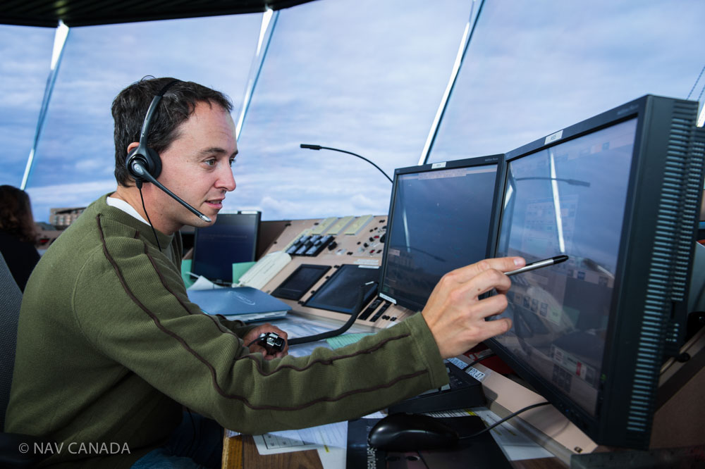
Changes to Raas operations
RAAS often occurs when a manned station closes for the night and service is required overnight.
The service is transferred to another site and operated as a RAAS
Once official transfer of responsibility procedures have been completed, the remote station provides RAAS until the morning when the service is transferred back
These operations are both safe and efficient.
Notes:
RAAS often occurs when a manned station closes for the night and service is required overnight.
The service is transferred to another site and operated as a RAAS
Once official transfer of responsibility procedures have been completed, the remote station provides RAAS until the morning when the service is transferred back
These operations are both safe and efficient.

Slide 12
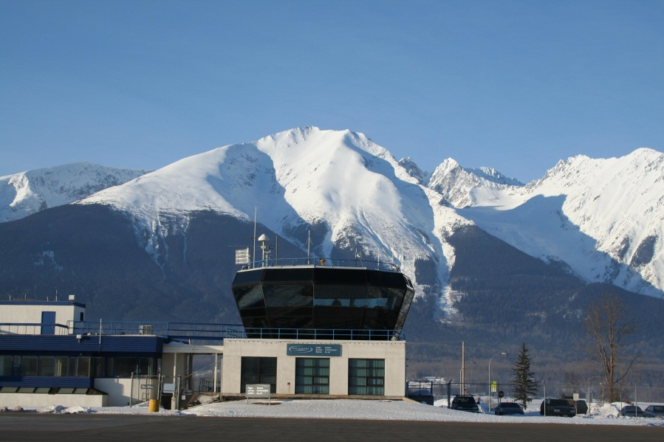
Raas operations at atc sites
RAAS also occurs at select sites when an ATC Tower closes for the night and service is required overnight.
The service is transferred to an FSS and operated as a RAAS
Once official transfer of responsibility procedures have been completed, the airspace changes from Class D to Class E
These services are currently provided for 9 ATC Towers in Saskatoon, St- Hubert, Kelowna, Prince George, Fredericton, Fort McMurray, Victoria, Thunder Bay and London.
Notes:
RAAS also occurs at select sites when an ATC Tower closes for the night and service is required overnight.
The service is transferred to an FSS and operated as a RAAS
Once official transfer of responsibility procedures have been completed, the airspace changes from Class D to Class E
These services are currently provided for 8 ATC Towers in Saskatoon, Sault Ste. Marie, Prince George, Fredericton, Fort McMurray, Victoria, Thunder Bay and London.

Slide 13
QUESTIONS?

