Slide 1
EASA update
Fabio GRASSO
EASA ATM Standards & Implementation Section Manager
IFISA Seminar
14 September 2022

Slide 2
Presentation outline
Regulation 2020/469 and FIS/AFIS related aspects
Standardised European Rules of the Air – FIS/AFIS RT phraseologies
Use of ATS surveillance systems in FIS provision
Qualification and training for FISO/AFISO
Update on relevant EASA regulatory activities

Slide 3
FIS/AFIS requirements in Regulation 2020/469
Regulation 2020/469 and related AMC/GM introduce a comprehensive set of requirements for ATS, applicable as of 27.01.22.
Requirements largely built on ICAO provisions (Annex 11, PANS-ATM, Doc 7030 EUR), adapted to EU regulatory conventions and operational context
Transposition of ICAO SARPs and PANS support their uniform application throughout the EU, hence safety of operations
Focus on FIS organisational and operational aspects (not very developed under ICAO)
Explicit reference to AFIS, not addressed by ICAO (only in Circular 211-AN/128 dated 2988)
Reminder: under EU law, FIS (including AFIS) are subject to certification
Limited certification is allowed in certain cases specified in ATM/ANS.OR.A.010, in particular for AFIS units regularly operating not more than one working position. In this case certain ATS.OR provisions only apply (i.e. technical/operational competence and capabilities, Management System, personnel requirements, open and transparent service provision)

Slide 4
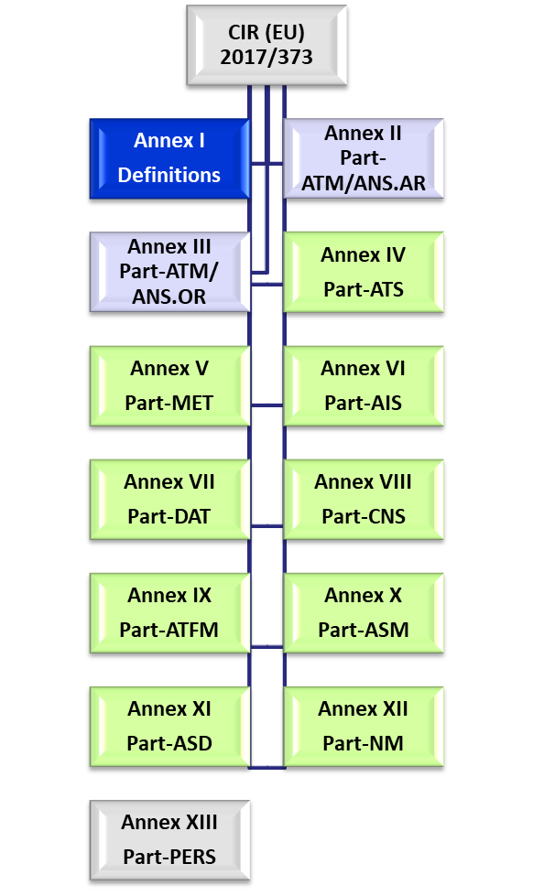
Part-ATS relevant provisions
Amendments introduced on Reg. 2017/373
New MSs’ ATS-related requirements
New ATS-related definitions
Organisation requirements - ATS providers:
Annex IV Subpart A
Technical requirements - ATS providers:
Annex IV Subpart B
Reference to ICAO ANNEX 10 Volume II, Annex 11 and SERA removed
Minor amendments to MET.OR
Amendments to SERA Regulation proposed for consistency with ATS requirements

Slide 5
Annex IV
Part-ATS
Annex IV ‘Part-ATS’ structure
Subpart A – ATS.OR
Subpart B – ATS.TR
Section 1 – General
Section 1 – General
Section 2 – Safety of services
Section 2 – ATC service
Section 3 – HF requirements
Section 3 – FIS
Section 4 – Communication reqs.
Section 4 – Alerting service
Section 5 – Information reqs.
Existing requirements with Reg. 2017/373
New requirements

Slide 6
Evolution of ATM/ANS Common Requirements
Regulation 2021/1338 and related AMC/GM
alignment of Annex V ‘Part-MET’ with ICAO Annex 3 up to its amendment 80, in particular on SIGMET/AIRMET provision by MWO, facilitation of area forecast for low-level flights;
aligns R2017/373 with R376/2014 on the reporting, analysis and follow up of occurrences in civil aviation
Regulation 2022/938 and related AMC/GM
facilitating implementation of the GRF and AWO EU requirements recently published
amendments to Annex VI ‘Part-AIS’ concerning aeronautical data catalogue, AIP structure and content, SNOWTAM definition. Addition of AWO-related definitions
RMT.0719 – Future tasks
NPA scheduled for Q4 2022. Including proposed amendments to R2017/373 to:
Cover regulation
Annex IV ‘Part-ATS’: ICAO Annex 11 Amdt. 52, PANS-ATM Amdt.9 (not RECAT ICAO!), APDSG proposals, outcomes of the ATS implementation workshop (held in June ’21), standardization outcomes
Annex VI ‘Part-AIS’: ICAO Annex 15, PANS-AIM, Annex 4
Annex VIII ‘Part-CNS’: updating references to ICAO Annex 10

Slide 7
Standardised European Rules of the Air (RMT.0476) (1)
ED Decision 2021/014/R issued on 24.11.21 – Applicable as of December 2022
Resulting from NPA 2021-05 publicly consulted
Revision of SERA RT phraseologies to introduce:
a comprehensive set of AFIS RT phraseologies for air–ground voice communications between pilots and AFIS units;
some additional RT phraseologies applicable to both FIS and AFIS to address specific operational situations; and
structural amendments to indicate which RT phraseologies are applicable when different ATS (ATC) service and/or FIS, including AFIS, are provided
‘Fast track’ regulatory action to align SERA RT phraseologies with ICAO PANS-ATM Amdt.11 ongoing – concerns ATC service provision only

Slide 8
Standardised European Rules of the Air (RMT.0476) (2)
NPA 2022-04 consulted from 25.05 to 25.08 – EASA Opinion due in Q1 ’23
Scope:
alignment with ICAO PANS-ATM Amdt. 7 to 9 (but not RECAT ICAO), regulatory consistency, safety recommendations implementation, standardization and implementation feedback
proposals on RCF and SID/STAR related provisions (ICAO PANS-ATM Amdt. 7 revised in cooperation with APDSG)
prohibition of supersonic flights over EU territory for environmental protection purposes
NPA 2022-06 public consultation from 30.06 to 30.09 – EASA Opinion by end ‘23
Scope:
introduction of a regulatory framework for the operation of drones
proposes minor SERA amendments related to the use of ‘energy’, ‘operating site’ and expands the FIS scope to ‘information on unmanned aircraft’

Slide 9
Use of ATS surveillance systems in FIS provision
ICAO and EU Part-ATS: FIS may be supported by ATS surveillance systems, to provide identified aircraft with information on:
any aircraft observed to be on a conflicting path with the identified aircraft and suggestions or advice regarding avoiding action;
position of significant weather and, as practicable, advice to the aircraft on how best to circumnavigate any such areas of adverse weather; and
to assist the aircraft in its navigation.
In respect of applicable requirements for ATS surveillance services (e.g. need for identification, continuous air-ground communication)
Eurocontrol working arrangements developing proposals to introduce supplementary provisions for EUR region – Expected to be submitted to ICAO EASPG by end 2022
EASA monitors this development for a possible amendment of existing Part-ATS provisions

Slide 10
Qualification and training of FISO/AFISO
EASA Basic Regulation does not include a specific mandate for establishing a common EU qualification/training scheme for FISO/AFISO
EU Reg. 2017/373 ATM/ANS.OR.B.005 Management system:
A service provider shall implement and maintain a management system that include a process to ensure that personnel are trained and competent to perform their duties in a safe, efficient, continuous and sustainable manner. In this context, the service provider shall establish policies for the recruitments and training of its personnel
MS/ANSPs to establish national/local arrangements for FISO/AFISO recruitment and qualification (including national licencing)
Detailed FIS requirements in EU Part-ATS and SERA (e.g. phraseologies) are the basis for training programmes, together with local procedures
Support to uniform level of safety in FIS provision throughout EU while enabling flexibility for local applications
FISO/AFISO mobility in principle not under question, subject to language requirements

Slide 11
ATCO licencing (RMT.0668)
Wave 1 - Opinion 06/2022 ‘Enhanced mobility options and streamlined qualifications for ATCOs’ published on 02.09
It proposes:
simplification of the ATCO rating and rating endorsement structure
updated ATCO basic and rating training syllabi
enhanced mobility options for instructors, assessors and student ATCOs
facilitated licensing in cases of dynamic cross-border sectorisation
a new process for crediting of military ATCO experience
Wave 2 - NPA (public consultation) scheduled for Q4/2022
Developed with RMG support, with focus on:
enhancing/harmonizing student ATCOs skills following initial training to ensure handling of complex and dense traffic situations
update of the instructors and assessors requirements
based on Covid-19 experience, enabling virtual training and enhancing the use of simulators
New process for crediting Third Country ATCO experience

Slide 12
Remote Aerodrome ATS (RMT.0624)
Further enhancement of the existing EASA Guidance based on implementation experience, research outcomes, technological innovations, regulatory consistency
NPA 2022-02 publicly consulted 02.05 – 02.08
+300 comments received, review in progress – ED Decision due in Q1 2023
Proposed further elaboration concerns:
ATCO licensing issues clarified (multiple endorsements, max 3)
ATSEP training reformulated
Daylight/night perception reworked
Voice and data recording guidance reworked
RTWR equipment usage for MET purposes clarified
New chapter on the involvement of airspace users
Migration from a conventional TWR to a RTWR
Contingency and degraded mode of operation
Better definition of local aerodrome constraints
A new chapter on socio-economic factors
Major update on human factors chapter
Major update on AIP chapter

Slide 13
Thank you for your attention!

