Slide 1
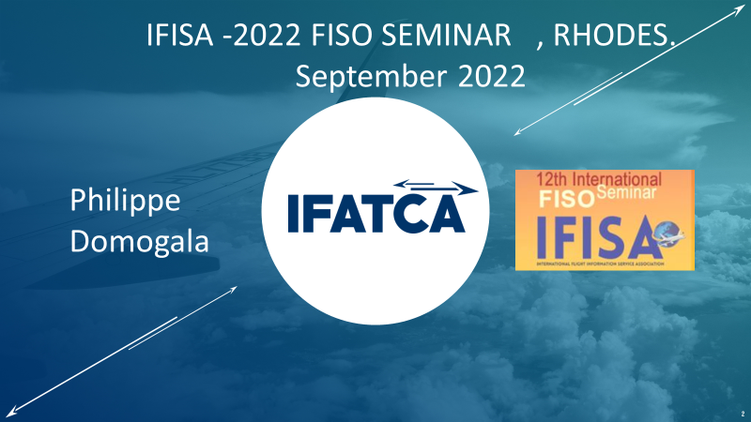
INTERNATIONAL FEDERATION OF AIR TRAFFIC CONTROLLERS ASSOCIATIONS

Slide 2
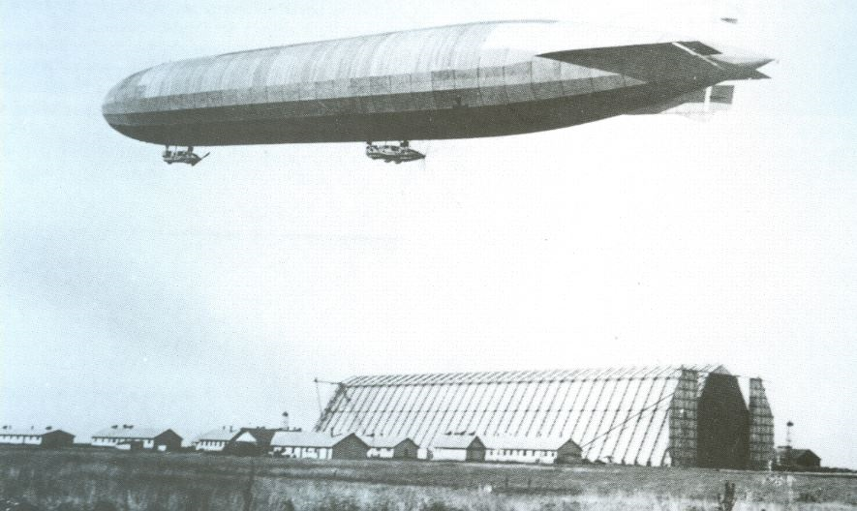
AFIS is Older than ATC
First Flight information
in 1915 The Telegraph Directorate of the Hungarian Royal Post installed and then operated a Poulsen-type GONIO-station at the airship base in Szentandrás.( 250 Km South of Budapest, today in Romania, but was part of the Autro-Hungarian Empire in 1916 ) The personnel of the GONIO station consist of civilian post officers. In January 1916 this Gonio station started radio direction finding service in cooperation with the other Gonio station in Yambol in Bulgaria some 600 Km further South, it was the first multinational agreement in aviation.

Slide 3
GONIO STATION 1916
One operator turning physically the antenna by hand to determine the direction of the transmission, another tranmitting the QDM

Slide 4
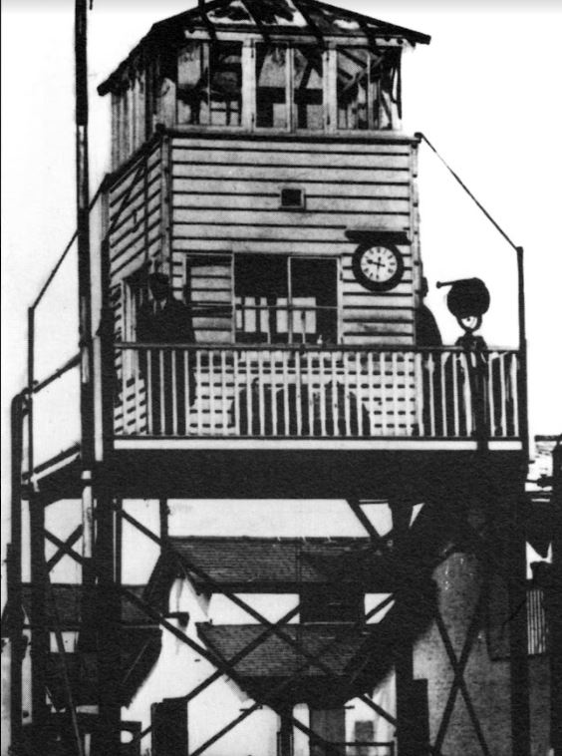
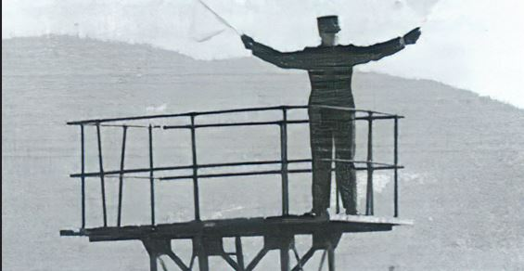
FIRST AFIS Officers : 1919
First “control Tower” London Croydon 1919
Providing weather information
and if runway was occupied or clear
for landing and take off using flags and lamps.

Slide 5
FIRST AIR TRAFFIC CONTROLLERS : 1922

Slide 6
COMMON ISSUES
LEGAL : no instructions given by IFISO but regulations and “ duty of care”
Boundary between not giving instructions according to local regulations and need to comply with the General law that obliges you to help , and prevent accidents ( DUTY OF CARE ) is not simple. Even more for AFISOs than for ATC.
FATIGUE /STRESS
REMOTE TOWERS . Multiple airports served by a single person .

