Slide 1
Centralized FIS and EKOFIS
Langen, 10. September 2022

Slide 2
Agenda
Centralization of FIS in Germany
History, Airspace, CWP, Statistics, Barriers, Benefits
EKOFIS
Necessity, Development, Training, Updates, Future development

Slide 3
Centralization of FIS

Slide 4
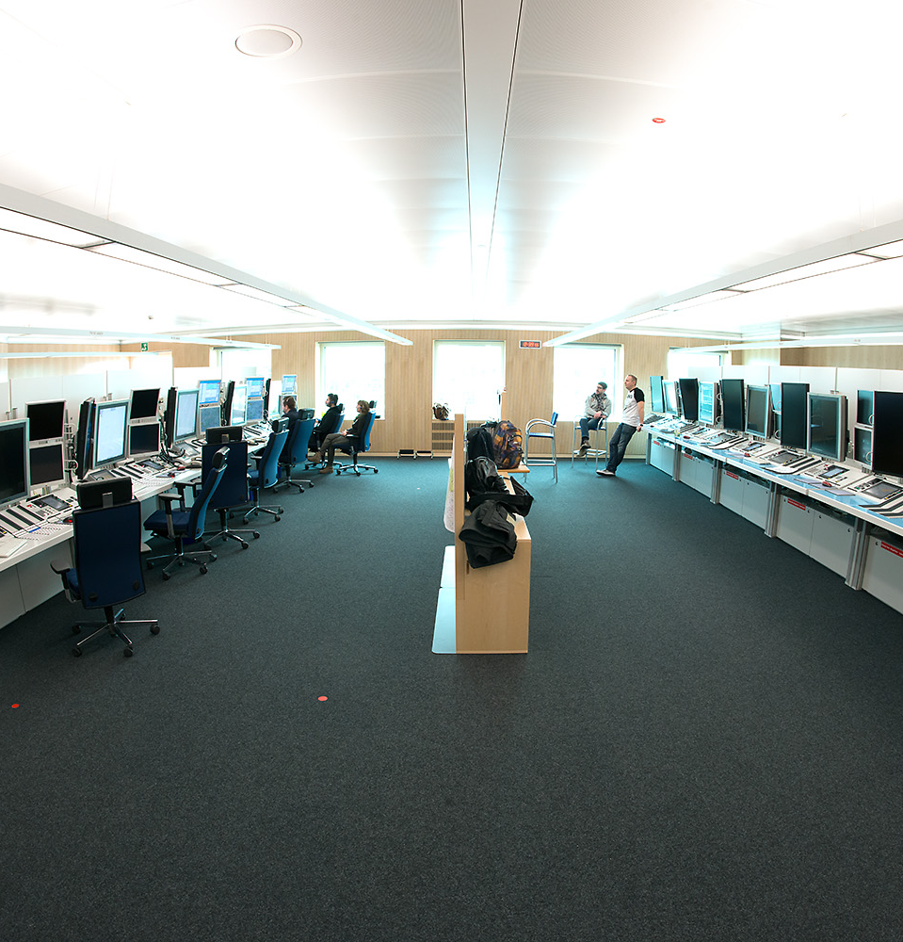
History of Enroute FIS in Germany
Until 1999 operated by ATCOs
1999 – 2018/2019 operated by FISOs in ACC Bremen, Langen and Munich
December 2016 Langen FIS moves to new Controlroom
March 2018 Munich FIS moves to Langen
March 2019 Bremen FIS moves to Langen
Since 28.03.2019 operated by FISOs centralized in Langen
2020 Implementation of EKOFIS
2021 Connection of FPL-Data to EKOFIS

Slide 5
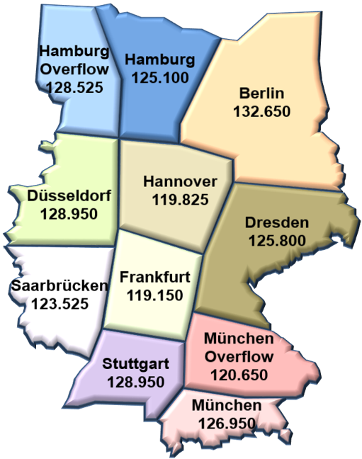
Organization
9 Sectors (+ 2 Overflow)
Opening Hours
Winter: 06:00 – 20:00 CET Sommer: 06:00 – 22:00 CEST during night time monitored by ATC
or
broadcast of alternative frequencies
35 FTE incl. SV
5 Supervisor

Slide 6
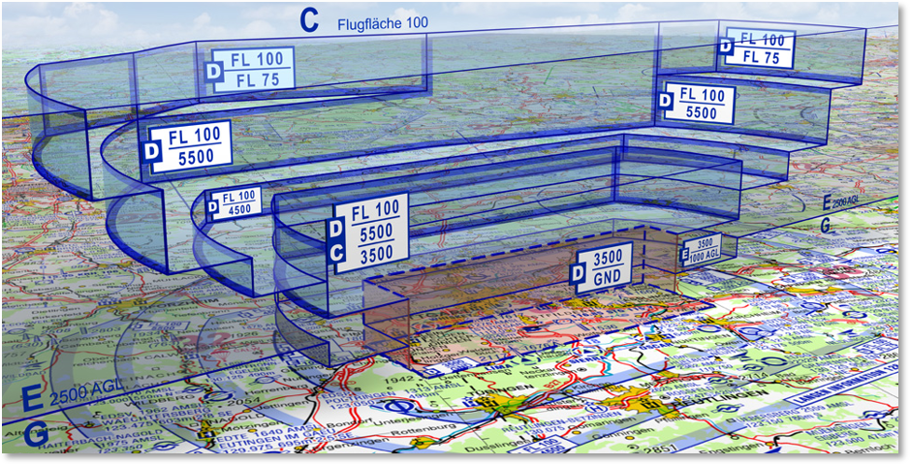
Airspace

Slide 8
ATCISS
Radarschirm
Internet
Radarschirm
Telefon + Frequenzen
EKOFIS

Slide 9
PEAK: July 2022 55.823 contacts

Slide 10
Benefits
Flexible deployment of staff
Uniform information level
Uniform equipment
Supervisor FIS available
Establishment of standards simplified
Integrated learning database (C/S – Aircraft)
Barriers
Close contact to all ACCs is affected
High amount of incidents

Slide 11
EKOFIS

Slide 12
EKOFIS
Electronic C(K)ontrolstrips FlS
System for creation and passing on of controlstrips
Developed by DFS
Originally developed for TWR use
Implementation December 2020
Connected to flightplan data 2021
Input to WACOM via PEN

Slide 13
Why EKOFIS?
Centralization increased the quantity of sectors
Handover of information became difficult
Possibilities showed up due to system development in ATC
TWR-System proved to be most flexible solution
Only configuration necessary
Integrated interfaces useful for future development

Slide 14
EKOFIS
Digital transformation within FIS
Before
After

Slide 15
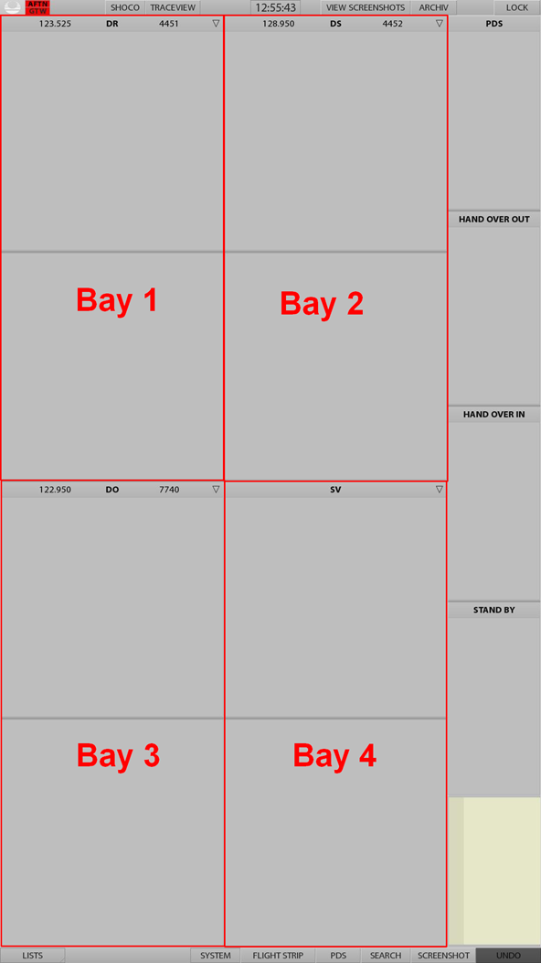
EKOFIS
Paperless stripsystem for FIS
EKOFIS allows to work up to 4 sectors combined (4 Bay layout with two-part setup)
Additional bays provide space for incoming and outgoing strips from and to other FIS sectors (HAND OVER IN and HAND OVER OUT) or temporary storage (STAND BY)
A scribble field allows handwritten notes
PDS strips (placard data set) are used for arrangements or otherwise important information

Slide 16
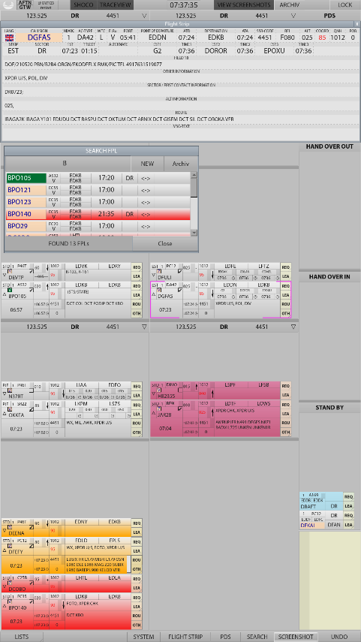
EKOFIS
Paperless stripsystem for FIS
AFTN gateway to receive flight plans and flight plan associated messages
Data exchange with AIS-C is planned in order to send flight plan and flight plan associated message.
Increased automation in flight plan processing and reduced workload

Slide 17
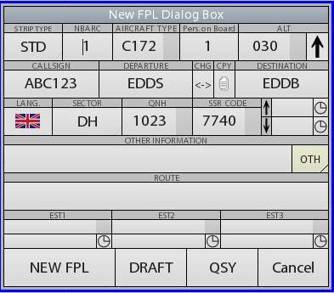
EKOFIS
Paperless stripsystem for FIS
If no flight plan is available,
strips are created via a menu dialog
(NEW FPL Dialog)

Slide 18
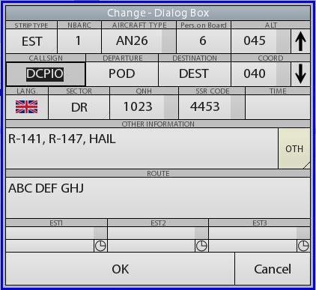
EKOFIS
Paperless stripsystem for FIS
Changes can be made by clicking on designated entries or fields on the flight progress strip
or via the Change Dialog Box

Slide 19
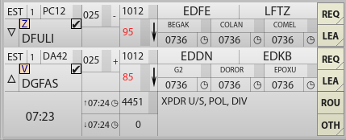
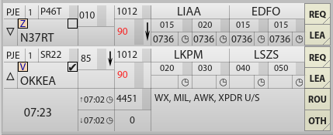
EKOFIS
Paperless stripsystem for FIS
EKOFIS provides different strip layouts and a reduced (standard) and a full data display
Standard
Estimate
PJE

Slide 20
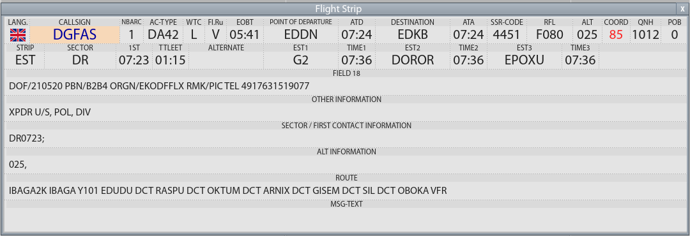
EKOFIS
Paperless stripsystem for FIS
A flight strip overlay provides all information listed in the flightplan

Slide 21
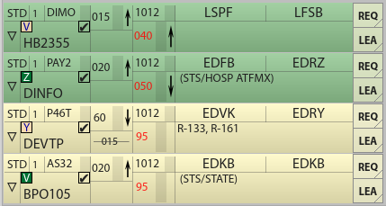
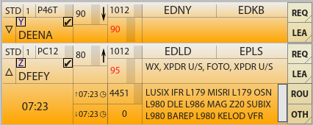
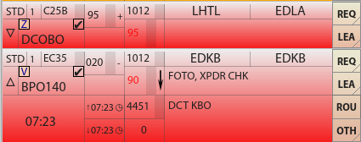
EKOFIS
Paperless stripsystem for FIS
Strips can be colour-coded if required
Automatic colour-coding is used when flight plan associated messages are received
CHG
DEP
ARR
CNL

Slide 22
EKOFIS
Paperless stripsystem for FIS
Requests may be automatically entered by using comboboxes

Slide 23
EKOFIS
Paperless stripsystem for FIS
Strips can be sent to FIS sectors or to the archive by using comboboxes
Content of comboboxes can be edited at any time from the SV-Position

