Slide 1
You fly we care

Slide 2
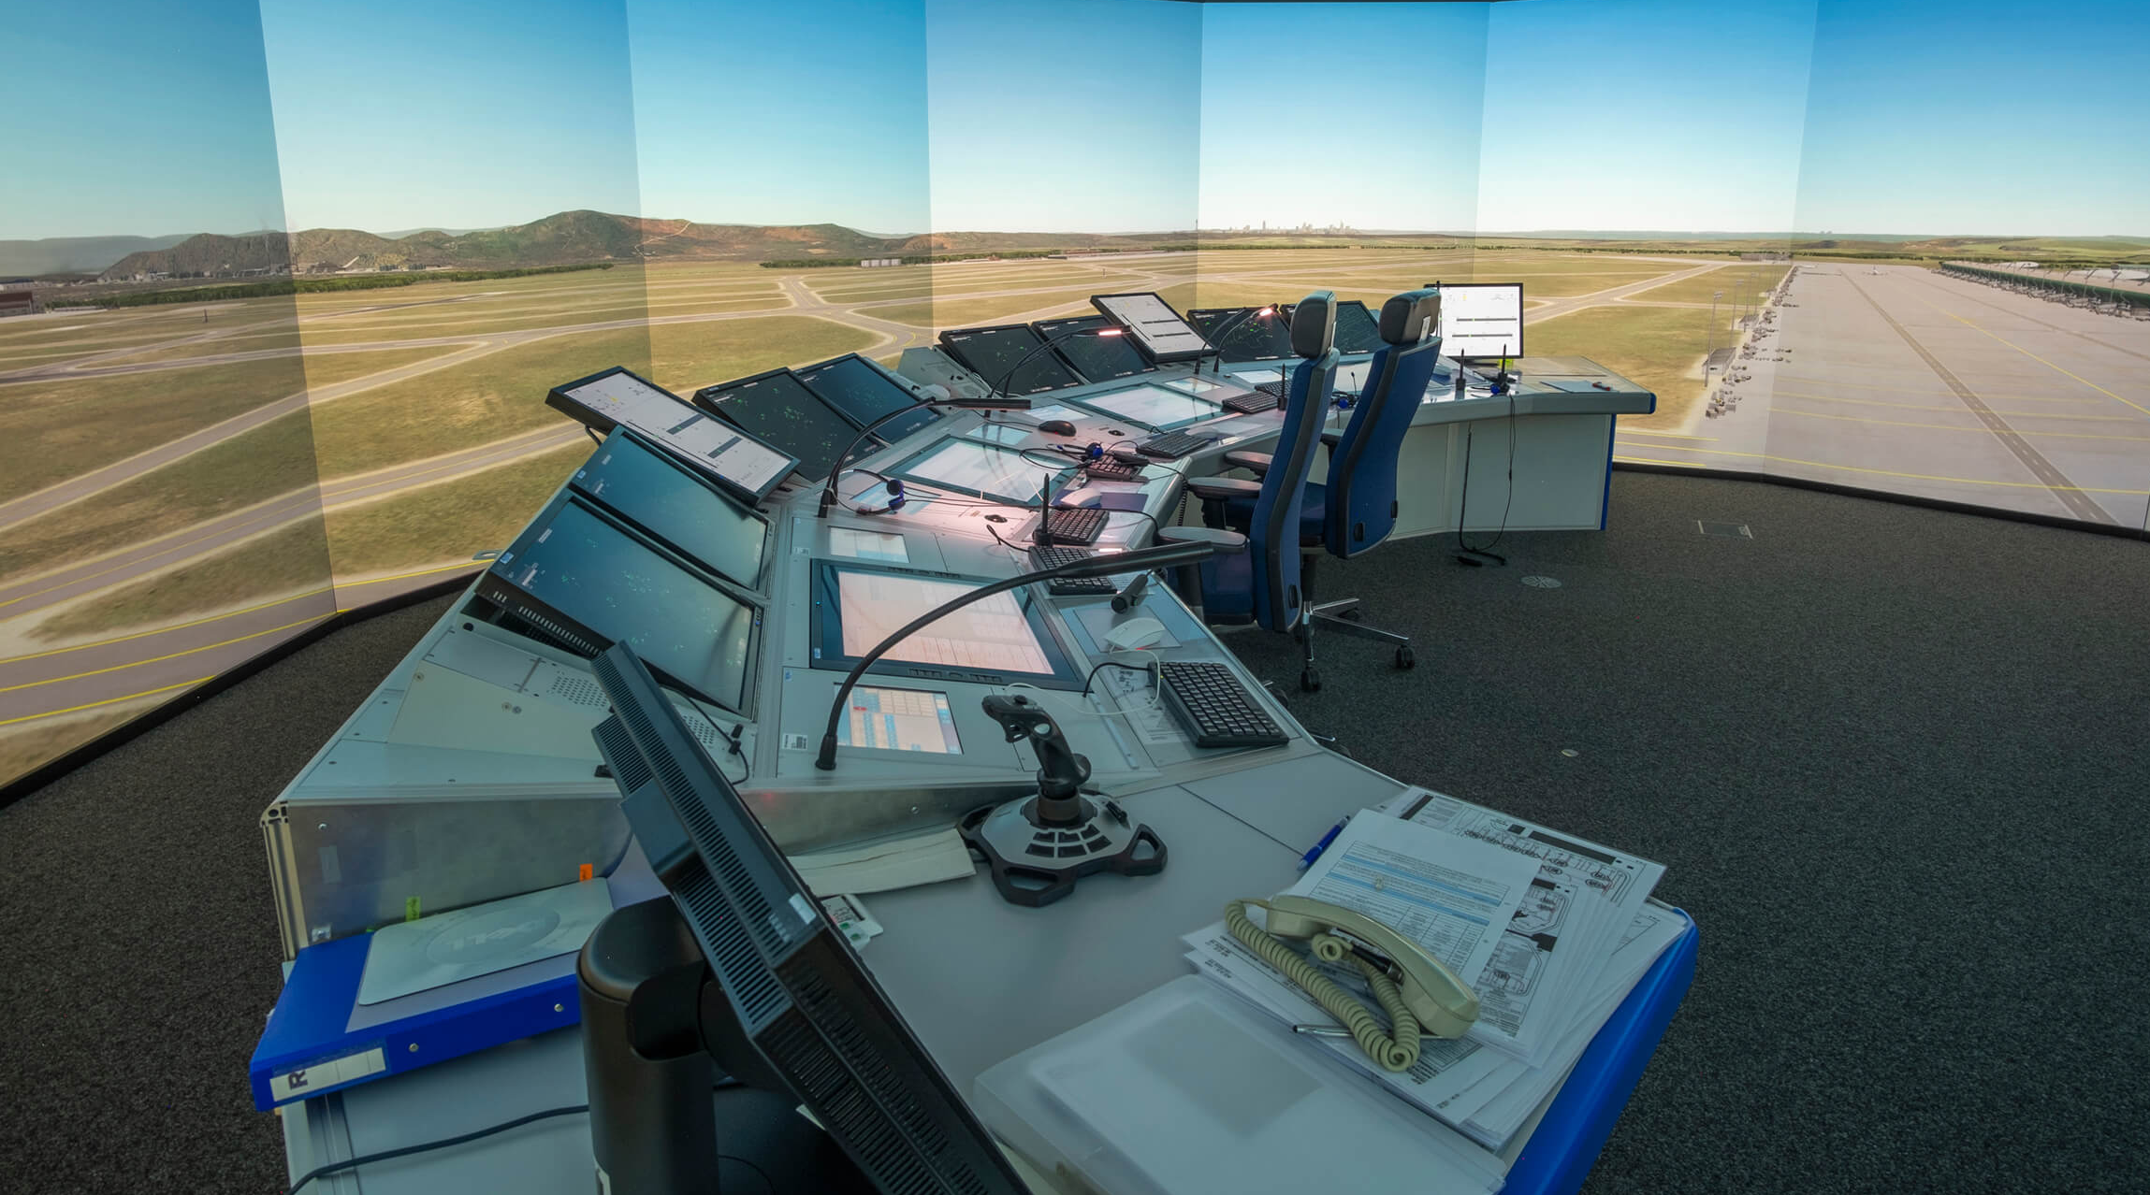
FLIGHT INFORMATION SERVICES

Slide 3
STATISTICS

Slide 4
WORLD POPULATION
7,8 Billion People on Earth.
1,5 Billion People in China.
1/5 of the World Population is Chinese.
Every 5th baby born is Chinese.
So…….

Slide 5
SQUAWK IDENT

Slide 6
DFS Group

Slide 8
Edinburgh
Emden AFIS-Dienste
Hamburg
Tower & Services DAS & ANSL
London Gatwick
Bremen
Münster / Osnabrück
Hannover
Berlin
Headquarters DFS & DAS
Weeze
Paderborn- Lippstadt
Magdeburg Cochstedt
DAS Aviation Academy (A²)
Düsseldorf
Dortmund
Mönchen- gladbach
Leipzig / Halle
Tower Service DFS
Köln / Bonn
Erfurt
Dresden
Control Centre (ACC)
Frankfurt
Langen
Nürnberg
Saarbrücken
ACC Karlsruhe
Karlsruhe / Baden-Baden
Stuttgart
München
Lahr
Memmingen
Friedrichshafen

Slide 9
YOU FLY – WE CARE

Slide 10
YOU FLY – WE CARE
ATS PROFICIENCY
QUALITY AND SAFETY
ATS BASIC AND RATING
CONVERSION

Slide 11
DESIGN TO SUCCEED

Slide 12
COURSE DESIGN PHILOSOPHY
OBJECTIVE
What is it that we must deliver?
What must the student be capable of and at what standard?
How will we transfer knowledge?
Which method/s will be the most efficient?
How will we know we have succeeded?
How do we measure the success and compared to what?
ACTIVITIES
QUALITY

Slide 14
GERMAN CONTEXT
Change in Regulation/Approach
Flugleiter to AFISO
FSPersAV
Recognised Curriculum
ICAO LVL 4 English LP
ICAO LVL 6 German LP
Medical Fitness
Flugleiter
PPL + AZF + Experience (min.) 1 Year Flugleiter
AFISO
Completion of Basic ATM Course and AFIS Rating Course, OR
Conversion Course AFIS

Slide 15
AFIS RATING
Recognition of prior learning (in lieu of Basic ATM course)
Pilot license qualification/experience VS AFIS Syllabus Requirements
Private Pilot License VS Commercial Pilot License
FIS ATS License and ATC (ADI) License VS AFIS License

Slide 16
AFIS RATING
Pilot license qualification/experience VS AFIS Syllabus Requirements
Radio Telephony – OTHER SIDE OF THE MIC
ATS Coordination – IFR CLEARANCES, HOLD FOR RELEASE
Data Presentation – FLIGHT PROGRESS STRIPS
Air Law – INTERFERED WITH AIRCRAFT

Slide 17
AFIS RATING
FIS License VS ADI License
Airspace – CLASS G
Conflict Management – DECONFLICT / REACT
Unidentified Aircraft – UNANNOUNCED
Runway Management – CONTROLLED / UNCONTROLLED - VEHICLES

Slide 18
TRANSFER OF KNOWLEDGE

Slide 19
theory
Learning Management System
Student Controlled Pace
Defined Building Blocks
Self study/Practise (RT, Airspace, Traffic Patterns)
One-to-One sessions
Paperless
iPad/Tablet based
Used for LMS and Learner Communication

Slide 20
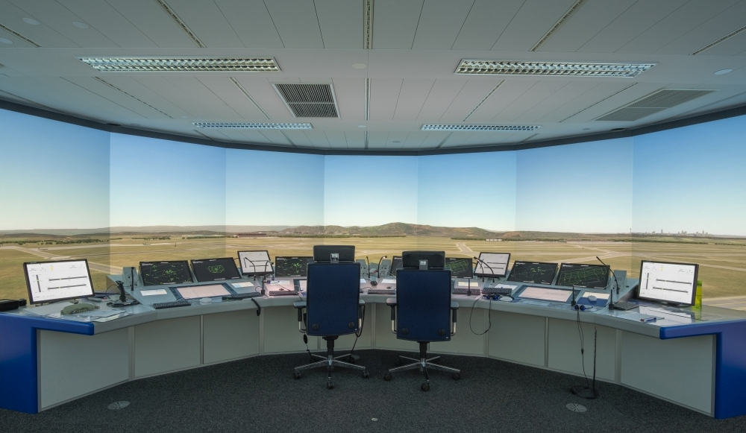
practical
3D Synthetic Training Device
270° & 360º
MET, RDR, SMGCS
Stop Bar Control
Flight Progress Board
Paper based
Electronic (Integrated systems approach)

Slide 21
Practical - remote
Must be;
270° Field Of View real world simulation,
Allows for Competency Based Instructional Techniques,
Avoid duplication (use current sim runs, avoid excessive internal training need)
Acceptable to the client and (applicable) Regulatory Standards.

Slide 22
Practical - remote
Hazard
Remote Simulation
Unsafe event
Loss of Verbal Communication
Unsafe event
Loss of Network Connection
Unsafe event
Failure of Hardware Systems
Unsafe event
Uncontrolled Student Environment
Unsafe event
New Human Machine Interface Environment

Slide 23
Practical - remote
Participant
Technical requirements and setup in advance,
User Manual and Introduction to the system,
Clear instructions and information on contingencies.
“Normal” flow of the learning process.

Slide 24
Practical - remote
Trainer
Familiarization with the system,
Comprehend contingencies and role assignment,
Identification of key differences in instructor tools (Remote VS On-site)

Slide 25
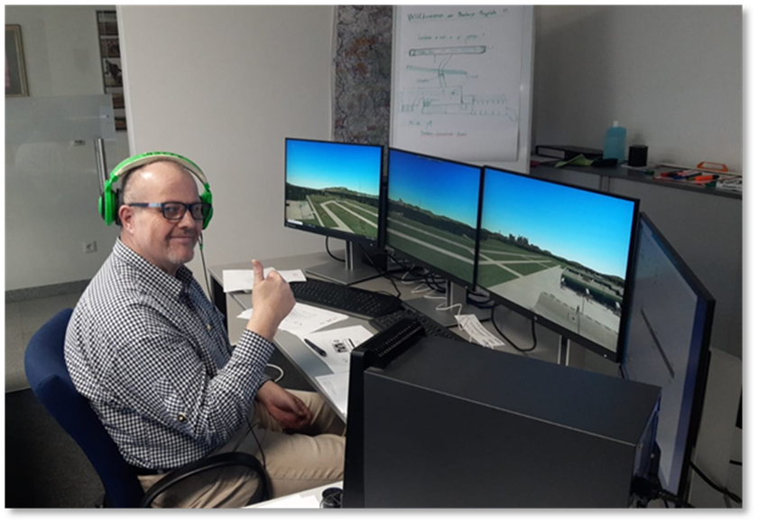
Practical - remote

Slide 26
The end user

Slide 27
You fly we care

