Slide 1
ICAO Manual of AFIS – Update IFISA Seminar September 22 Rob Daniel UK CAA Principal Airspace & ATM Policy

Slide 2
Scope
Background
Activities to date
Any questions

Slide 3
Background
September 1988
Circular 211 on Aerodrome Flight Information Service (AFIS) published
April 2016
Proposal to replace Circular 211
October 2016
ATM Ops Panel decision to replace Circular 211

Slide 4
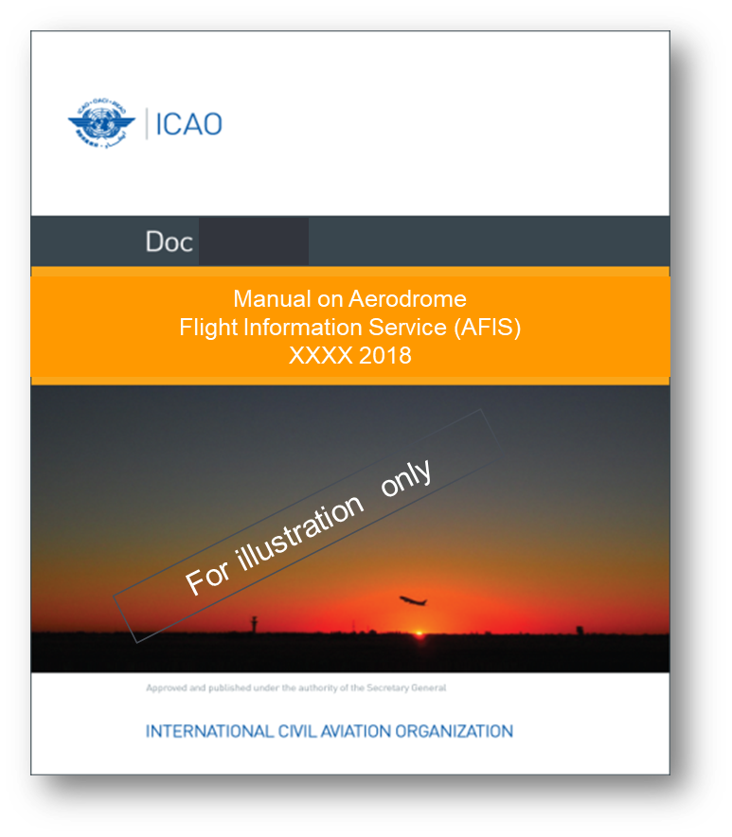
Activities to-date

Slide 5
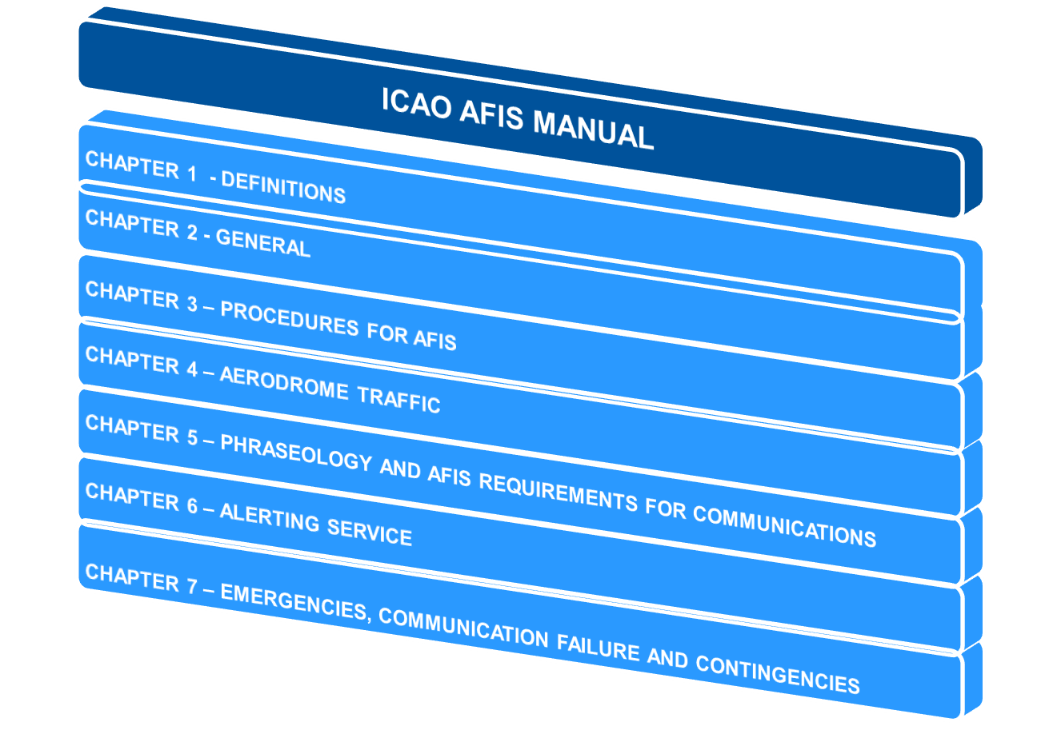
Activities to-date

Slide 6
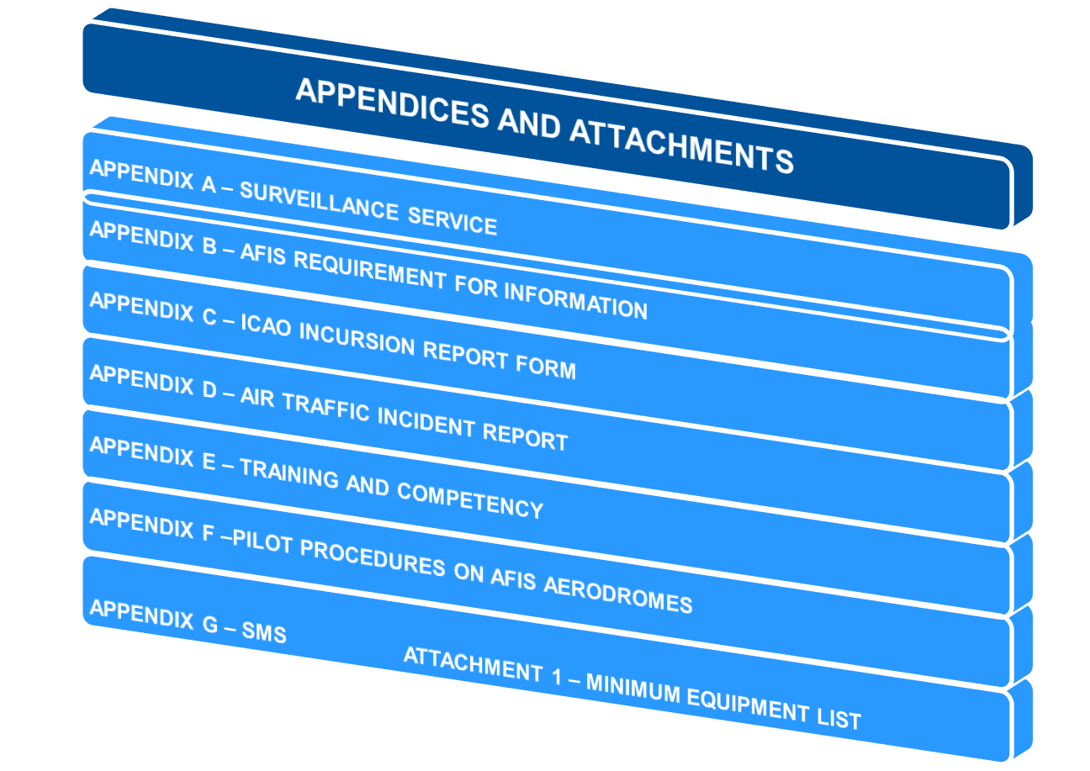
Activities to-date

Slide 7
Activities to-date

Slide 8
Determining Criteria
Quantitative
Annual number of movements
Aerodrome traffic density
Traffic mix: IFR vs VFR
Qualitative
Type of operation; e.g. GA, CAT,

Slide 9
Closing comments
Much more review work to do.
Delivery to Secretariat – 30 June 2023.

Slide 10
What do you need from a Manual of AFIS?

